Slide 1
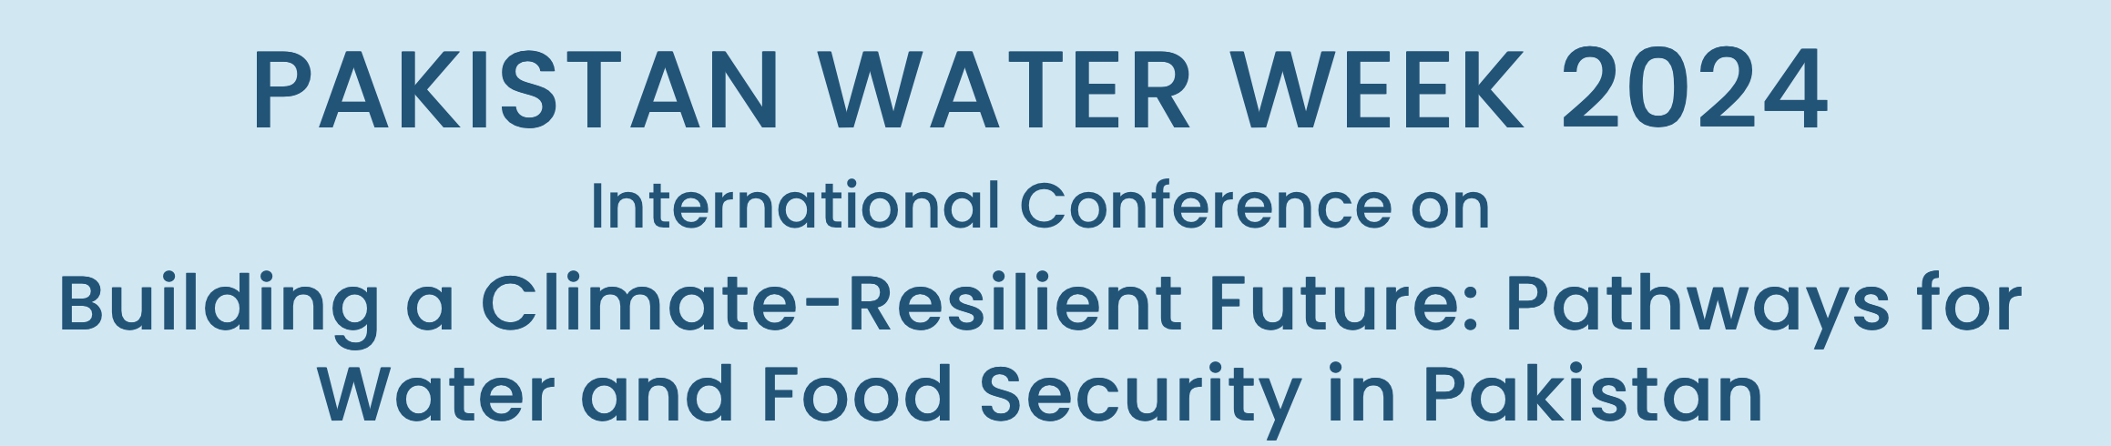
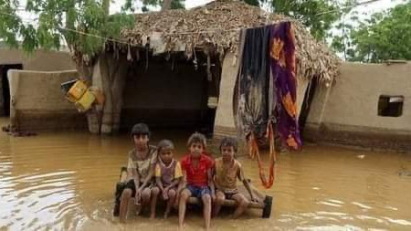

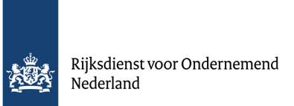
Towards local and system flood resilience:
turning threats into opportunities
Frank van Steenbergen
Ehsan Leghari
Ashfaque Soomro
Salam Buzdar
fvansteenbergen@metameta.nl

Slide 2

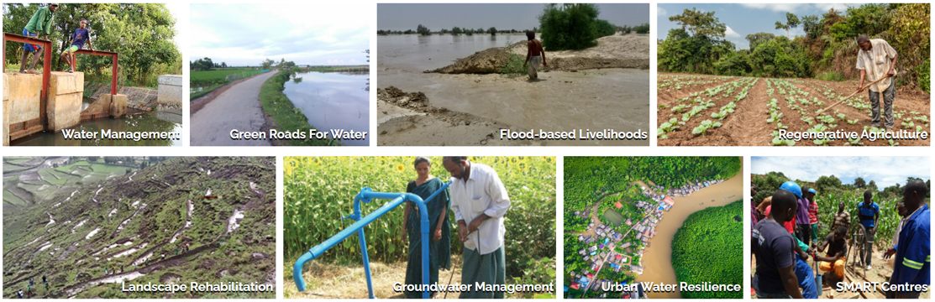
Making the difference,
Working on practical scaleable approaches and solutions
Working on local flood resilience in:
Ethiopia, India, the Netherlands, Pakistan, South Sudan, Sudan, Yemen

Slide 3
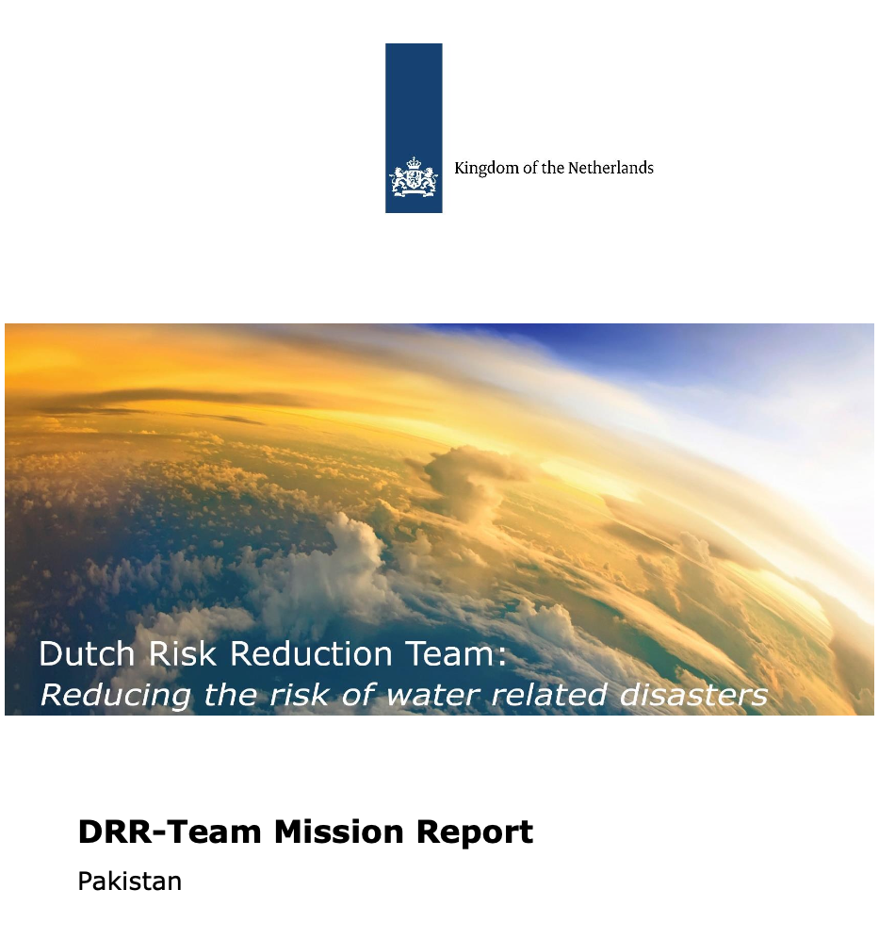

Learning
Preparation and discussion of shared White Paper on Flood Resilience, national discussion, international work
Local Dialogues and Community Consultations in Sindh, Baluchistan and Punjab provinces of Pakistan from July-September 2024 under RVO assisted DRRS program
Focusing on four crucial areas:
  Flood resilience and spatial planning
  Anticipatory action
  Post flood recovery
  Community response or lack of it
Realizing we need to rethink flood management and flood resilience

Slide 4
Communicating and sharing the learning
https://thewaterchannel.tv/thewaterblog/floods-are-about-rain-floods-are-also-about-drainage/
https://thewaterchannel.tv/thewaterblog/flood-resilience-and-spatial-planning-in-pakistan-where-are-we-two-years-after-the-devastating-flood/
https://thewaterchannel.tv/thewaterblog/flood-proofing-the-road-network-2-roads-for-controlled-drainage-in-pakistan/
https://thewaterchannel.tv/thewaterblog/blog-on-the-road-for-water-safe-flood-water-drainage-bridges-and-causeways/
https://thewaterchannel.tv/thewaterblog/flood-evacuations-tough-realities/
https://thewaterchannel.tv/thewaterblog/from-dam-to-damage-in-balochistan/
https://thewaterchannel.tv/thewaterblog/understanding-why-sindh-faces-frequent-flooding-insights-from-a-provincial-consultative-dialogue/
https://thewaterchannel.tv/thewaterblog/understanding-why-sindh-faces-frequent-flooding-insights-from-a-provincial-consultative-dialogue/
https://thewaterchannel.tv/thewaterblog/excessive-moisture-utilization-in-kachi-plain/

Slide 5
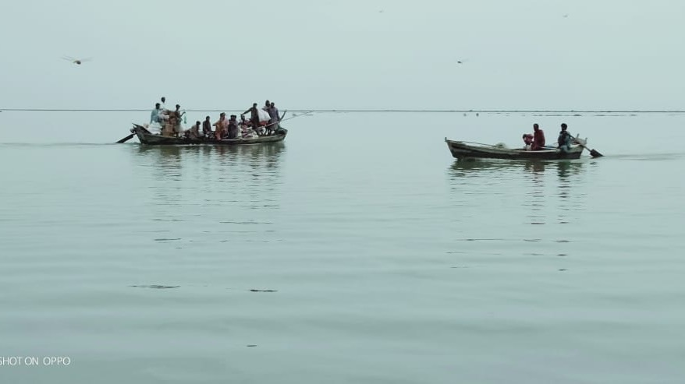
Towards local and system flood resilience:
turning threats into opportunities
Changing our approach: four statements:
We need to combine flood resilience with general development/ land use management
We can and should do better with anticipatory action
We need to give a strong place to community flood resilience
There are also beneficial impacts of floods that we should harvest

Slide 6
We need to combine flood resilience with general development and land use management
The problem is not just climate change or undue rain, the problem is also the blocked drainage, encroached flood plains, poor barrage operation, ill-designed dams – flood resilience needs to be part of spatial planning and land management

Slide 7
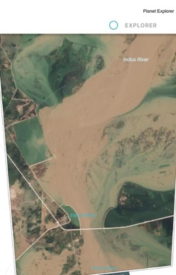
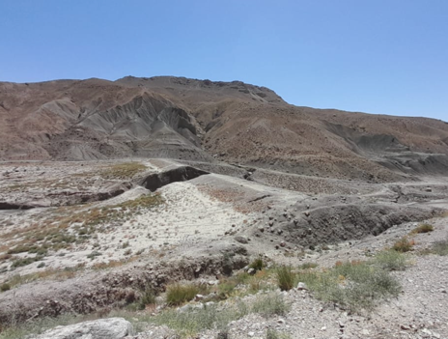
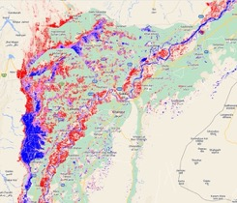
We need to combine flood resilience with land use management
what were some important causes of the 2022 flood?
Ill-designed dams
Blocked natural drainage
Catchment degradation
Bridges as chokepoints
Encroached flood plain
Barrage operations
Waterlogging: no capacity
to absorb flood run-off

Slide 8
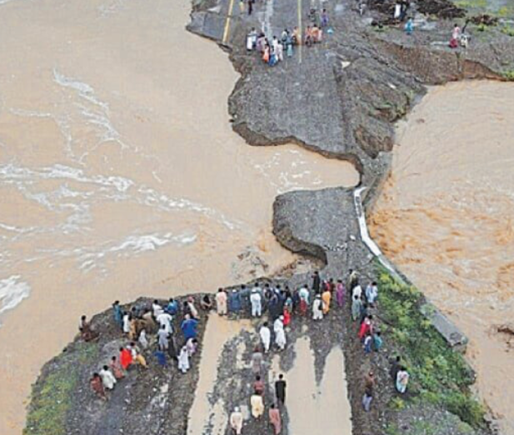
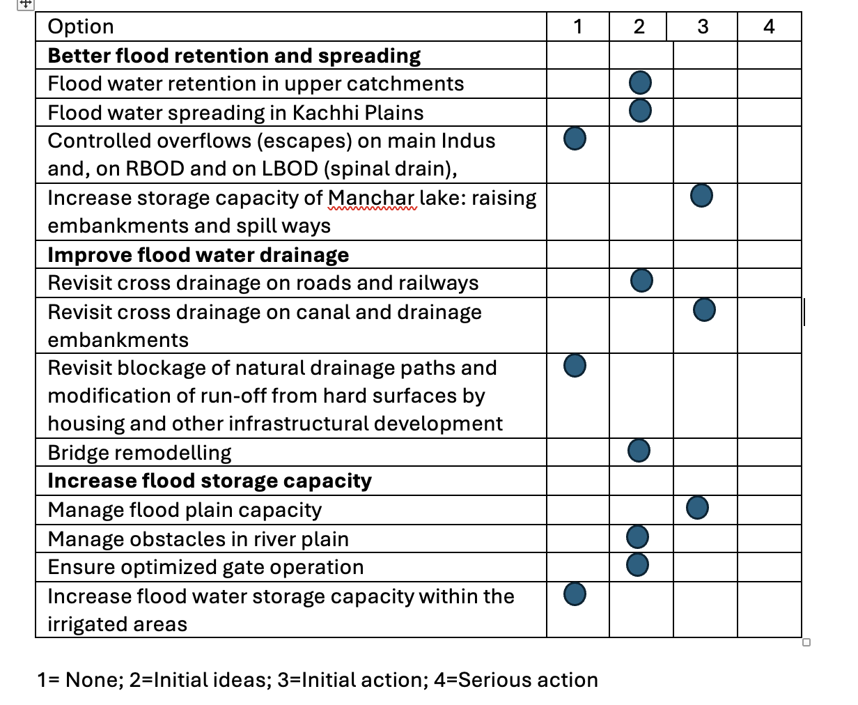
We need to combine flood resilience with land use management:
are we making progress?
Some progress at
level of plans and initial action, shift still to come

Slide 9
2. We can and should do better with anticipatory action - why
Evacuation sometimes cause more hardship than floods itself – transport crisis especially for most vulnerable
Communities were unreached
Scope for improved procedures (for instance NOCs)
Changing the focus beyond relief

Slide 10
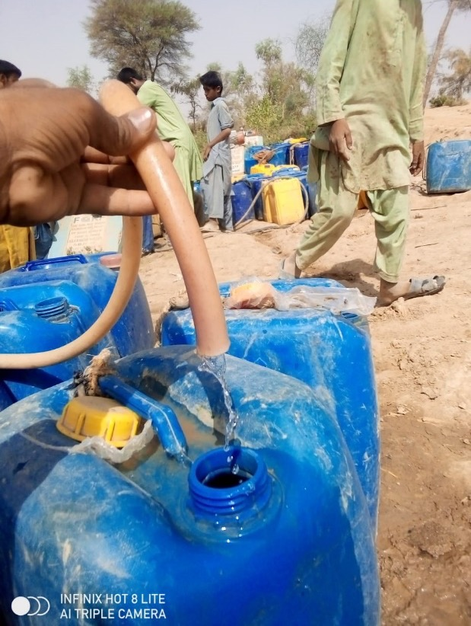
2. We can and should do better with anticipatory action – for instance
Restore patrolling protocols
Connect communities with EWS
Local flood preparedness planning and action
Planning for access to emergency productive inputs (seeds, livestock, business credit)
Combine relief with building back better
Example shallow wells around water ponds in Bhag,
installed after the 2022 floods:
More secure water supply
Better quality
Continue to be in use

Slide 11
3. We need to give a strong place to community flood resilience
Communities are first responders and defence; much ‘relief’ by self management
  Staying in relatives or friends’ houses
  Selling livestock and household assets (like jewelry etc), taking debts
  Quickly rebuilding one’s houses, business, farm activities
  Yet poorest people do not bounce back - loss of livestock and assets

Slide 12
3. We need to give a strong place to community flood resilience
Much can be done, several good practices happening (but sporadically often(
  Flood resilient houses and livestock sheds
  Protected health, and educational facilities
  Improved storage/ availability of seeds, grains and fodder
  Local protection bunds and elevated areas (roads)
  Natural flood blockers- tree planting, block tree planting
  Access to credit and grants
  EWS connected to mobile phones
  Local DRR and land management plans
  n terms of preparedness and response
  – to reduce intensity of floods and wind damage

Slide 13
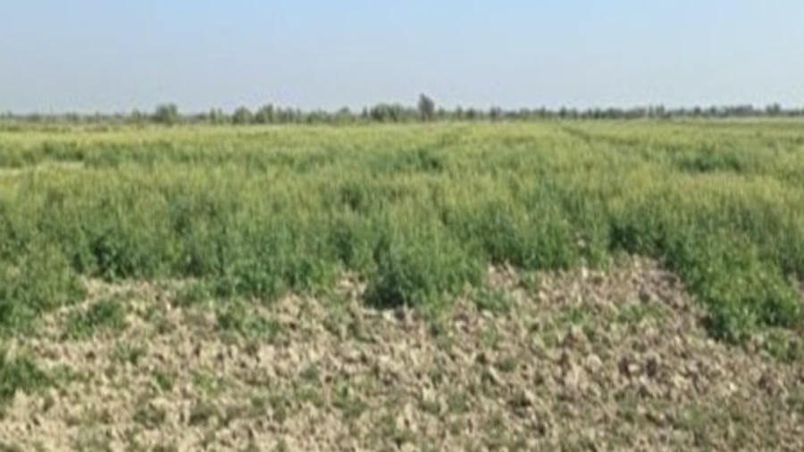
4. There are also beneficial impacts of floods that we could harvest
Productivity boon in some areas of the 2022 floods – arugula and chickpeas
Plan for it, be prepared – water spreading and land access

Slide 14
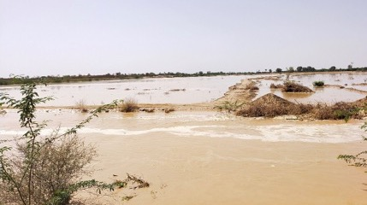
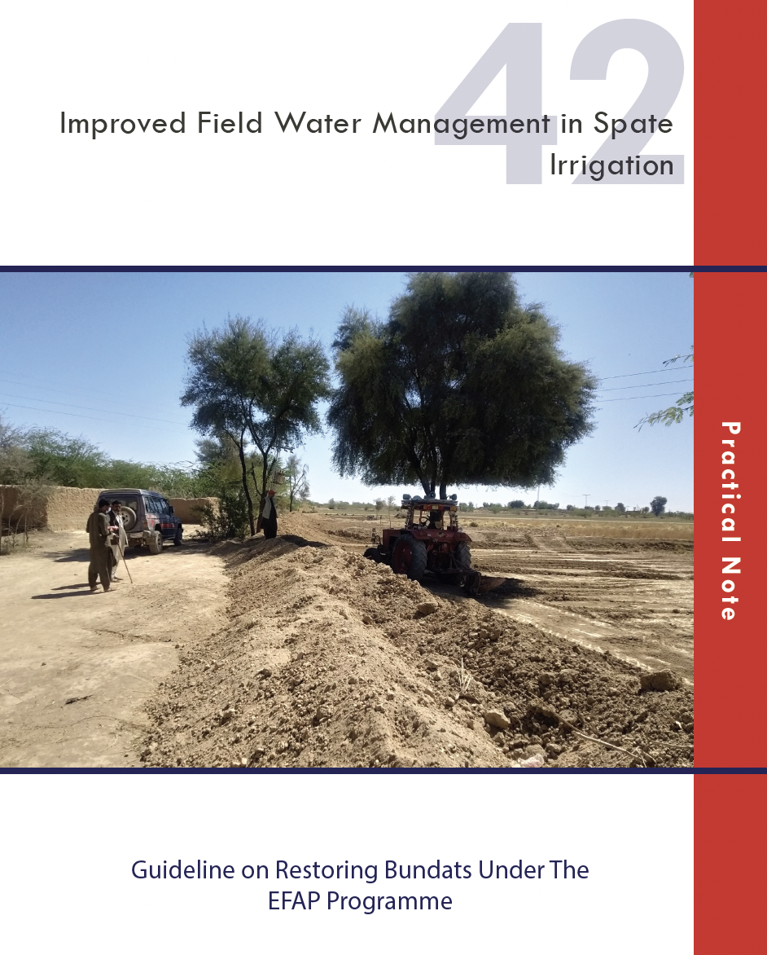
4. There are also beneficial impacts of floods that we could harvest
Paying attention to the 1 Million ha under rod kohi/spate in Pakistan with appropriate techniques
www.floodbased.org

Slide 15
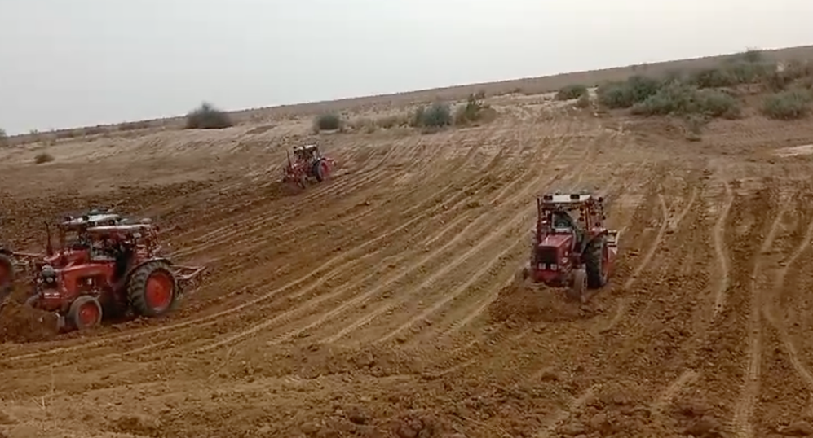
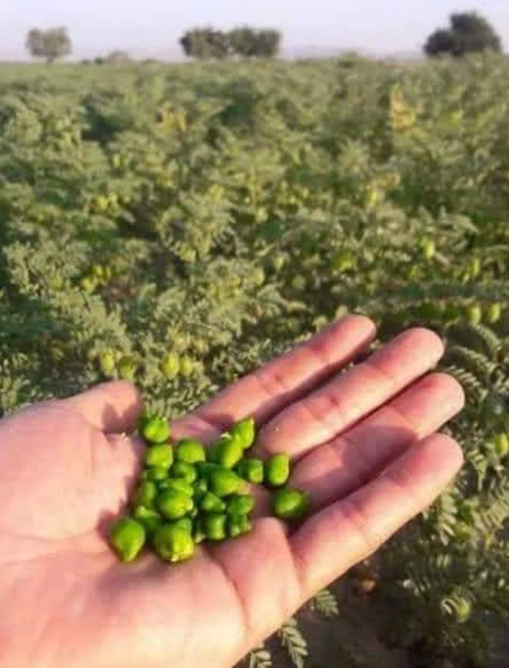

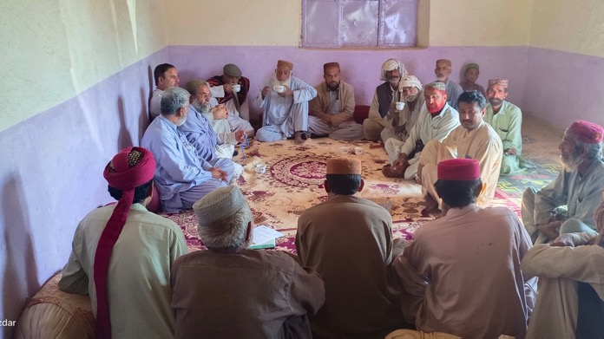
4. There are also beneficial impacts of floods that we could harvest: lessons from NEWARBI
Improved flood water diversion: enormous impact at USD 15/ha!
Introduce new crops/ varieties:
rapid take-up
Drinking water improvement
easy and important solutions
Local goverance – better water allocation

Slide 16
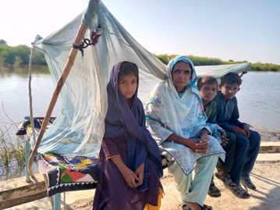
Move beyond:
External relief
Special ‘disaster’ control
Limited technical measures (EWS, embankments)
Importance of:
Broad range of measures
Part of overall development
Anticipatory action
Networking and learning of all parties
Communities in centre

