Slide 1
Sustainability and unintended impact assessment of water spreading weirs (WSW) and establishment of long-term monitoring site
Module 3
08 September 2020
Nigussie Abadi
Mekelle University

Slide 2
1 Objectives of Module 3
General
Analyze the institutional and governance dynamics of Water spreading weirs as well as its impact on the livelihoods of pastoralists and semi-pastoralist community of Afar regional state of Ethiopia.
Specific
• To analyze the institutional and governance dynamics of water spreading weirs in the region
• To analyze to impacts of the water spreading weirs on the livelihoods of the community
• To analyze unintended benefits and cost of the water spreading weirs.
Notes:
On

Slide 3
Research Questions
Are land and water users ready to maintain the structures? Are local organizations ready and equipped to support them? What is the maintenance to be expected?
How are land and water users dealing with the increased availability of water? How are they deciding on the distribution and allocation of water?
Are they able to make the best use of water, are there improvements possible in their organization but also in the way water is managed or in the crops and input choices?
Are there unintended impacts – such as increased infestation of invasive species or conflicts with other land and water users?

Slide 4
METHODOLOGY
A reconnaissance visit to decide on the number of communities for the study
Select water user associations from upstream, and downstream of the water spreading weirs
Collection of primary and secondary data through interview with
Individuals
Local government agencies
Women groups and
Other stakeholders involved with the implementation of water spreading weirs
Notes:
On

Slide 5
Method of Data collection
Multi-stakeholder meetings to collect data on existing institutions for water spreading weirs management and the resulting water governance systems.
PRA (Participatory Rural Appraisal) tools
Use of well-being method for social survey
Notes:
On

Slide 6
Suggestion
Conducting a brief survey questionnaire at least for those beneficiaries who are settling around the water spreading weirs just to complement the qualitative information through PRA and checklists

Slide 7
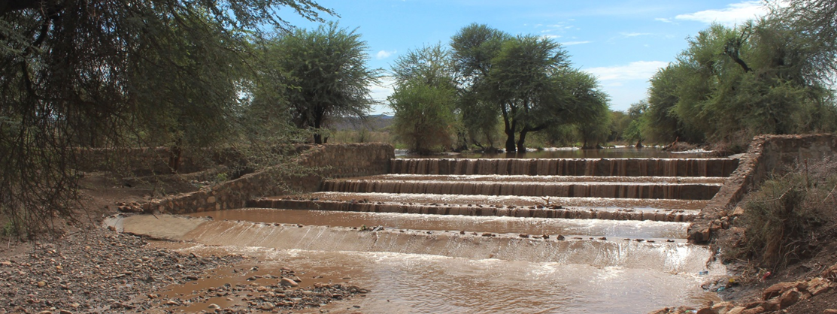
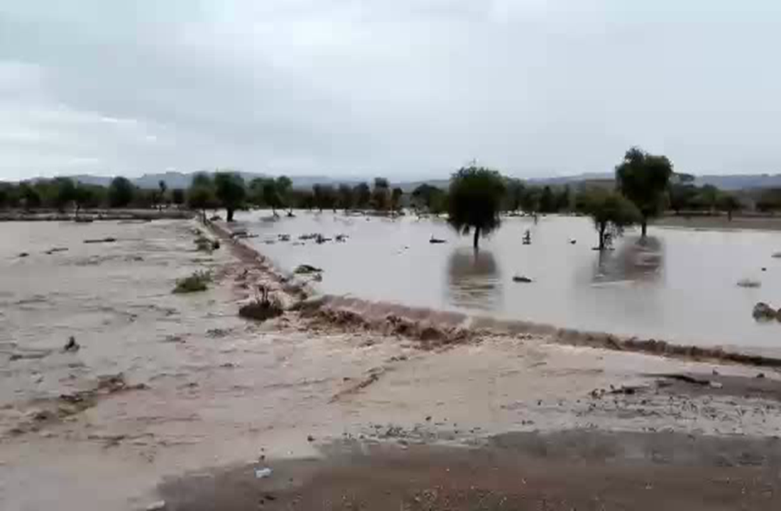
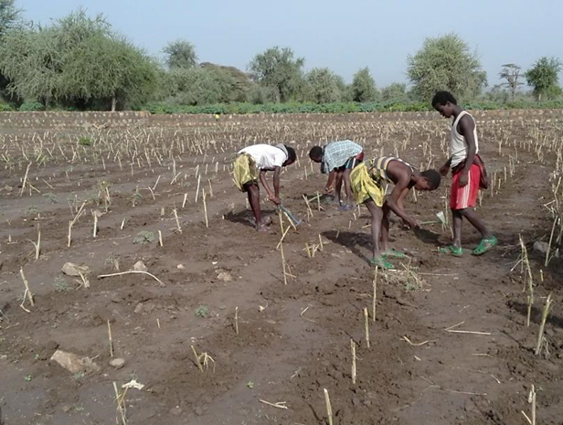
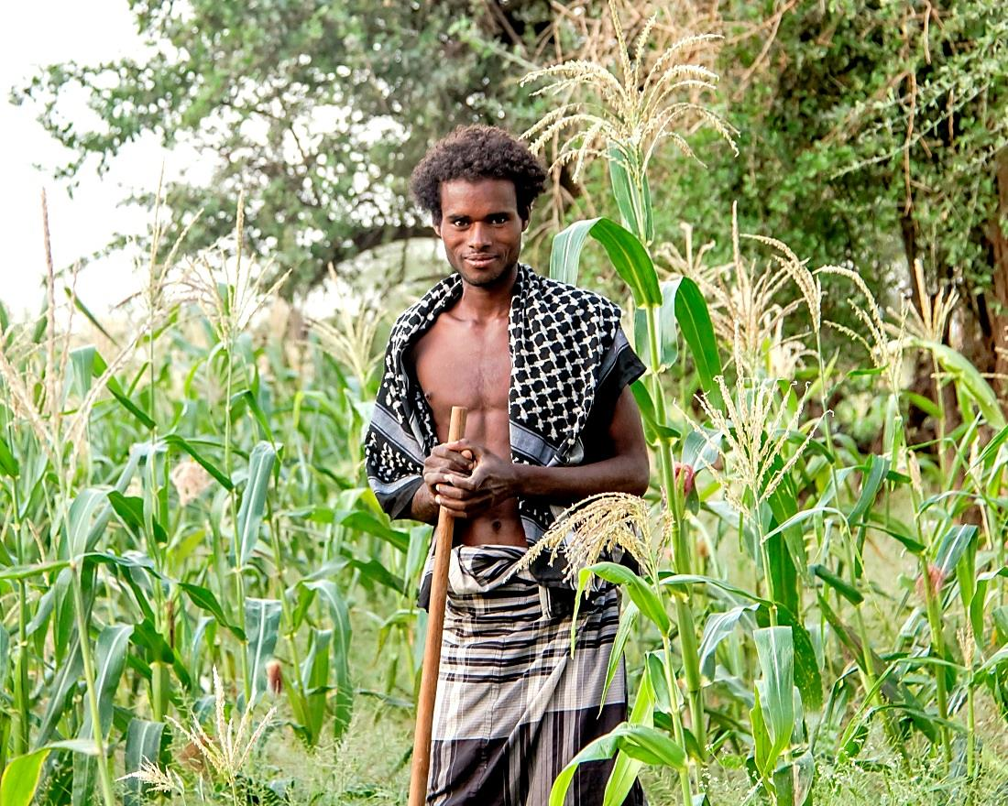
THANK YOU!!!!
Photo credit: GIZ SDR program
FSW in Afar, Ethiopia (GIZ SDR ASAL)

