Slide 1
Sustainability and unintended impact assessment of water spreading weirs (WSW) and establishment of long-term monitoring site
Overview of the WSW assessment
08 September 2020
Eyasu Yazew
Mekelle University

Slide 2
1 Objectives of the WSW assessment
General
Improve the implementation and performance of the water spreading weirs by assessing sustainability parameters for long-term operation as well as familiarize key partners with the approach and the business model.
Specific
Module 1: Hydrological and sediment study
Measure and understand the hydrology of the floods including discharge, peak flood and flood hydrograph;
Assess the potential and risks associated to sediment transportation and deposition.
Module 2: Establishment of long term groundwater monitoring site
Establish a monitoring site for ground water recharge analysis.
Notes:
On

Slide 3
Module 3: Social and institutional dynamics study
Assess the sustainability of the WSW cascades in terms of the social and institutional dynamics and performance such as participation of users, willingness and/or capacity to contribute to operation and maintenance of the schemes, benefit sharing, and unintended impact and effects;
Assess the capacity of government experts in implementation and operation of WSW cascades.
All modules:
Devise practical strategies that could improve the efficiency and sustainability of the WSW cascades;
Alert unintended impacts from the WSW cascade construction; and
Build the capacities of research institutions in the above-mentioned capacities by involving local resources.
Notes:
On

Slide 4
2 Deliverables
Inception report
Synthesis report of each module
Establishment of long term groundwater monitoring site
Evaluation of government and expert willingness/capacity gaps in implementation and operation of WSW
Preparation of integrated business / operational management model
Notes:
On

Slide 5
3 Road maps
3.1 Study site selection
The initial idea was to assess one WSW per cascade per Wereda
However, it was realized that critical lessons will be learnt and major development and management inputs generated only if the entire WSWs within a cascade are investigated, evaluated and monitored as a unit (instead of one WSW per cascade)
Accordingly:
Detailed monitoring and investigation will be carried out on the entire WSW in two cascades; and
Lightly study the rest.
No. | Investigation category | Study site | Wereda
1 | Detailed investigation cascades | Tabiadora | Gulina
 |  | Wokri Ede | Yalo
2 | Light investigation cascades | Duba | Ewa
 |  | Shakayboru | Chifra
 |  | Leikora | Awra
Notes:
On

Slide 6
3.2 Initial road map
Intensive field work and investigation by MU team in collaboration with SU and Wereda partners
Installation of state-of-the-art hydrological and sediment monitoring equipment (Mini Divers, turbidity meters, groundwater monitoring divers)
Social and institutional dynamics interviews/FGD
Evaluation of the government’s willingness/capacity and the technical capacity gaps of experts in implementation and operation of WSW
Notes:
On

Slide 7
3.3 Revised road map
Revised road map (Plan B) is now prepared due to the following two reasons.
3.3.1 Recommended additional activities after reconnaissance mission
Recommended additional activities and inputs identified after the reconnaissance mission
No. | Activity | New | Additional | Module
1 | Assessment of volume of captured flood, soil moisture. ET and biomass using WAPOR and RS | X |  | 1
2 | Delineation of area rehabilitated by the WSW cascades | X |  | 1
3 | Soil moisture monitoring using soil moisture probes | X |  | 1
4 | Cross sectional surveying of the river at the selected hydrological and sediment monitoring locations |  | X | 1
5 | Detailed hydrogeological and geophysical investigation using resistivity meter | X |  | 2
6 | Increased drilling cost due to increased depth of groundwater table |  | X | 2
7 | Groundwater monitoring well drilling supervision |  | X | 2
Notes:
On

Slide 8
3.3.2 Recommended changes due to COVID 19 crisis
Major challenges due to COVID:
Delay in the import of automatic monitoring equipments
Travel restriction of MU team
Installation of automatic data monitoring equipments as well as fieldwork by the MU team practically impossible for the last six months
Proposed adaptive strategy approach:
Adaptive and responsive technical proposal and data collection checklist prepared for each module (Will be presented later)
Increase the role of local partners (SU and Wereda experts) in field data collection and ground truthing
Water balance modelling using WetSpass and MODFLOW to understand the hydrology (runoff, AET and groundwater recharge)
Role of the MU team members will change – with less time in field data collection, yet more time in supervision, quality control, sourcing of modelling data and desk work
Notes:
On

Slide 9
4 Way forward
4.1 Additional human resource/responsibility
No. | Organization | Required persons | Responsibility
1 | MetaMeta Addis Ababa | WAPOR and RS specialist (Moti Gemechu) | Assessment of volume of captured flood, soil moisture. ET and biomass using WAPOR and RS – dekadal analysis over 10 year period Delineation of area rehabilitated by the WSW cascades Sourcing of data for modelling
2 | Semera University | Experts: Hydraulic Engineer, Hailemariame Mengistu Doko Hydrogeologist Hindeya Gebru Socio-economist Mohammed Adem Ali | Coordinate the installation of data monitoring equipments under the supervision of the MU focal persons Download/collect data from monitoring equipments under the supervision of the MU focal persons Carry out scientific data collection under the supervision of MU focal persons Collect relevant secondary data from regional stakeholders in consultation with MU focal persons Supervise the collection of primary data by local “army of foot soldier” based on the prepared checklist Collect field data under module 3 Contribute to the final reporting
3 | Study Weredas | Focal persons: 1 focal person and 1 expert per Wereda (For 5 Weredas) | Coordinate the installation of data monitoring equipments with Semera University focal persons Coordinate the guarding of installed monitoring equipments Collect primary data based on the prepared checklist under the supervision of MU and SU focal persons
Notes:
On

Slide 10
4.2 Accomplished tasks and revised plan for remaining activities
4.2.1 Accomplished tasks
Fact finding reconnaissance mission
First kick-off workshop (February 2020)
Inception report
Preparation of revised proposal and data collection checklist for each module considering the restrictions posed by COVID
Purchase of hydrological monitoring equipment
Plan B road map, plan and budget
4.2.2 Revised plan (Plan B)
The attached revised plan is prepared in response to the emerged additional activities and the restrictions posed by Corona pandemic
Notes:
On

Slide 11
4.3 Success factors
Close coordination and team work (GIZ-MetaMeta-MU-SU-Wereda)
Coordination: Ethiopia team leader/SU coordinator
Team work: MU/Moti-SU-Wereda focal persons
Close communication and update
Among MU/Moti-SU-Wereda focal persons (Continuous)
Among MU/Moti-SU-Wereda teams (Every two weeks)
Among MetaMeta-MU-SU teams (Every three weeks)
Among GIZ-MetaMeta-MU-SU team(Every one month)
Create data sharing platform
Adjust the adaptive strategy and plan according to the developments of the COVID pandemic
Notes:
On

Slide 12
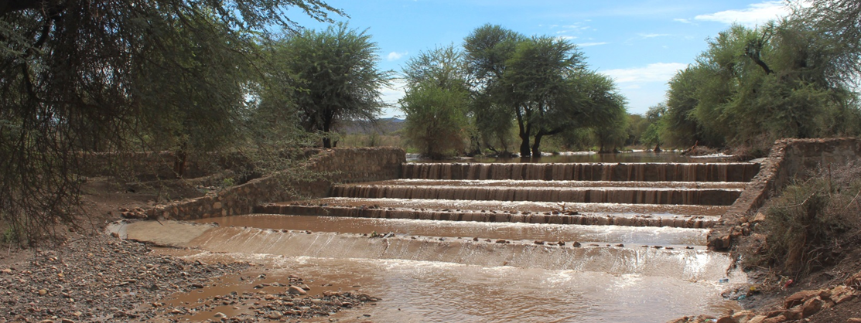
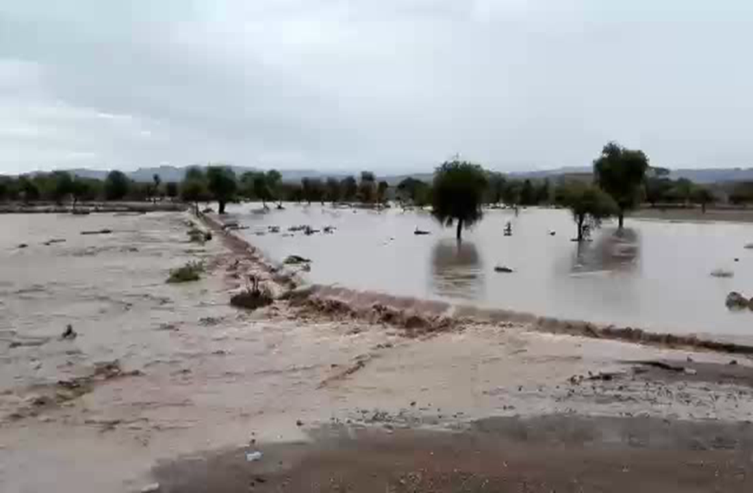
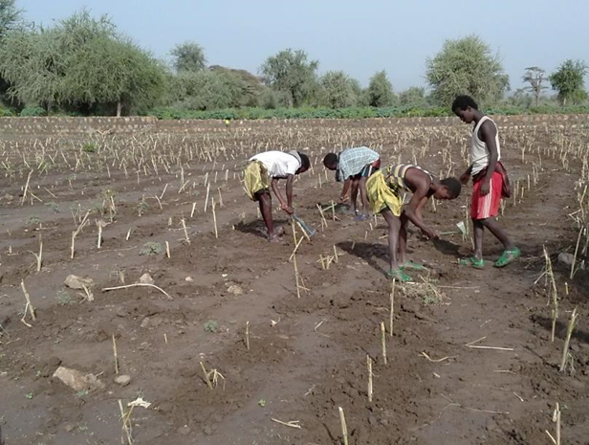
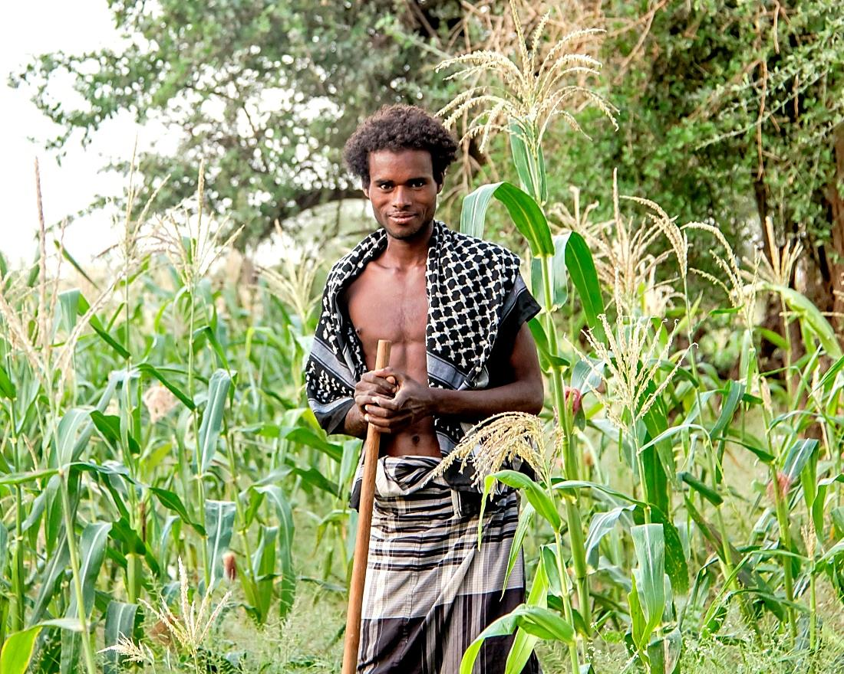
THANK YOU!!!!
Photo credit: GIZ SDR program
FSW in Afar, Ethiopia (GIZ SDR ASAL)

