Slide 1
Overview of the
Establishment of long-term groundwater level monitoring site (Module 2)
08 September 2020
Gebrerufael & Hindeya
Mekelle –Samera University

Slide 2
1 Objectives
To establish long term groundwater level monitoring site
to evaluate WSW role on groundwater recharge.
to assess the performance of the WSW for long-term operation
2 Deliverables
Calibrated WetSpass model in collaboration with module 1 team
A standard report indicating the activities and results
Established long-term monitoring site for groundwater level
Notes:
On

Slide 3
3. Questions
How are the water spreading weirs affecting the groundwater recharge?
How is the deposited sediment in the vicinity of the WSW affect the groundwater recharge?
What is the magnitude of the groundwater level fluctuation during no flood and flood season?

Slide 4
4. Approach/Methodology
Proposed methodologies/activities
The first and best option
hydrogeological and geophysical study to select observation well sites
determine drilling method (Manual or Machine) and recruiting drilling crew
Set up and implement long term groundwater level monitoring site
Optimal Methodology under COVID 19 travel restrictions
Set up distributed water balance WetSpass model (AET, Runoff, Recharge)
data collection and input preparations
Setup and calibrate the model

Slide 5
How supervision and quality control will be maintained?
Data collection will be done via local partners based on
checklist prepared by the Mekelle and Samara University focal persons under close supervision
Data quality check will be done via regular communication and data sharing

Slide 6
Data requirement for the modeling
Soil map ( if exist , unless taking soil samples for texture analysis to verify FAO soil map )
Topography Slope( from DEM)
Land use (Summer and winter) image classification
Temperature (summer and winter) near by stations
Precipitation ( summer and winter) near by stations
Wind speed (summer and winter) nearby stations
PET (Summer and Winter) from CROPWAT
Groundwater depth ( summer and winter) from near by drilled borehole

Slide 7
Study site
Proposed study site for detail investigation is at Gulina
criteria for selection groundwater monitoring site
Shallow water table depth (18-20 meters from ground)
Favorable topography and availability of water bearing formation
Potential for recharging flood
Workability and practicality for drilling activity based on this Golina is selected for detail investigation
Notes:
On

Slide 8
Analysis
Preparation of input thematic layers ( time consuming)
Meteorological data
Land‑use/land cover
Soil texture
Groundwater depth( static water level during drilling)
Topography and slope
Impute quality matters for the modeling result

Slide 9
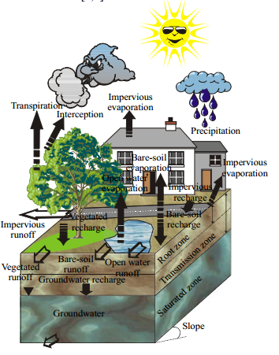
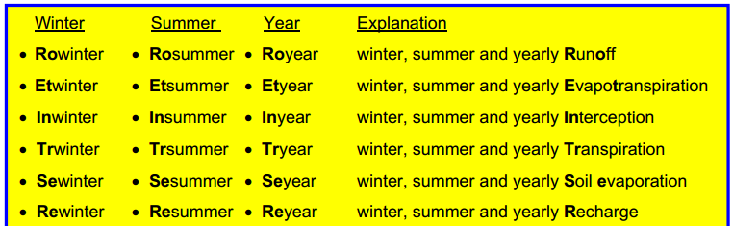
Overview of WetSpass
WetSpass is an acronym for Water and Energy Transfer between Soil, Plants and Atmosphere under quasi Steady State
Inputs for the WetSpass
Grid files | Tables(dbf)
Soil | -Soil parameter -Runoff coefficient -Landuse parameter(summer and winter)
Topography
Slope
Landuse(Summer and winter)
Temperature(summer and winter)
Precipitation( summer and winter)
PET(Summer and Winter)
Wind speed (summer and winter)
Groundwater depth( summer and winter)
WetSpass output

Slide 10
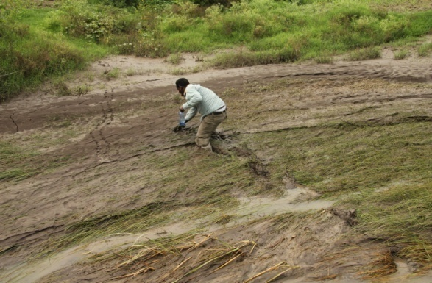
THANK YOU!!!!
FSW in Afar, Ethiopia (GIZ SDR ASAL)

