Slide 1
Sustainability and unintended impact assessment of water spreading weirs (WSW) and establishment of long-term monitoring site
Module 1
Supporting Remote Sensing Analysis
Moti.G
Metameta

Slide 2
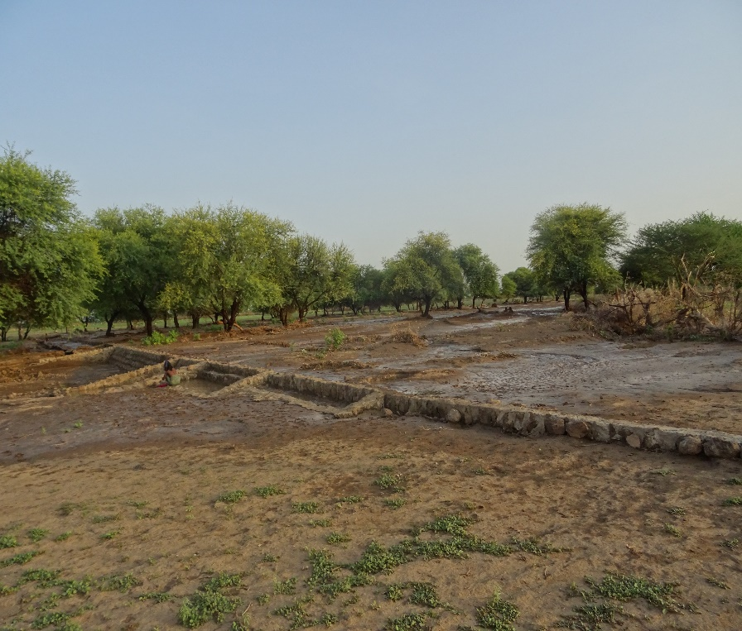
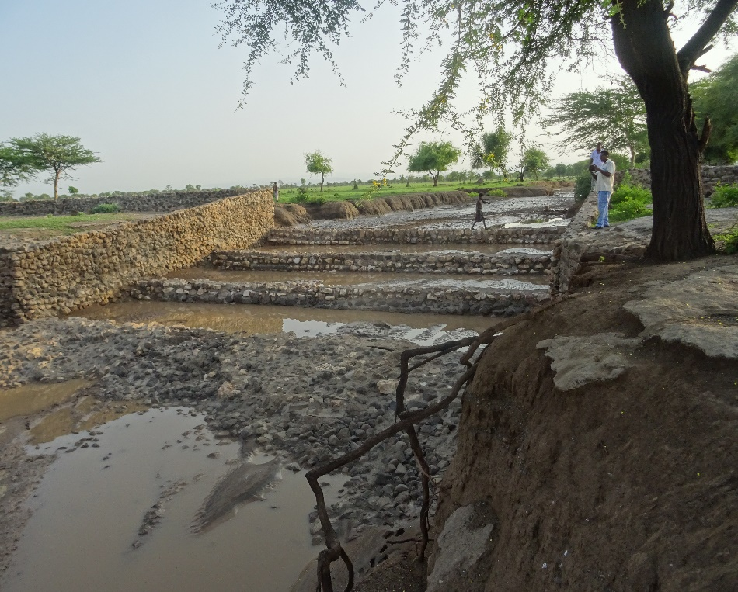
Introduction
WSW are low retention walls commonly built in the foot slopes of mountainous landscapes, designed to regulate seasonal floodwaters, reduce runoff and minimize erosion.
In addition it increase SM
and make available conditions
for crop production practice.
In addition to manual evaluation, remote sensing source provide important
Data’s to evaluate wsw.
When compared to manual evaluation RS data more time and labour saving.
Therefore, this specific investigation focus on open source RS data
to evaluate the performance of wsw constructed in Afar region of Ethiopia.

Slide 3
Objective
General objective
To evaluate the performance of wsw by using RS data
Specific objectives
To delineate the potential area affected by wsw.
To evaluate the temporal change on vegetation and SM due to wsw.
To calculate the volume of water captured due to the construction of wsw.
RS data used
NDVI
NDWI
AETI
NPP

Slide 4
Delineation of potential area
Acquire image from Landsat7 & 8.
Pan sharpening data from 30m to 15m
Calculate average NDVI (15m) before and after wsw.
Un supervise classification of NDVI (bef. & aft.)
Identify the threshold value
The raster was binarized.
The rehabilitated area was identified

Slide 5
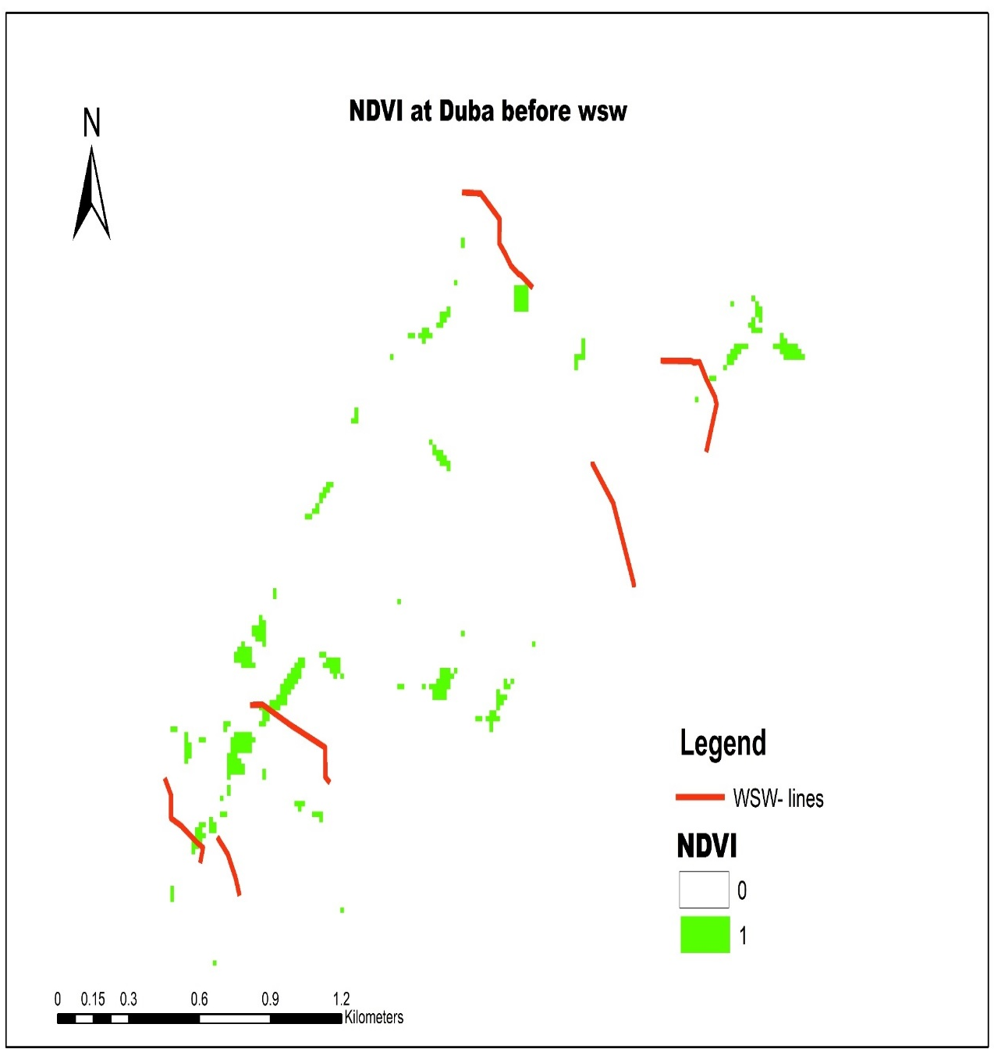
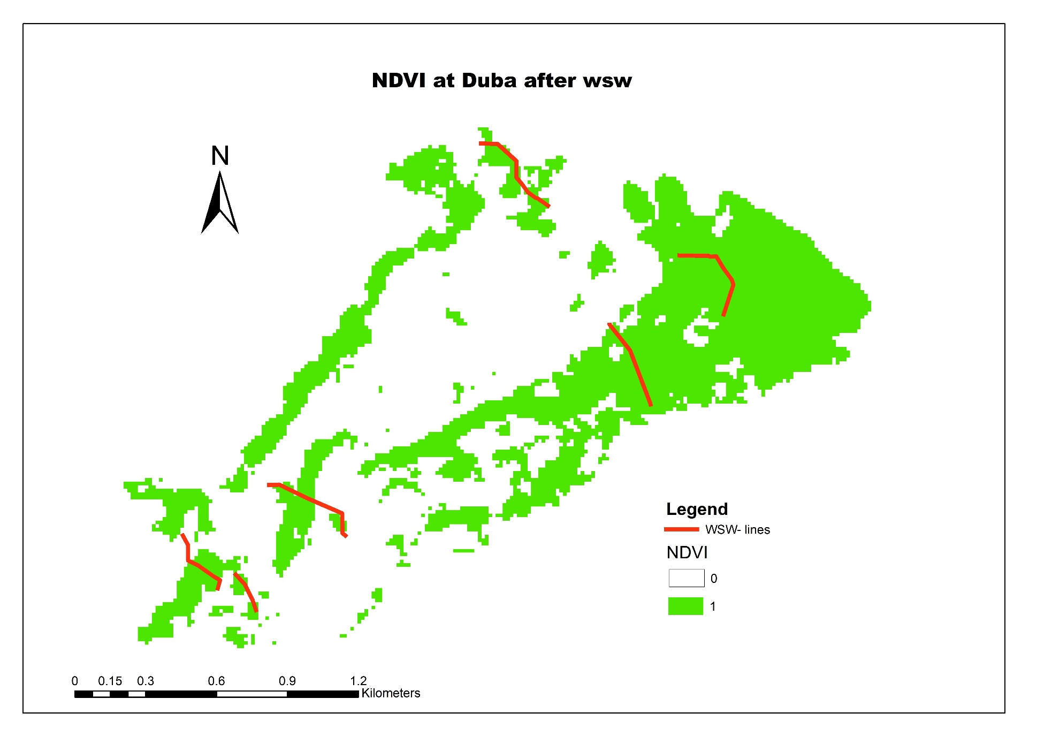
Results

Slide 6
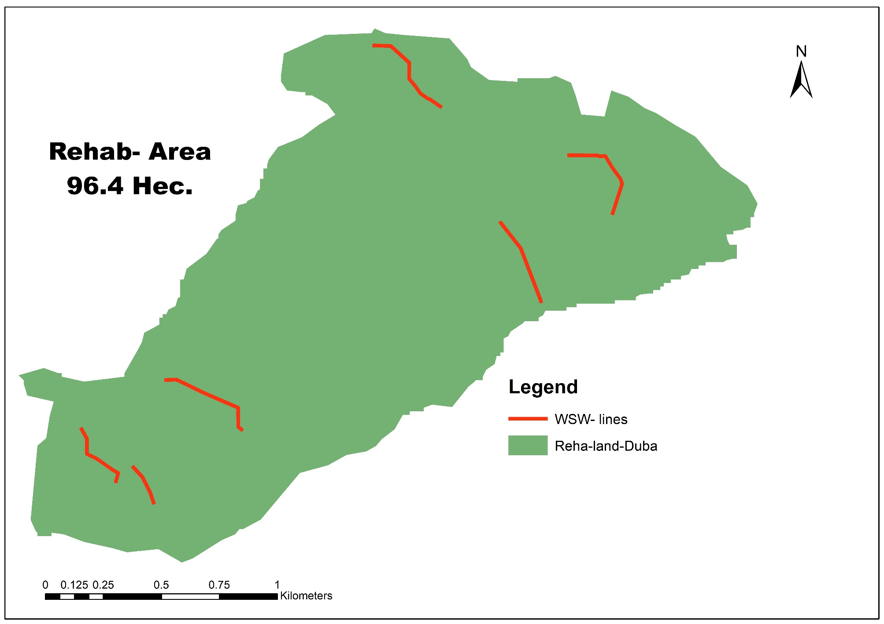

Slide 8
Rehabilitated area (ha.)
Duba | 96.4
Lerkura | 244
Wahale Ale | 79
Wekridie | 62

Slide 9
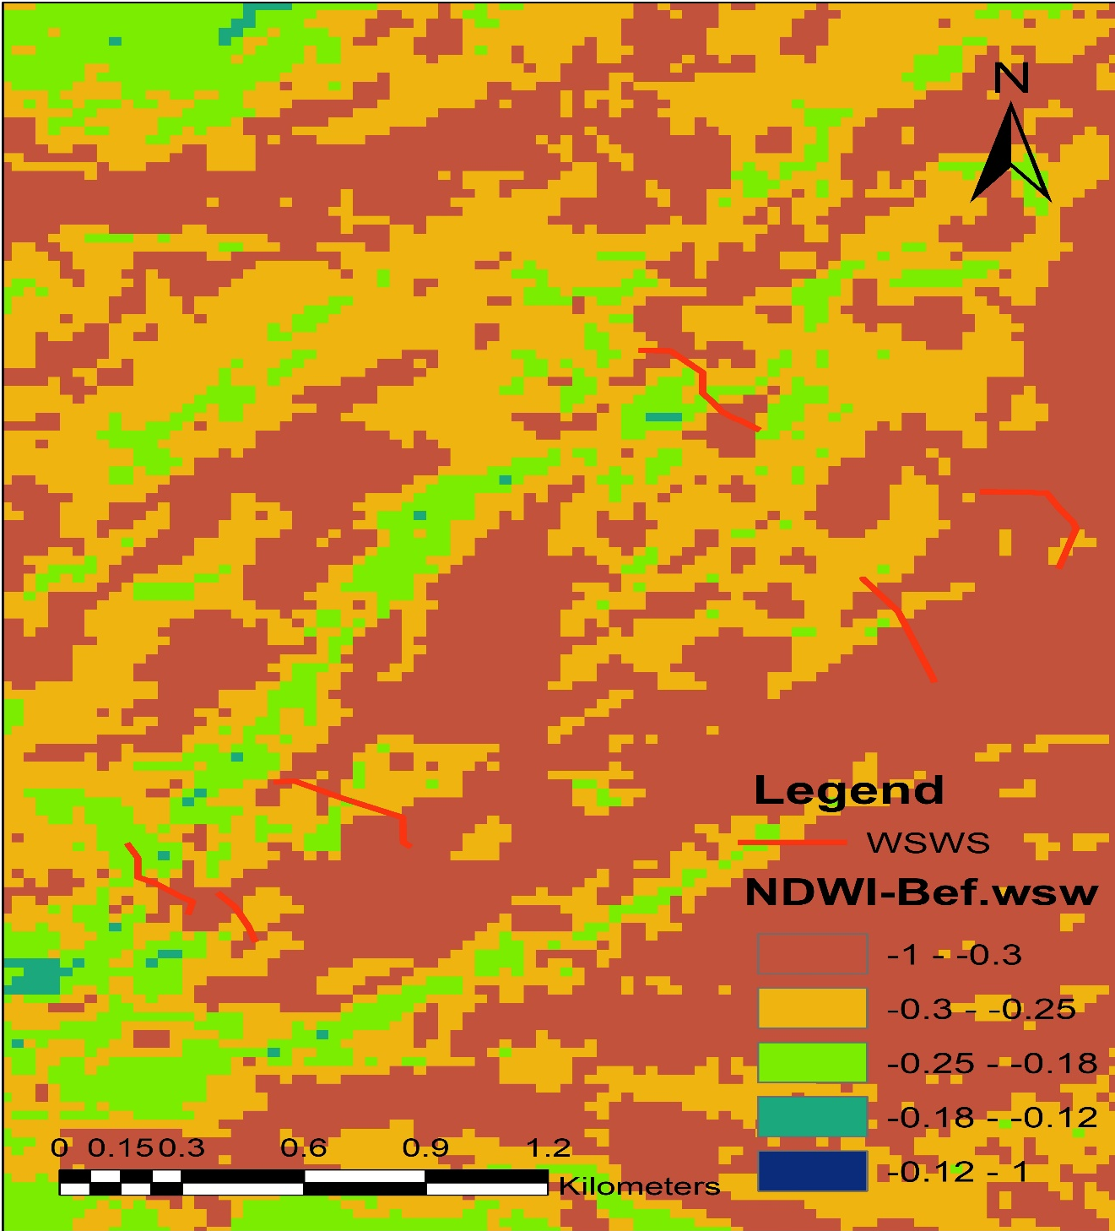
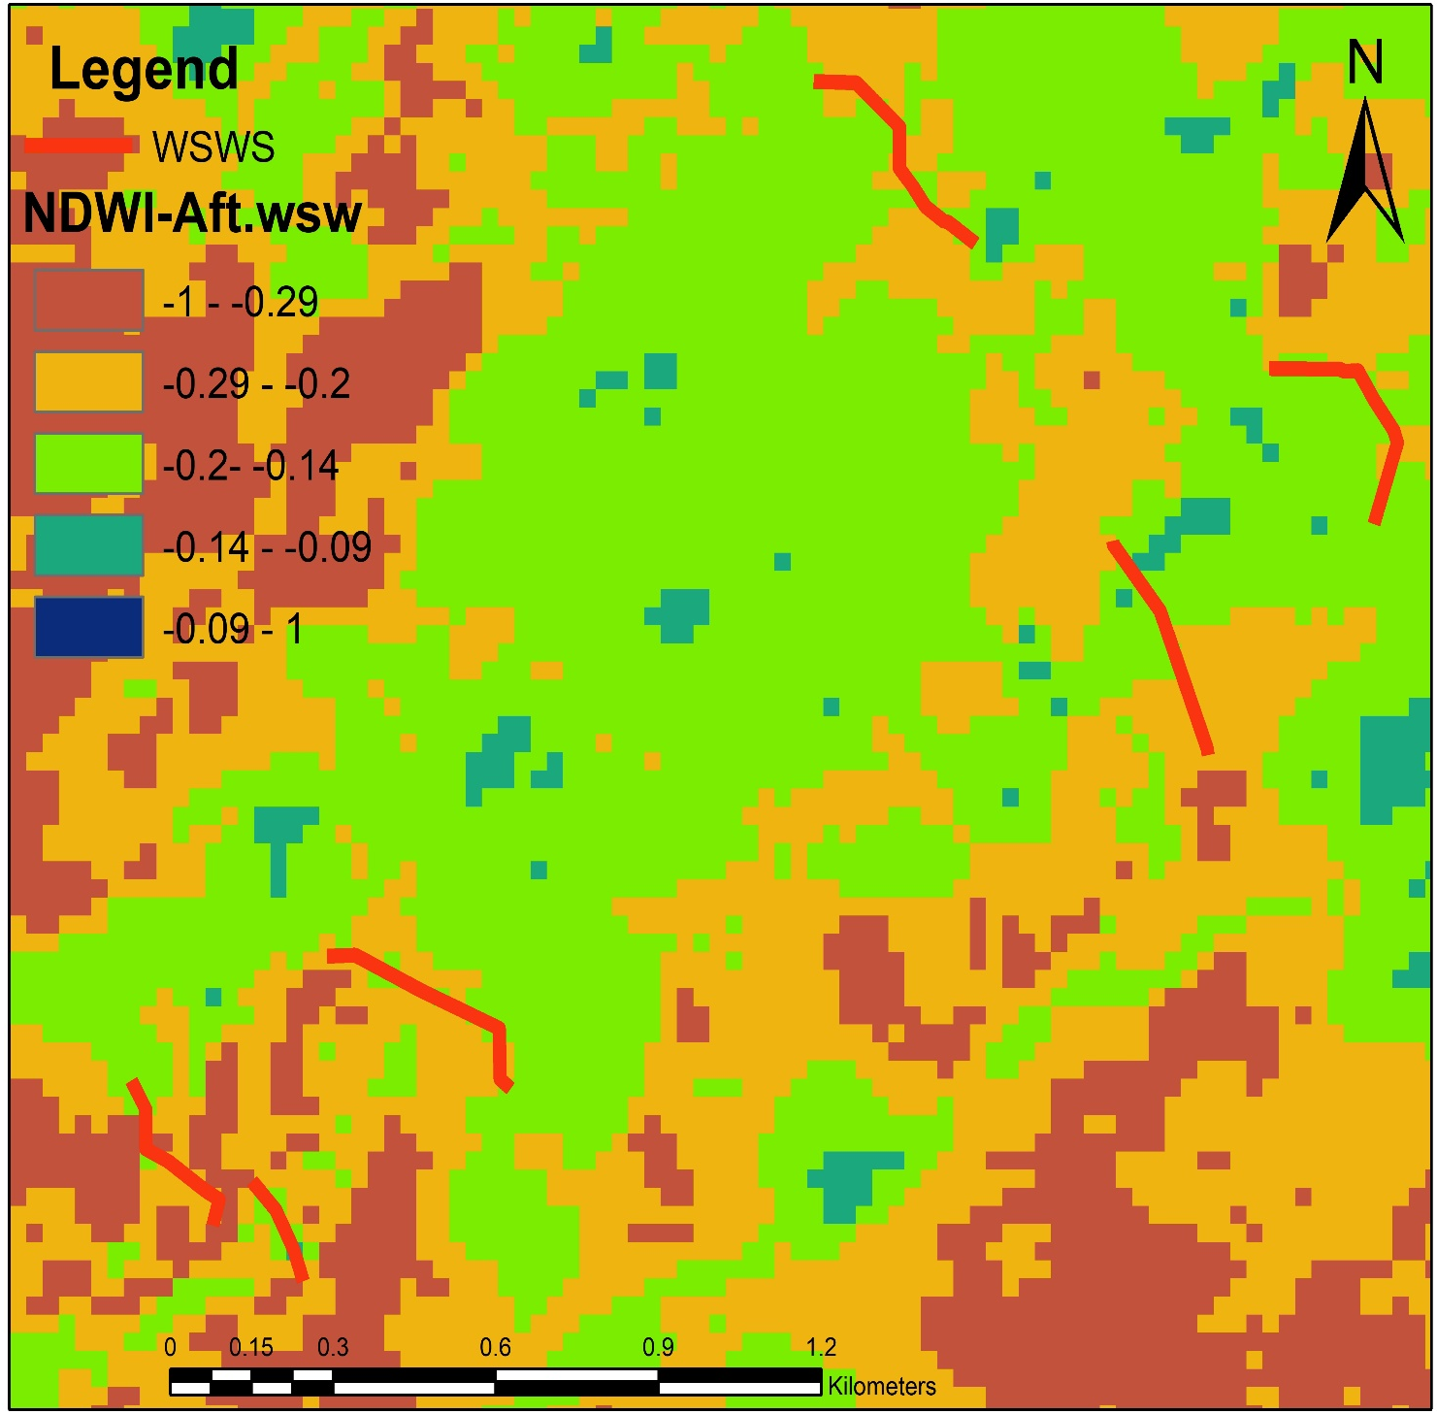

Slide 15
April |  |  |  | Increase | % Increase
Duba | Avg. AETI (mm/day) | Bef.wsw | 0.67 | 0.28 | 42.08
 |  | Aft.wsw | 0.95
 | Avg. NPP (gC/m2) | Bef.wsw | 0.24 | 0.14 | 58.76
 |  | Aft.wsw | 0.38
Months | Lekura |  |  | Increase | % Increase
April | Avg. AETI (mm/day) | Bef.wsw | 0.49 | 0.42 | 85.7
 |  | Aft.wsw | 0.91
 | Avg. NPP (gC/M2) | Bef.wsw | 0.10 | 0.28 | 282.3
 |  | Aft.wsw | 0.38
May | Avg. AETI (mm/day) | Bef.wsw | 0.53 | 0.52 | 97.95
 |  | Aft.wsw | 1.06
 | Avg. NPP (gC/M2) | Bef.wsw | 0.07 | 0.19 | 251.85
 |  | Aft.wsw | 0.26

Slide 16
Valley | Increase AETI (mm/day) | Reh.Area (ha.) | Vol.AETI (m3)
Duba | 0.28 | 96.4 | 269.9
Lekura | 0.42 | 244 | 1024.8
Wekridie | 0.29 | 62 | 179.8

Slide 17
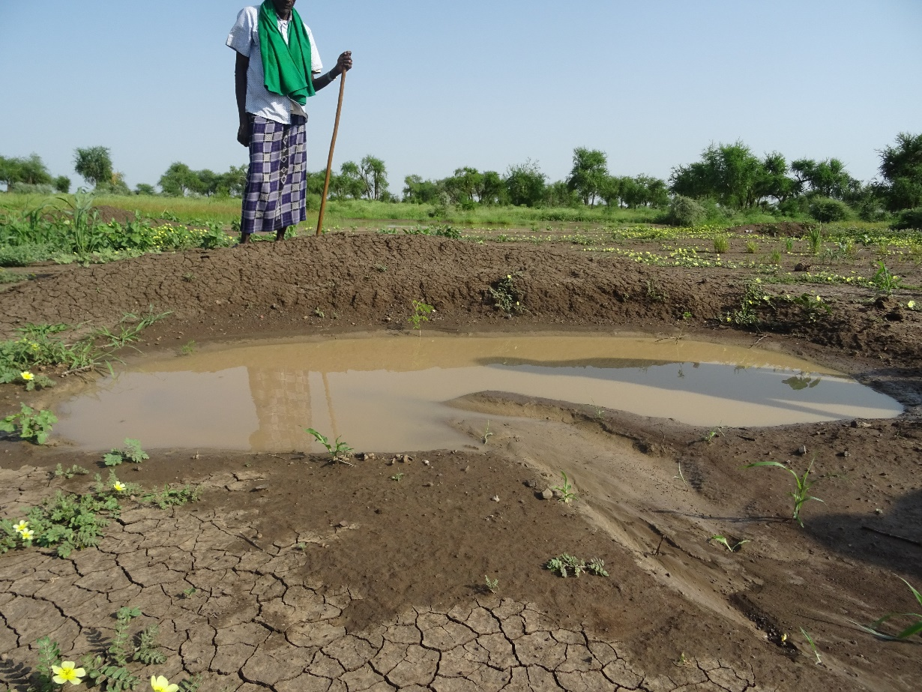
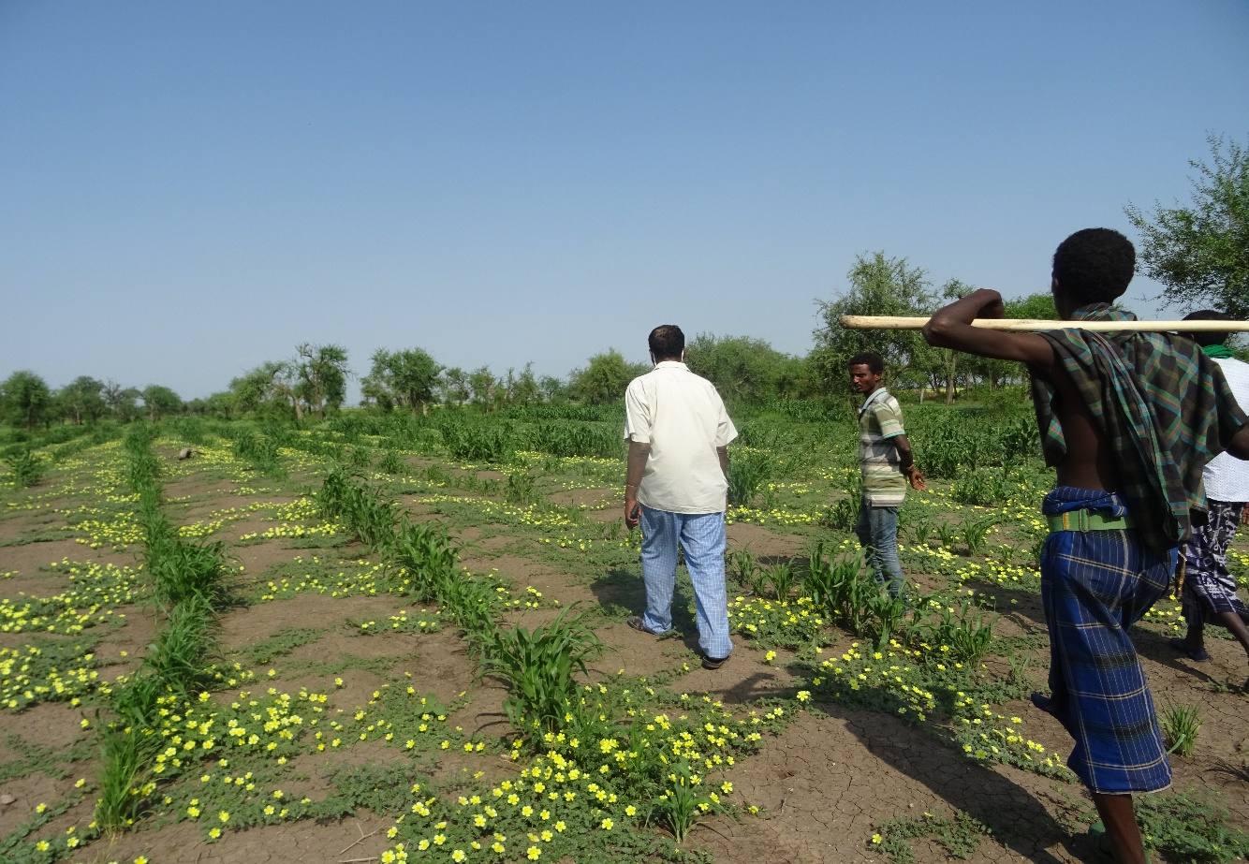
Moisture conservation structure
Constructed in Lekura wsw.
Maize field at Lekura wsw
After construction of wsw.

Slide 18
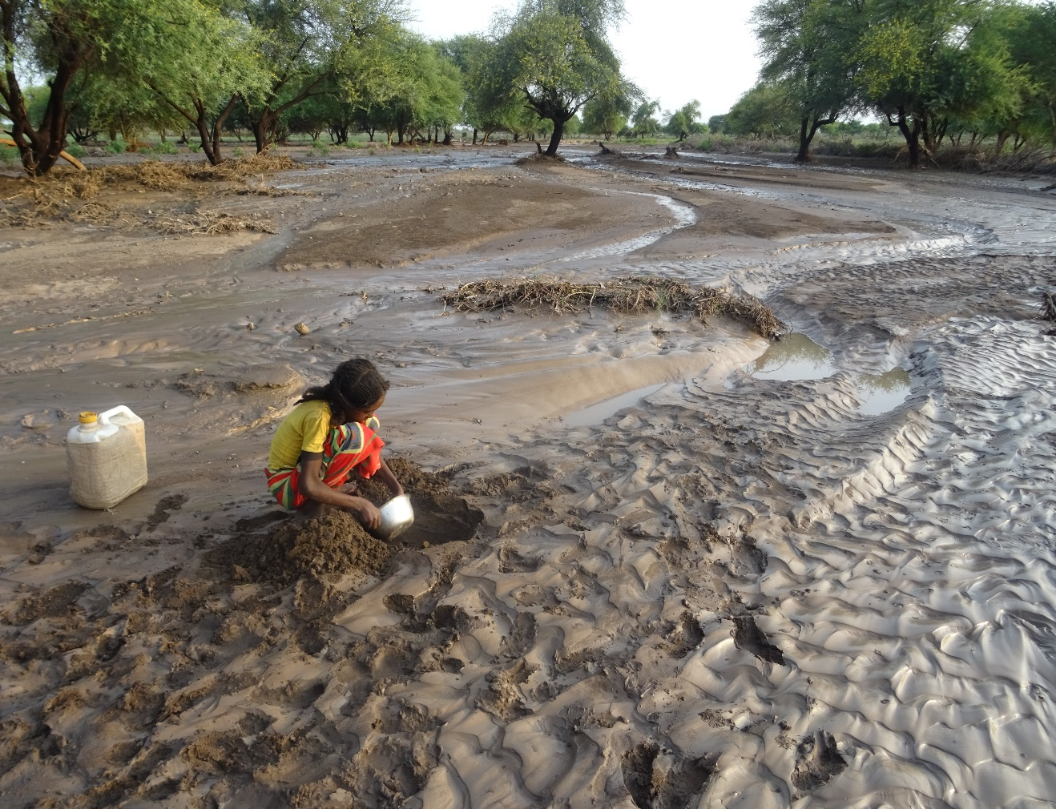
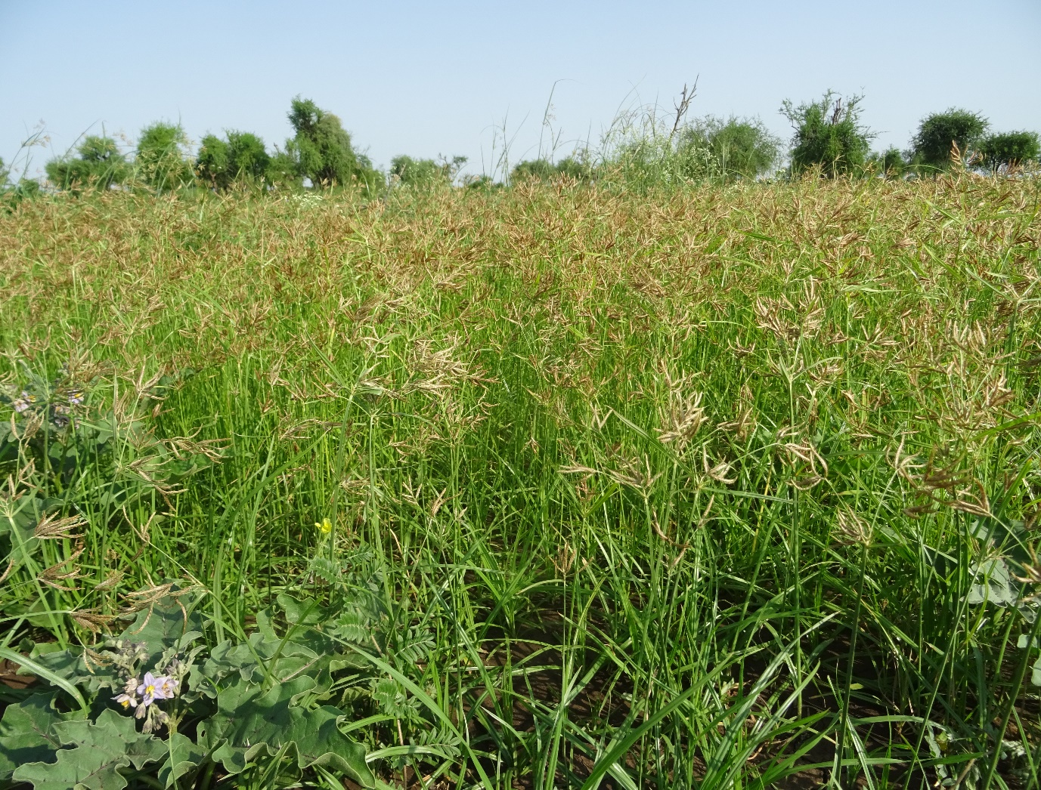
A girl fetching drinking water
From SM stored in sand at Duba wsw.
Grass grown in Lekura valley
After construction of wsw

Slide 19
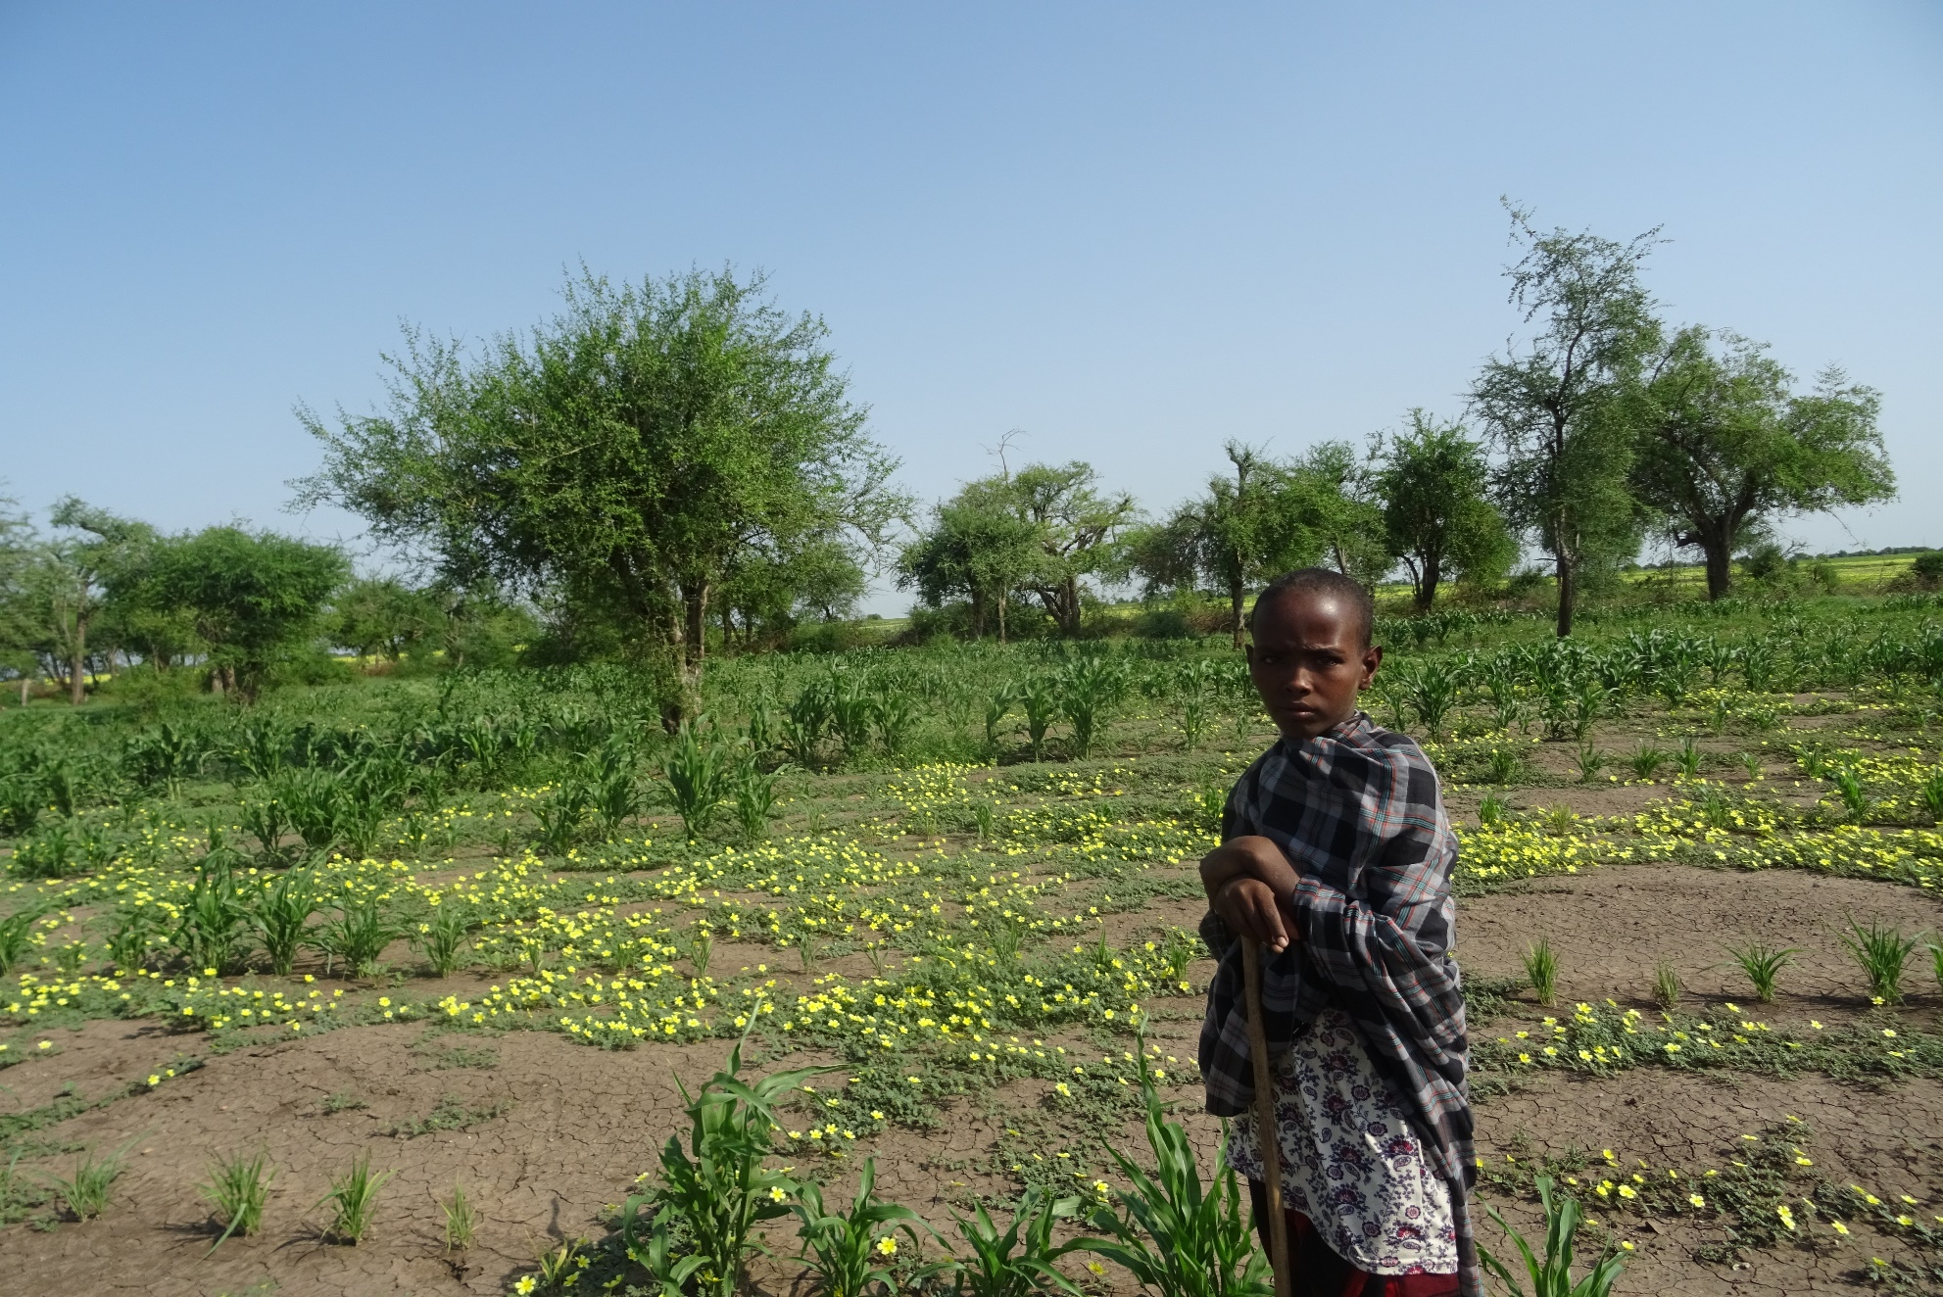
THANK YOU!!!

