Slide 2
Introduction and Rationale
Where was the research conducted – show the map of the study area along with some facts (Is it pictures?
It was the area which is found near to where i used to work and had dream to alleviate the existing problems.
Improved technologies were not implemented till today (eg. Ziway)
Bringing the solution implies motivating farmers to work on there field yearly.
As dutch peopole say, we don’t fight water we leave with it so we don’t fight flood we have to leave with it

Slide 3
Introduction and Rationale
Crop production in koka floodplain with river & hand-dug wells as a main water source, plays a vital role in supplying the food demand of the capital cities around it.
Hand-dug wells either collapse or face sediment deposition every year – which resulted in cost.
Inexistence of wells in some part of the floodplain – affect second season productivity (while struggling to use river water).
Lack of systematic study aimed at enhancing productivity of floodplains.
Lack of new technology introduction to farmers (eg. Ziway)

Slide 4
Key Research Questions
What are the technical differences and commonalities among the various traditional shallow-wells and how does this translate into resilience to flood damage and timely delivery of supplemental irrigation?
What alternative shallow-well technologies could be recommended that are technically feasible and affordable?
How effective are the existing agronomic practices with regard to enhancing productivity? What if alternative measures could be recommended?

Slide 5
Research Methodology

Slide 6
Major findings
Generally floodplain area
Hand-dug well
Without hand-dug well
With protected material
Without protected material

Slide 7
Major findings
Characteristics | From Mojo River (on the edge of floodplain) | From Mojo River (Completely inside floodplain) | From Koka Lake
Depth of wells | 10 – 12 meter | 6 – 10 meter | 6 – 12 meter
Groundwater depth | 8 – 10 meter | 7 – 9 meter | 4 – 8 meter
Diameter | 1.5 meter | 1 meter | 1 meter
Accessibility | Using slanted path | From the top | From the top
Position of pump from ground | 2 – 4 meter | On the ground – 2 meter | On the ground
Flood cause type | Sediment deposition | Sediment deposition & total collapsing | Sediment deposition & total collapsing

Slide 8
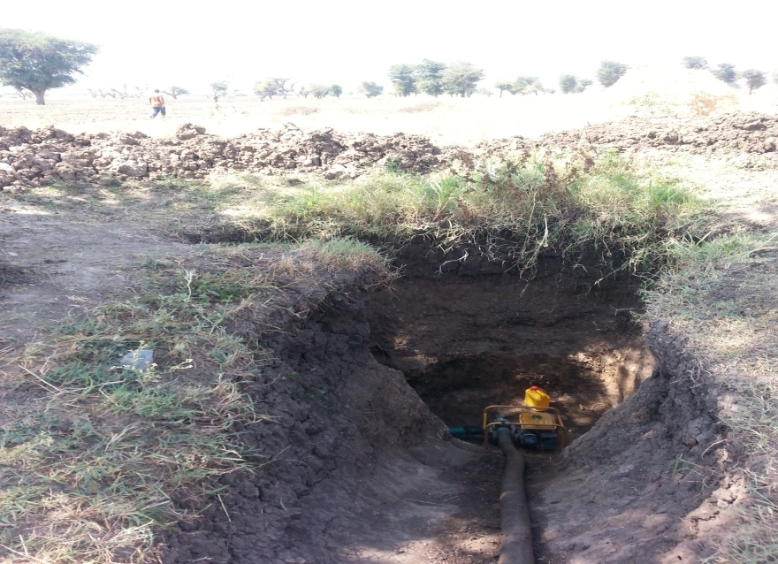
Collapsing & sediment deposition
Sediment removed
Collapsed well

Slide 9
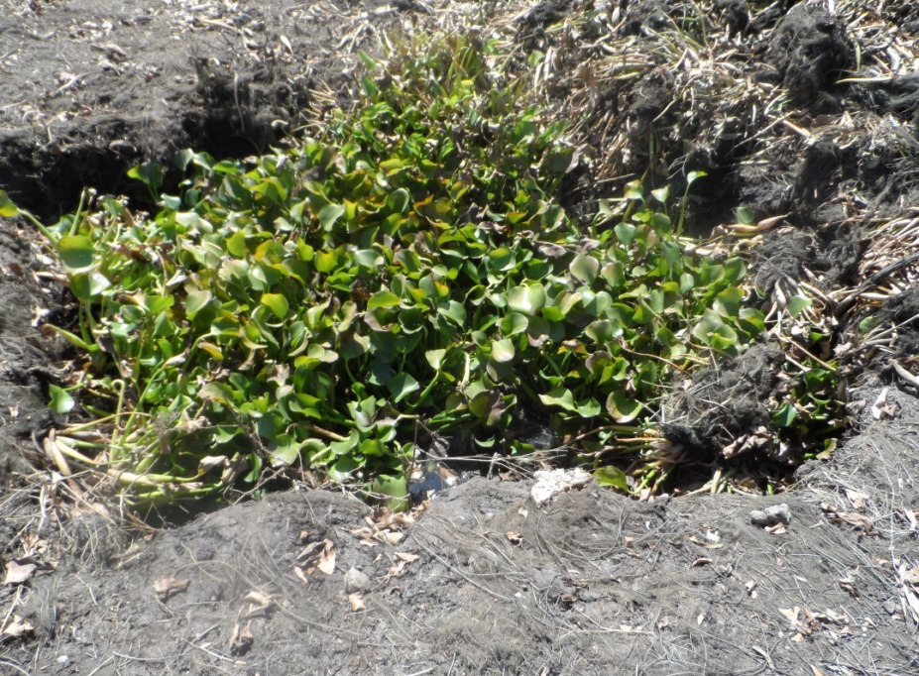
Lilies grown & sediment
Protection material, collapsing of wells
Lilies and sediment

Slide 10
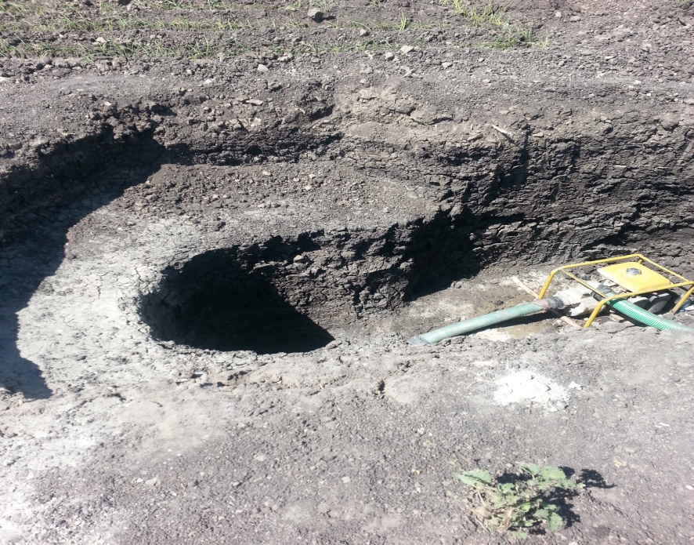
Sediment removal and newly constructed
Sediment removal from protected wells
Newly constructed well due to failure of previous

Slide 11
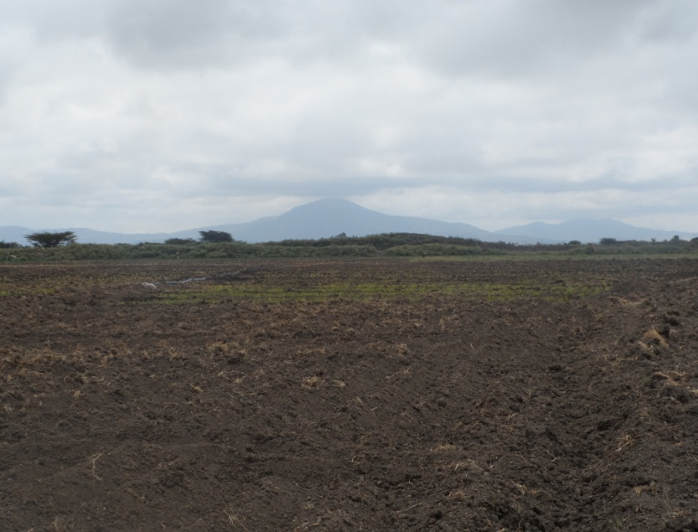
River flow and extraction of water from it
River flow decrease
Extraction of irrigation water from river

Slide 12
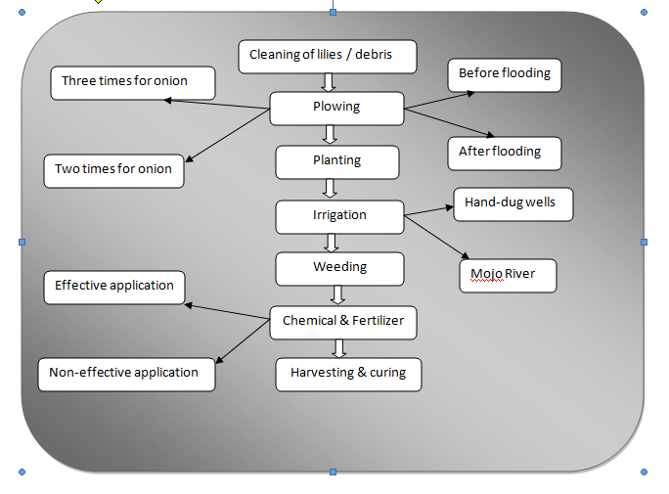
General Agronomic practice in floodplain

Slide 13
Cropping pattern
 | 1st cropping season | 2nd cropping season | 3rd cropping season
Farmer 1 | Onion | Onion | Previous cropping timing. Plant maize. Grazing Skip due to low river flow
Farmer 2 | Chickpea | Onion
Farmer 3 | Onion | Maize
Farmer 4 | Tomato | Onion
Farmer 5 | Onion | Tomato
Farmer 6 | Chickpea | Tomato
Variation is due to Farmers preference (crop rotation) Flood recession frequency Farmers skip few month of moisture (after flood recede) and only do plowing Agreement with in farmers to leave the area for grazing

Slide 14
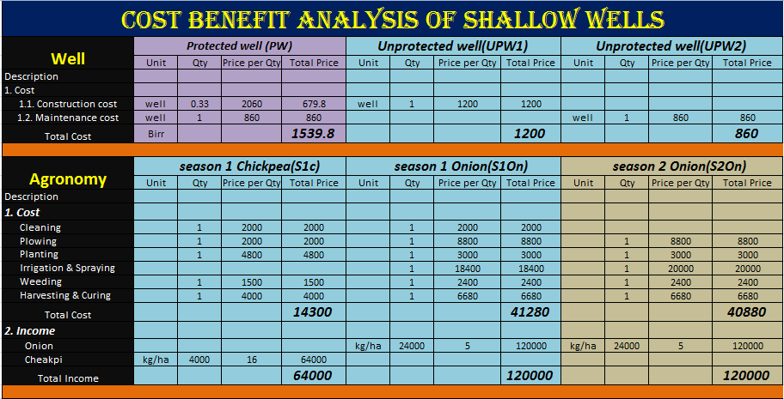

Slide 15
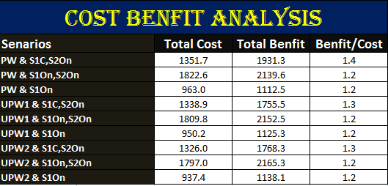

Slide 16
AquaCrop result for no stress

Slide 17
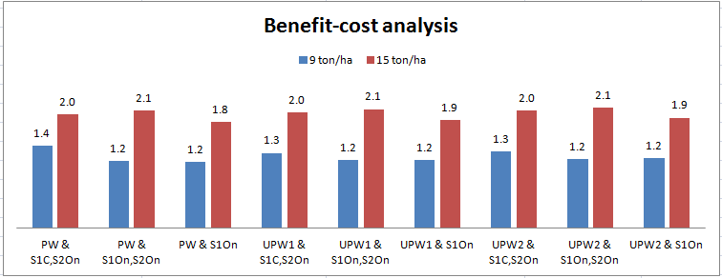
Major findings

Slide 18
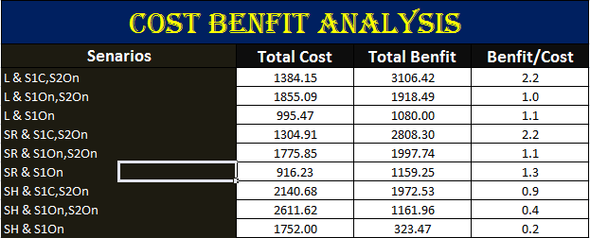

Slide 19
Conclusions
Shallow-tube well implementation will benefit farmers in gaining third crop season in areas which are near to Mojo river or areas with shallow ground water table.
Near Mojo river second cropping season irrigation schedules will be upgraded.
Farmers still with shallow ground water table, within depth of 8 till 10 meter will benefit from implementing lining with cement.
Crop production under no stress result in obtaining maximum yield of 15 ton/ha, leads to an increase to benefit cost ratio of 2.1.

Slide 20
Recommendations
Detailed local study on the crops produced needs to be implemented for upgrading the yield gained.
Small pond/ reservoir implementation to be considered by agriculture sector, to fill the pond by pumping during flooding so that will both help for non-flood & floodplain production.
Studies on the abstraction of ground water to control the effect on the floodplain as it is an ecosystem that has to be preserved.
Workshops for sustainable implementation and maintenance of shallow-tube wells.
Institutional set up to educate farmer in case of new technologies.

Slide 21
Thank you
አመሰግናለሁ
Dank u wel

