Slide 1
Prosopis Julifora in Spate Irrigation Systems

Slide 2
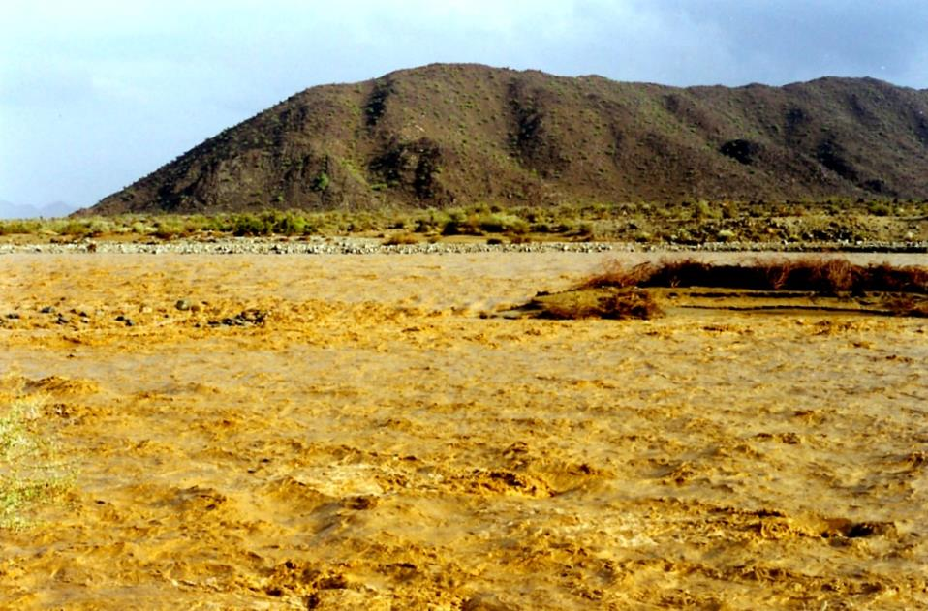
Diverting short terms floods from ephemeral streams
For rangeland, agriculture, local drinking water storage
and increasingly groundwater recharge
Important land and water use in many ASALs
Upcoming in Horn of Africa
due to population pressure and change in water patterns

Slide 3
Spate irrigation in ASAL – globally
Estimates
In addition there is spate irrigation in Ethiopia (110,000 ha) and Kenya (20,000 ha)
Spate irrigation was practized by Red Indians as well as Queen of Sheba – in comparison history in Horn of Africa is recent

Slide 4
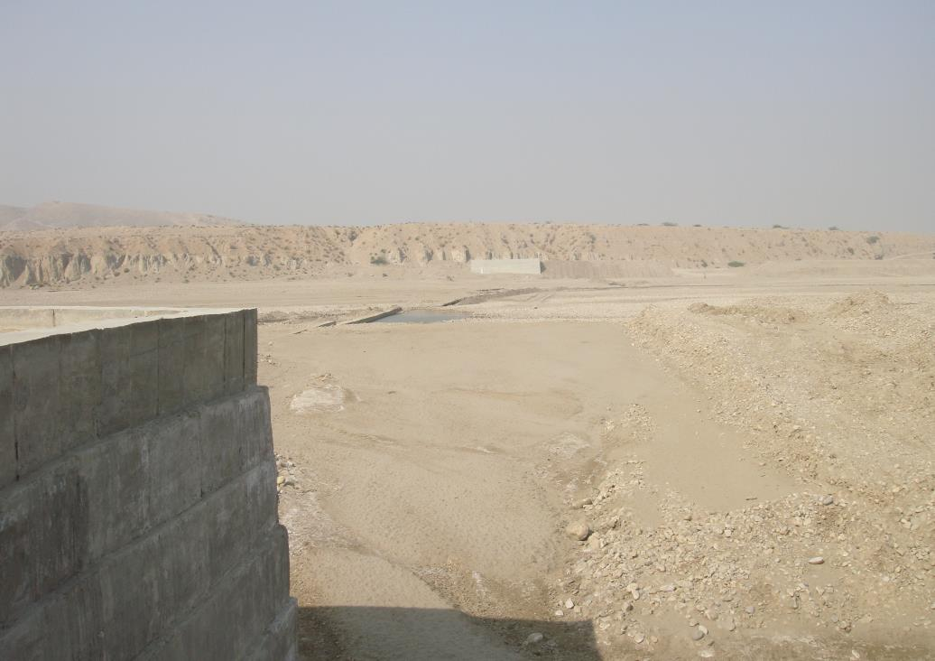
Engineering in spate irrigation is different
Dealing with:
High sediment loads
Dynamic river morphology
Excluding very high floods
‘Killing’ the force of water

Slide 5
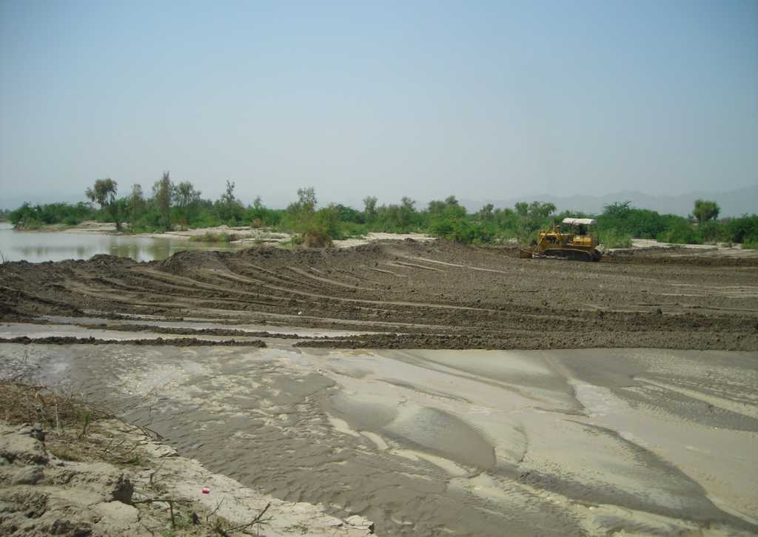
Constructing soil diversion and guide bunds in lowland systems

Slide 6
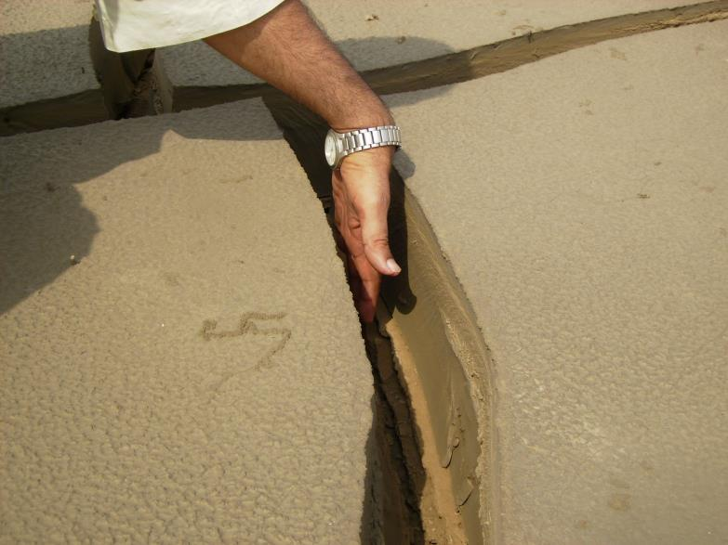
Managing sediment as important as managing water

Slide 7
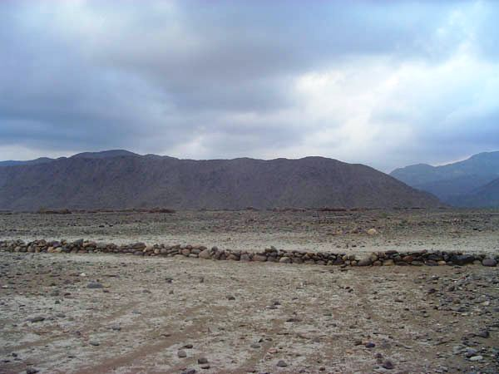
Land being built up by sediment

Slide 8
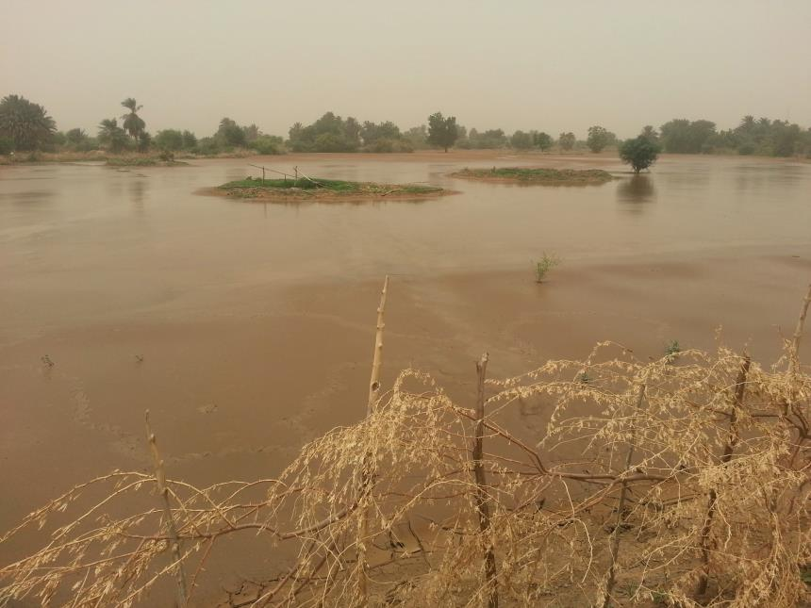
Recharge of wells from flood water

Slide 9
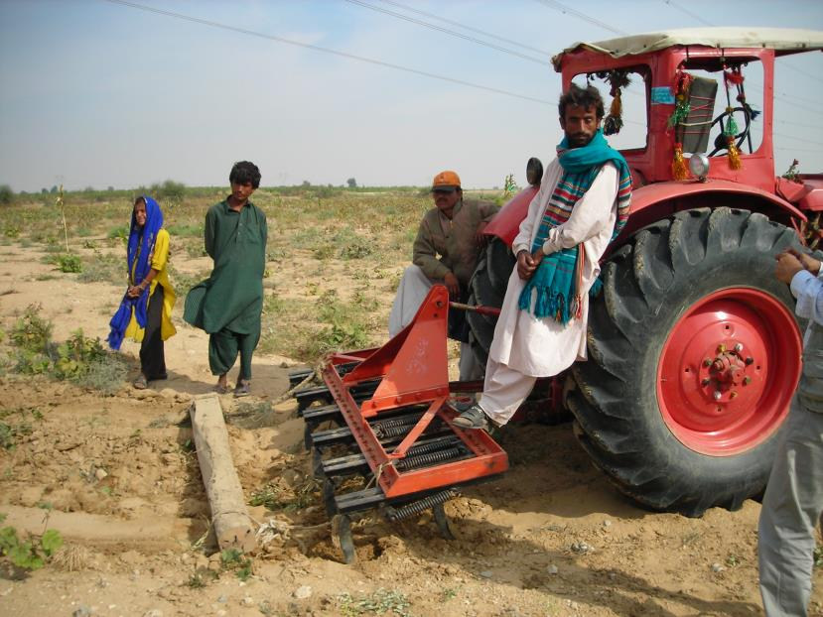
Moisture conservation is key: ploughing and mulching

Slide 10
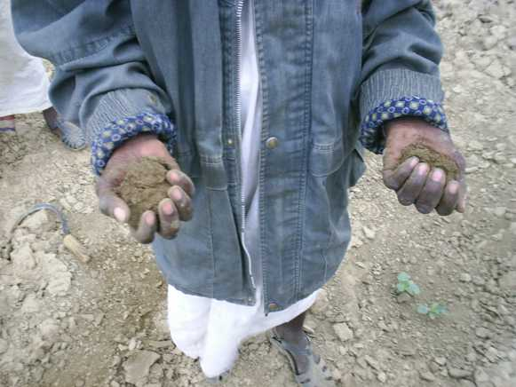
Moisture conservation is key: ploughing and mulching

Slide 11
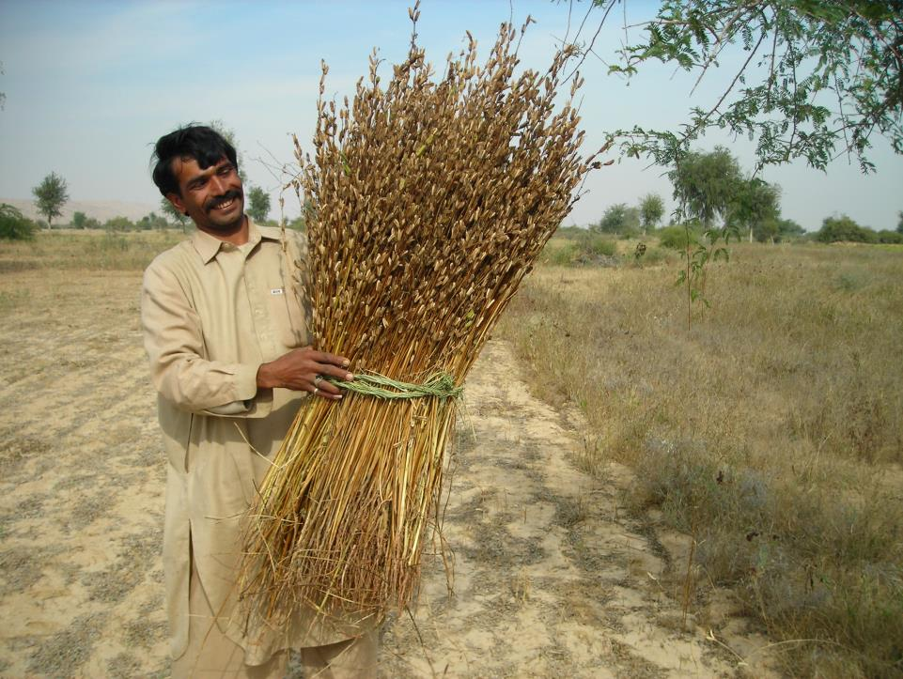
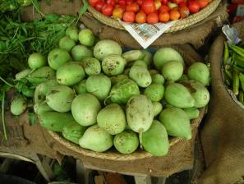
Contribute to food security and economic growth – from areas with high variability
Important crops:
Oilseeds
Pulses
Coarse grains
Cotto

Slide 12
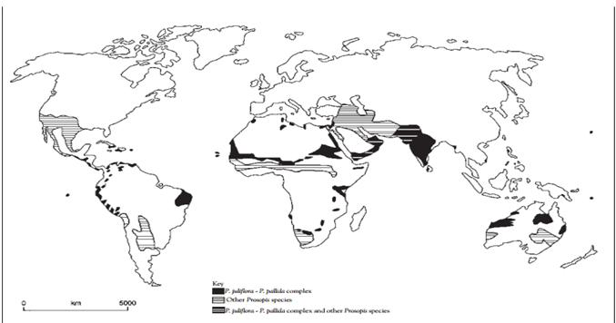
Prosopis juliflora geographical range in the year 2000 (Source: Pasiecznik et al., 2001 )

Slide 13
Prosopis Juliflora in Spate Irrigation
Increasing fast
Clogs canals and reduces their capacity
Blocks rivers, especially deltas – flooding becomes uncontrolled
Invades land
Country overview: Eritrea, Ethiopia, Pakistan, Sudan and Yemen
Control or Management of Prosopis juliflora
Making use of Prosopis juliflora
Conclusions: How to address the Prosopis juliflora challenge?

Slide 14
Eritrea
Introduction purpose | Impact | Mitigation
Early 80s Migration Livestock From Sudan | Crop cultivation more labour intensive and costly, because farmers have to remove seedlings and shrubs from the fields. Infestation still remains low. Potentially it can become a serious risk. | Attempts by local administration under food work. Prosopis simply re-grew. Some research Only measure in place up to this date - and this may not even contribute to the control of Prosopis’ spread - is the approval for the cutting of Prosopis wood from live trees.

Slide 15
Ethiopia
Introduction purpose | Impact | Mitigation
Late 70s Biological soil and water agent | Afar and Somali regions most affected Displacement of natural pasture grasses as well as native tree species. Originate from many small villages, extending along the main (water) routes; now steadily advancing into the surrounding landscape. | Controlling Prosopis juliflora in the Afar region in a number of ways. Mass campaigns to clear Prosopis juliflora have been organised. Control through utilization such as charcaol production and pod crushing, recently bricket making Not much could be done to eradicate or control Prosopis juliflora- need integrated land use planning, community mobilization, technology transfer, private sector participation and supply of resources.

Slide 16
Pakistan
Introduction purpose | Impact | Mitigation
Second half of 19th century – but quick acceleration in recent two decades Control soil erosion and desertification | Prosopis juliflora slows downthe spate flow in the canals. Obstructs livestock from accessing drinking water. Suppresses natural vegetation and dominating fallow lands. Selling Prosopis juliflora as fuelwood or as charcoal is a popular business Farmers use branches for fencing | Focus on productive use Research to cultivate Prosopis juliflora in saline areas for providing fodder, fuel wood and timber Prosopis juliflora is used along the coast of Balochistan for sand dune control and prevention of sea incursion.

Slide 17
Sudan
Introduction purpose | Impact | Mitigation
1917 Stabliize sand dunes | Large areas invaded in drought-prone areas In Gash, decrease in the channel discharge capacity (25%), reduction in groundwater level, land infestation Source of fodder and river bank stabilization, Income from charcoal making and fuel wood from Prosopis juliflora. | Campaign in 1996 by the Kassala state government to eradicate Prosopis juliflora through community mobilization. In 2005 private companies were contracted. Mechanical, chemical and biological methods were used. Gash livelihood project (2004): Land was titled to farmers on the condition that it would be taken back if they could not control the shrub. Re-infested in the Gash delta. Lack of follow up programs, inadequate management and weak enforcement of regulations played a major role.

Slide 18
Yemen
Introduction purpose | Impact | Mitigation
1974 To combat soil erosion and dune movement | In wadi Hajar, causing floods by blocking watercourses and diverting floodwater into villages. Investation of productive land in Hodeidah governorate, Hadramout, Lahej, Abyan and Shabwa Drying out data palms – destabilizing coastal areas | FAO implemented a project to manage and control Prosopis juliflora. Farmers were trained in the use of Prosopis juliflora pods for animal feeding and the stems of the plant for firewood. Pods became a profitable enterprise for the farmers.

Slide 20
Land cover change in the Gash scheme, Sudan.

Slide 21
Effect of Prosopis Juliflora infestation on canal discharge capacity in the Gash scheme.

Slide 22
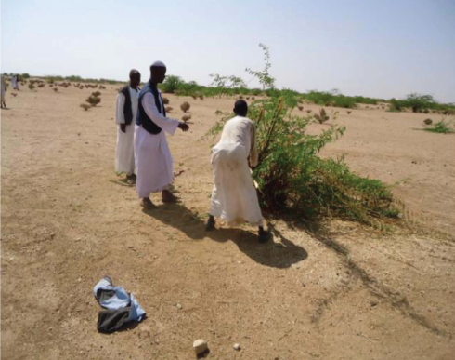
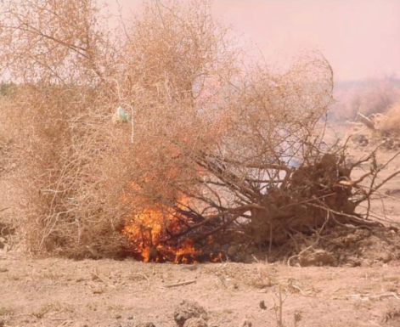
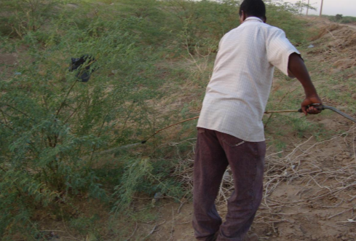
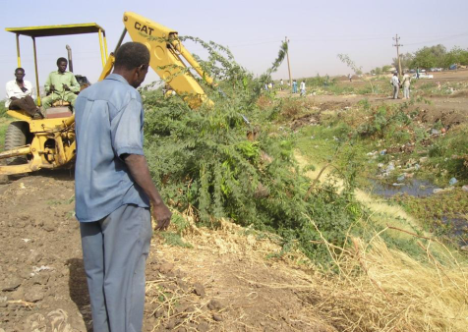
Methods of control

Slide 23
Control and Management
Biological: (predators/ pathogens such as Algarobius bottimeri, Algarobius prosopis, Prosopidopsylla flava and Evippe spp)
Experimented in Sudan and Australia
Slow process
Burning the stump with kerosene after it has been cut (Yemen)
Works when plant is dry and roots not too deep

Slide 24
Control and Management
Mechanical: (stick racking, chain pulling, bulldozer pushing and blade ploughing)
Effectiveness depends on soil moisture
Reinfestation esp. when much young trees and seedlings
Maintenance and follow up care is important
Chemical: (Round up, 2-4 D, Glenside, Kerosine and diesel oil)
Cutting and spraying/painting freshly cut stems
Use when plant is actively growing, but before having pods

Slide 25
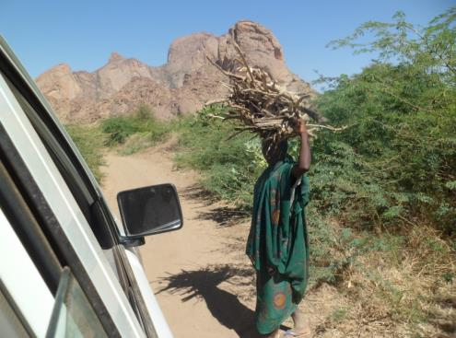
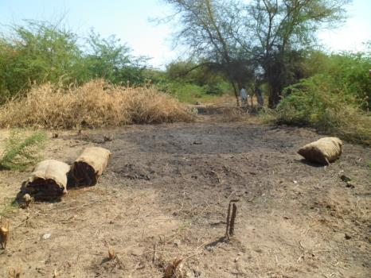
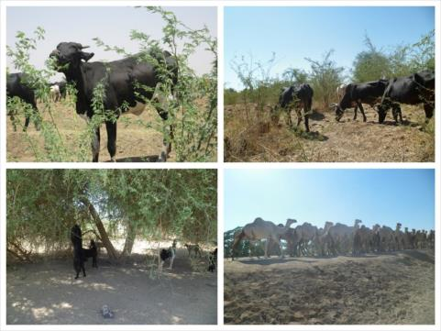
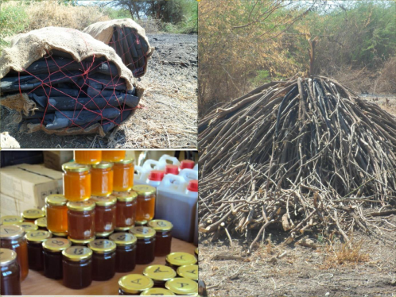
Beneficial use

Slide 26
Making use of prosopis juliflora
Fuel wood, charcoal and brickets
Biomass feed for energy plants
Timber (if not too craggy)
Fodder
Land reclamation (tera preta, biochar)
Honey, gum and sugar

Slide 27
No single remedy: focus on combination of control and making use of Prosopis juliflora
Positive Aspects
Negative aspects
Can play a role in sustaining the livelihood of poor rural households
Source of fuel and dry season animal feed
Wood does not spit, spark or smoke excessively (produces good charcoal)
High quality and hard timber (can be processed into furniture or construction material)
Good animal feed
Can act as vegetative fencing to delimit and protect properties
Lack of traditional knowledge on how to manage and control the plants
Obstructs paths and roads
Hard and costly to remove
Expands quickly even in the hardest conditions
Thorns can injure animals and people
Depletes the water moisture and groundwater
Few plants are able to grow under its crown shade
Can favor the breeding of malaria spreading mosquitoes
Causes pastoralists communal lands to shrink.

Slide 28
Conclusions: How to address the Prosopis Juliflora Challenge in Spate Irrigation Systems?
Intense land use planning and regulation – not allow cattle movement between areas
Combine ‘combating’ and ‘utilizing’
Focus on removal from water ways, highly productive land or land important for local food security
Land using communities encouraged to uproot seedlings when still easy to remove
Promote innovative uses (bio-char or energy bio-mass - bricketing)
Alternative land uses – Acacia charcoal plantations
Introduce broader range of eradication measures

Slide 29
www.spate-irrigation.org

