Slide 1

Prosopis, Parthenium and beyond -
Elements for an integrated strategy of IAS control in the Afar region
Wondimagegne Chekol and Irmfried Neumann
Paper presented at the
Regional Conference on Managing Prosopis Juliflora for better (agro-)pastoral Livelihoods in the Horn of Africa.
May 1 - May 2, 2014, Addis Ababa

Slide 2
Prosopis came not alone
More than 35 IAS in Ethiopia
Prosopis control to be part of an integrated IAS-strategy
IAS-control: a method integrated into modern sustainable landuse et resource conservation

Slide 3
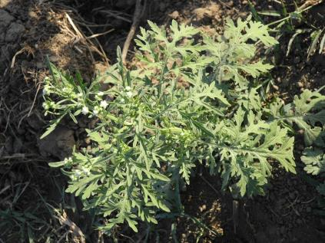
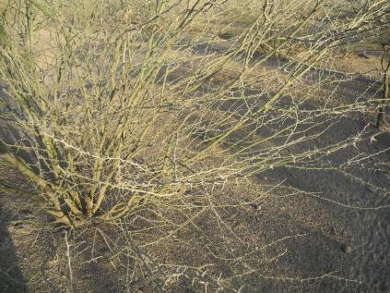
Important invasive species in Afar region
Parthenium hysterophorus
Acacia nubica

Slide 4
Distribution of P. hysterophorus
Map by Dr. Kassahun Zewdie, EIAR: PP-Presentation Biological Control of Parthenium hysterophorus in Ethiopia: An overview

Slide 5
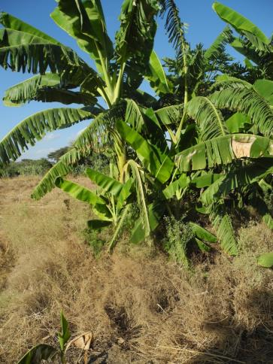
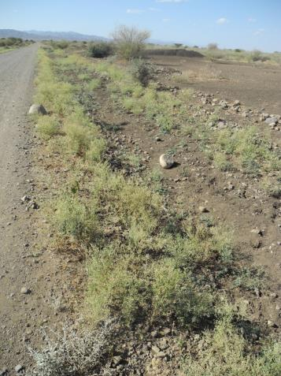
Parthenium hysterophorus damages
Dry-season aspect. Photos: Nov. 2013, close to Chiffra
Overgrown irrigation plot
By the roadside

Slide 6
Control measures of P. hysterophorus
      On farmland (irrigated)
      Irrigation canals
      On rangeland
      Road sides
      Settlement areas

Slide 7
Implementation of control measures
      In Afar only marginal activities of Parthenium control:
      Some on irrigated land
      Very little on range land

Slide 8
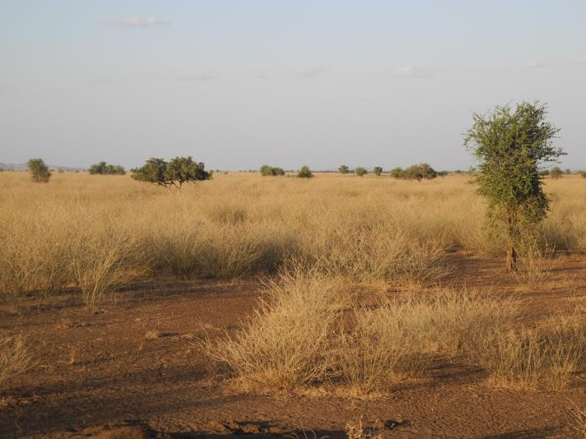
Acacia nubica invading rangeland dry-season aspect. Photo: Nov. 2013, close to Chiffra

Slide 9
Common frame of control for all IAS
Benefits: synergies in on the level of
    Observation of spreading,
    information/capacity development,
    policy dev., institutional strengthening, etc.
Resulting in stronger institutional setting, faster response, less cost, etc.

Slide 10
Elements of an integrated strategy
Integration Levels:
    Policy definition
    Institutional mandates
    Socio-cultural compatibility of measures
    Cooperation of actors
    Landscape ecology
    Economic (Profitability of land-use)
    Research and Technology Development
    Information & Capacity Development

Slide 11
Focus: communities / land-users
Challenge: continuity of control measures
How to put land-users in the driver seat
Socio-cultural compatibility of measures including gender
How to create stimulus for land-users to invest in profitable land-use.

Slide 12
Focus: Total area coverage
Ambition to cover the total area of the Afar National Regional State
But with site- and context specific measures
Adapting measures to communites, to land-use, to natural conditions, etc. ?

Slide 13
Focus: Integrating IAS control
IAS be integrated into a larger package for the strengthening Livelihoods:
  Land use planning
  Modernising agriculture and range land-use
  Accompany ongoing transformation of livelihood strategies

Slide 14
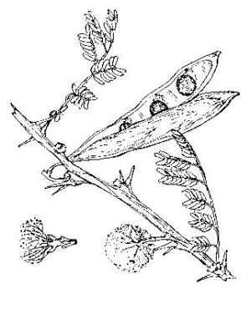
Focus: Institutional development
How to create a fitting institutional set-up between national – regional and local level?
  Clear institutional mandates for all levels

Slide 15
What to build on?
  Sound base to build an integrated strategy on:
  Existing research (Removing barriers to invasive plant management in ET,
  Experiences gained in programmes
  Existing vocational programmes
  Policy paper of Afar
  Willingness of partners

