Slide 1
The promise of FBFS
Mini Seminar 13/3/2014

Slide 2
Rain fed Agriculture or
Irrigated Agriculture
What is the area under either system
What is global production under either system

Slide 3
FBFS –
Africa estimated 10-25 M ha
MuAch to learn
Add: Mozambique, Sudan, South Sudan, Kenya (Tana Delta), Ghana

Slide 4
FBFS:
Asia (Bangladesh, Myanmar, Vietnam)

Slide 5
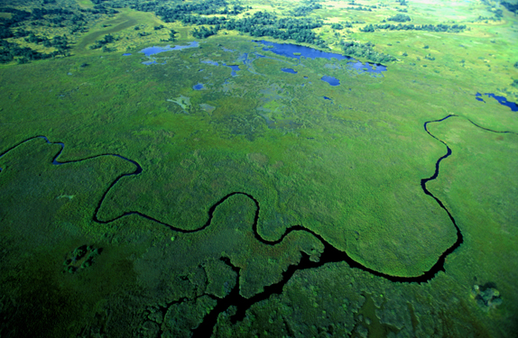

Slide 6
Zambezi Basin

Slide 7
Different FBFS
Spate irrigation
Flood recession/ flood rise agriculture
Inundation canals
Dambos, bas-fonds (flood depression)

Slide 8
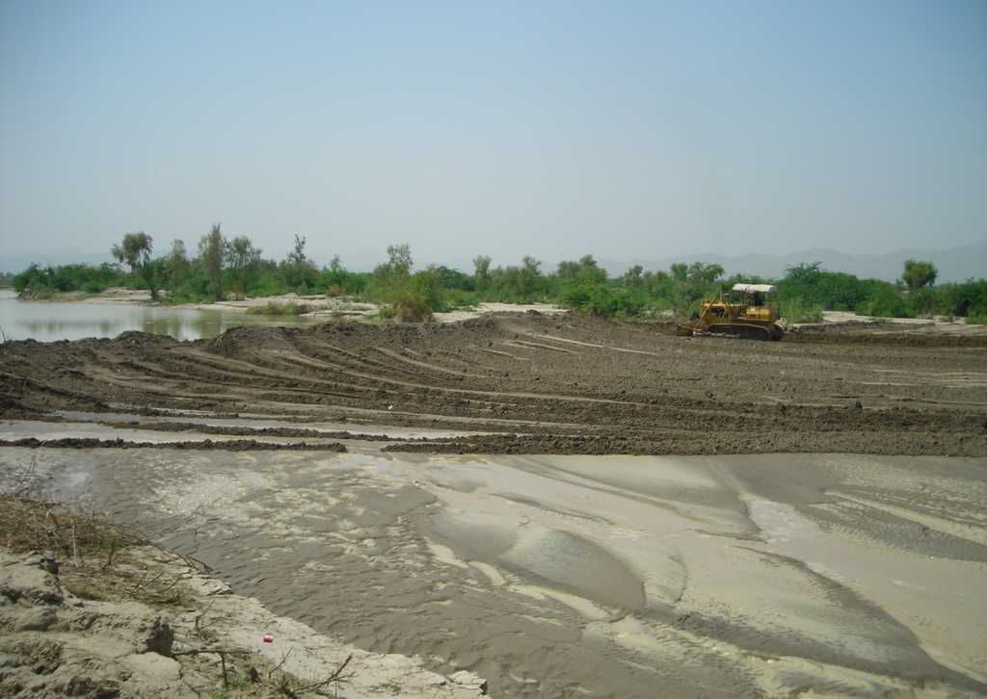

Slide 9
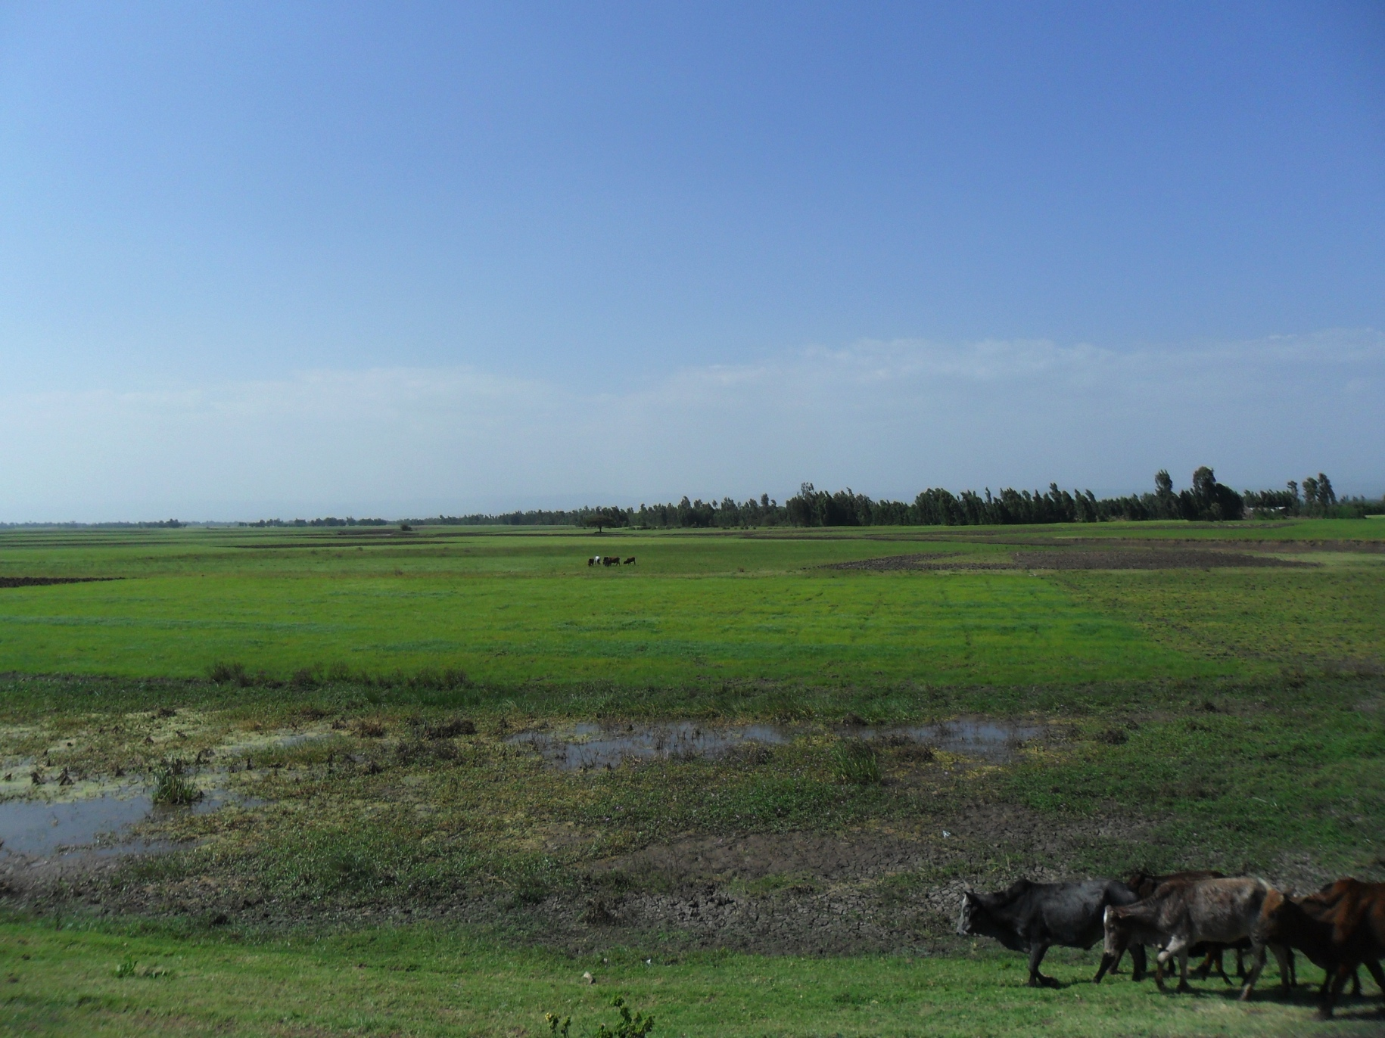

Slide 10
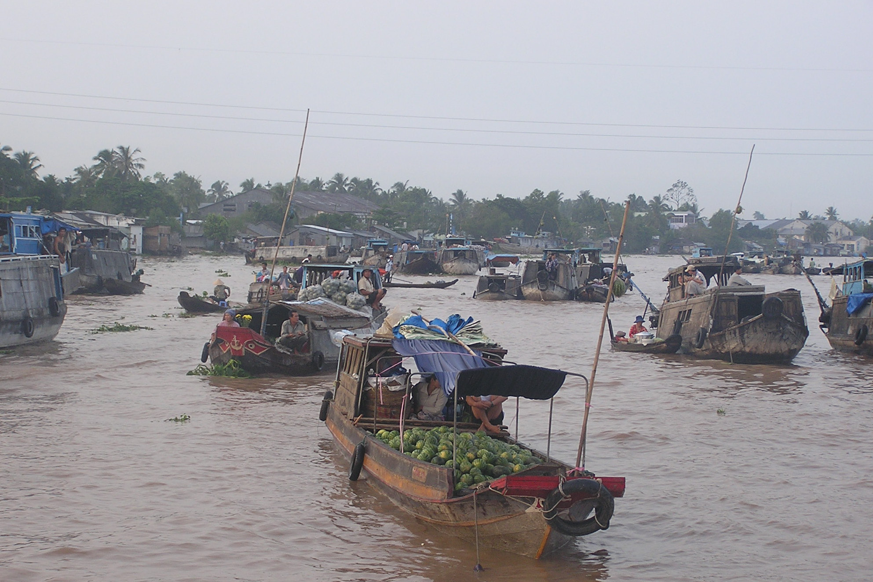

Slide 11
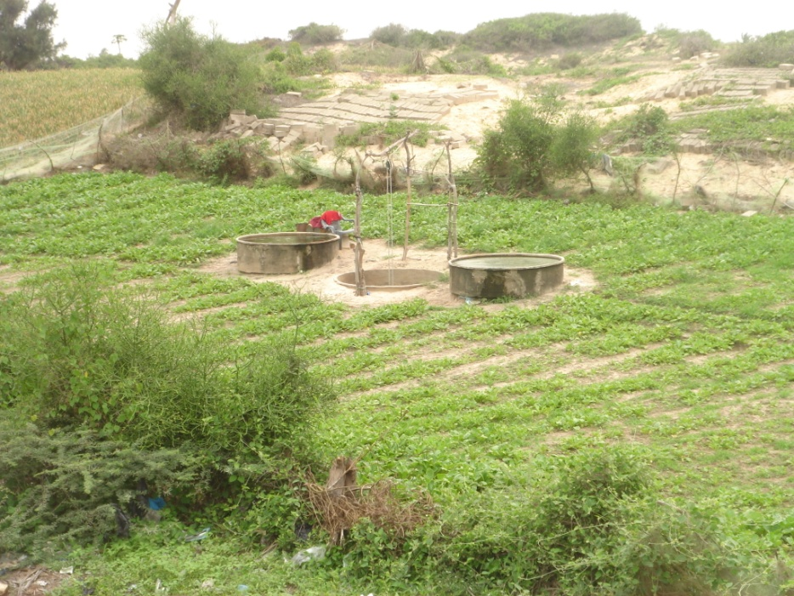

Slide 12
What can be done
Improved agricultural practice – special varieties
Improved floodplain water management:
  Better flood retention, making use of rising floods
Diversification
Artificial Flood Releases – from dams
Innovative technologies – esp shallow groundwater irrigation and aquaculture

Slide 14
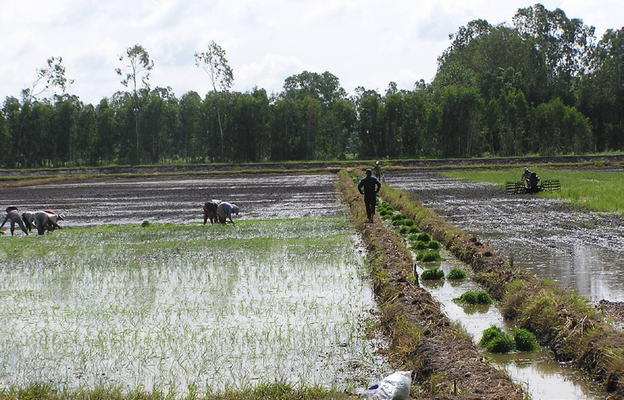
Figure 1: Increasing rice cultivation in the floodplains of The Mekong

Slide 15
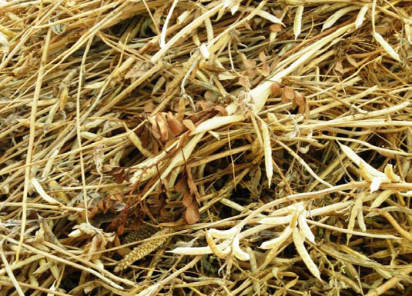

Slide 16
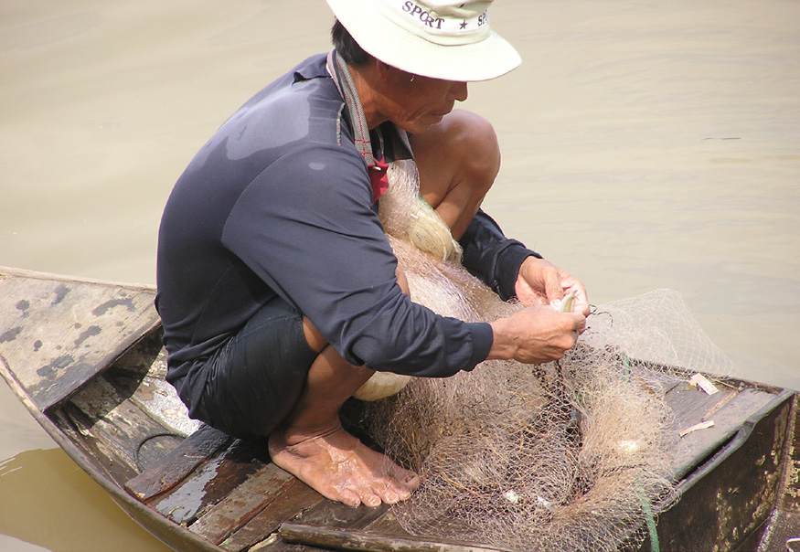
Figure 3: Fisheries being the dominant source of income, especially for landless and poor households.

Slide 17
Figure 22: Contour ponds
Figure 23: Barrage ponds

Slide 18
Figure 24: Paddy ponds made in a flat dambo
Figure 27: Fingerpond orientation and cross-section (van Daam et al. 2006)

Slide 19
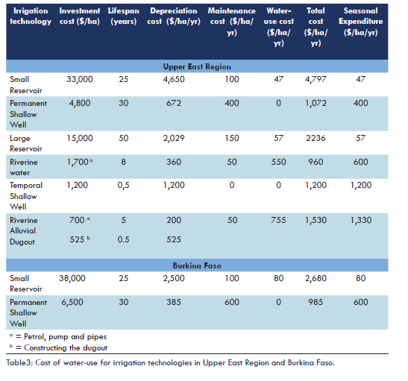

Slide 20
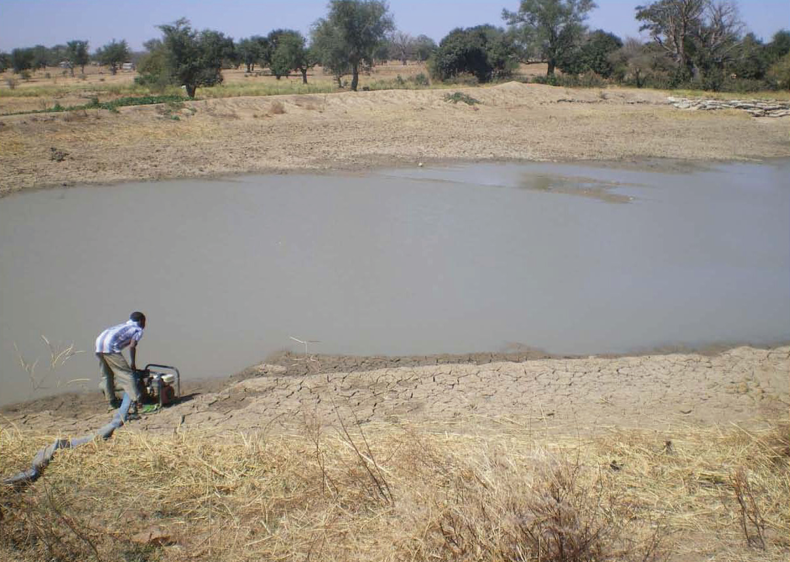

Slide 21
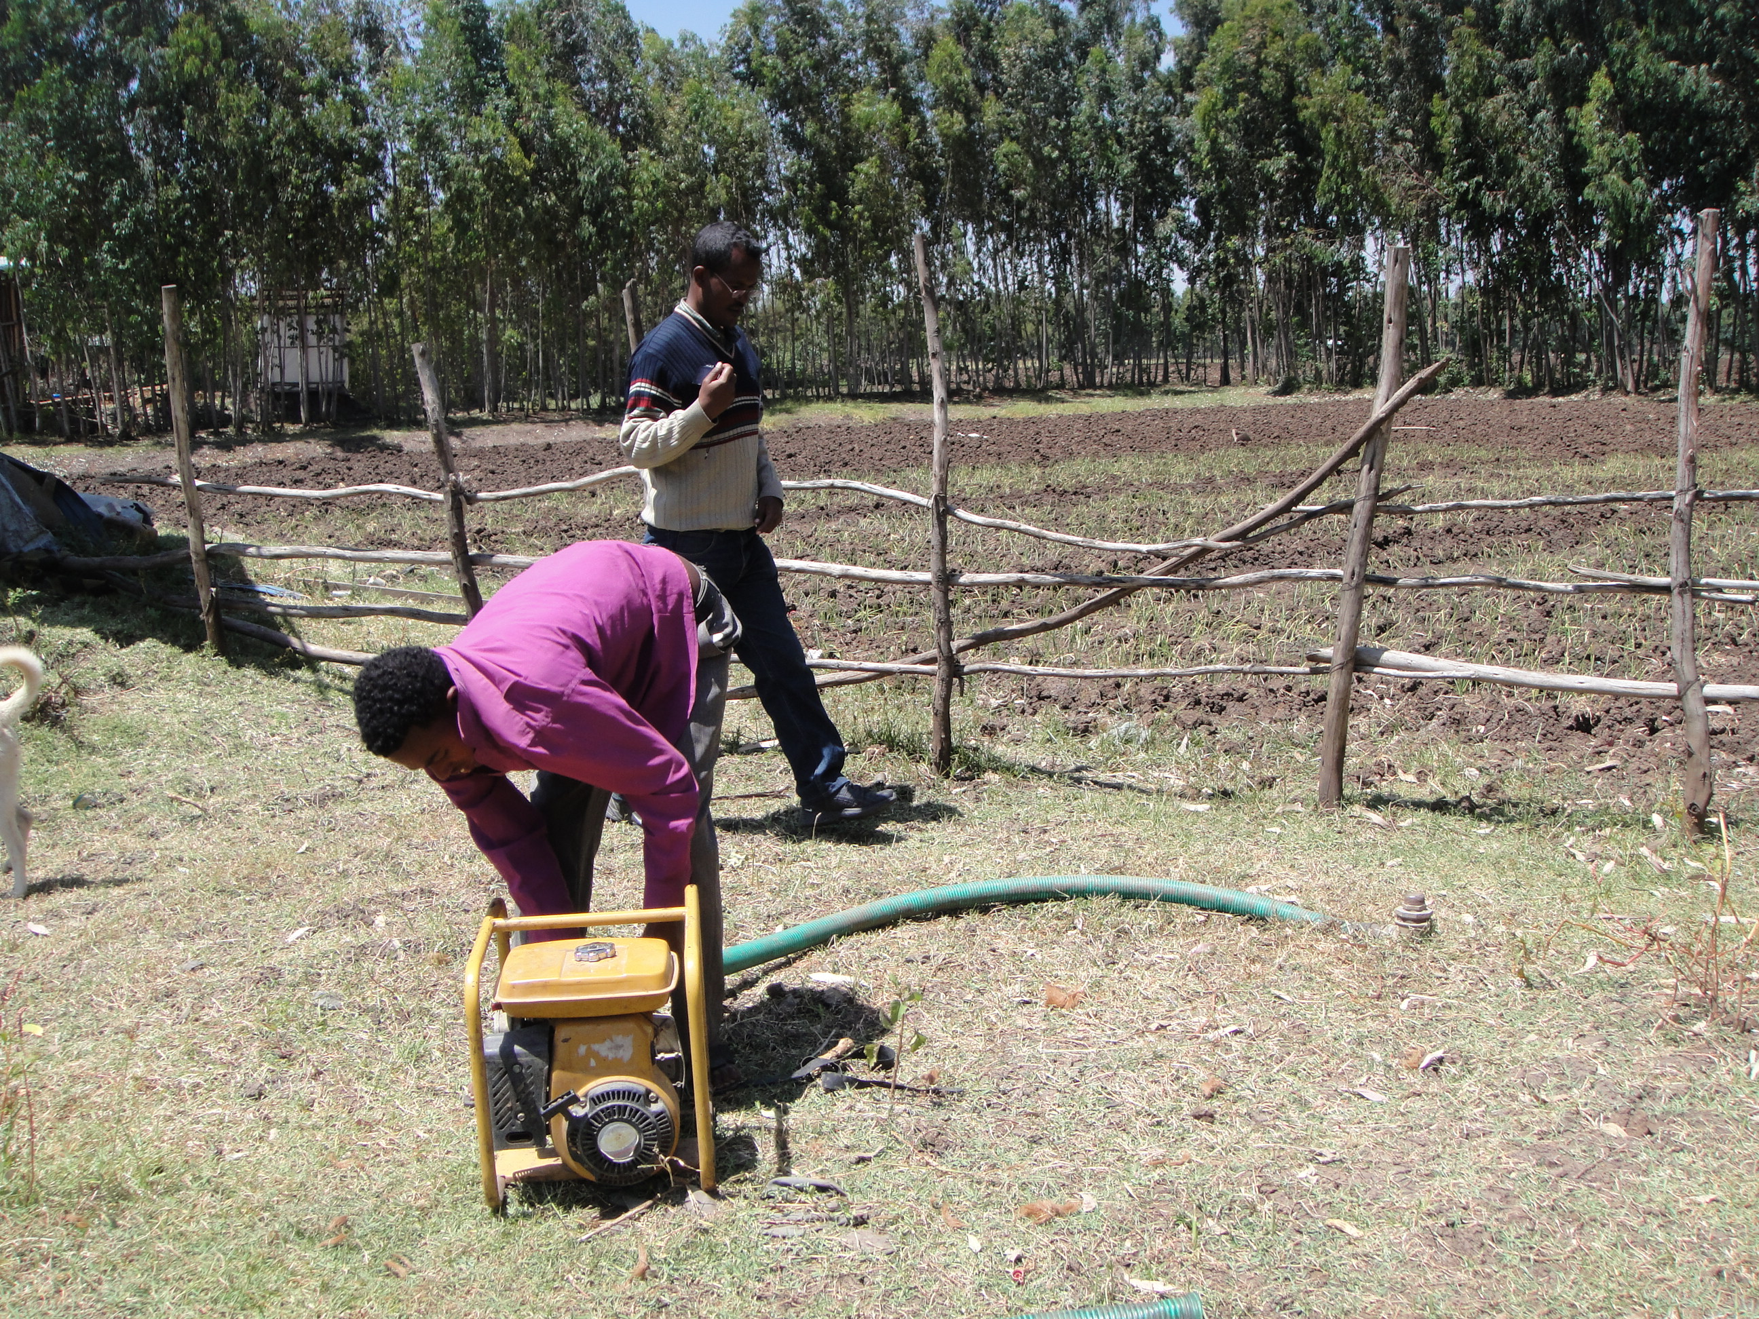

Slide 22
Special issues to tackle
Political:
Effect of dams
Land grabbing
Technical:
Multifunctional management
Sediment management
Invasive species
Special breeds, special varieties

Slide 25
Prosopis juliflora
Focus on removal of prosopis juliflora from water ways, highly productive land or land important for local food security. Keep close vigilance and intense use of these lands
Land using communities should be encouraged to uproot prosopis juliflora seedlings when they are still easy to remove.
Land use planning – not allow cattle movement between areas with prosopis juliflora
Combating and utilizing prosopis juliflora in communal lands should be supported. Ways must be found to empower communities to make joint efforts with governments and authorities and private sector (for instance in biomass conversion)
Explore innovative uses such as the use of prosopis juliflora bio-char or energy bio-mass
A new body of regulations is required to facilitate the commercialization of prosopis juliflora products. Policies must promote the production of charcoal and poles for fencing and construction, which until now is discouraged

Slide 26
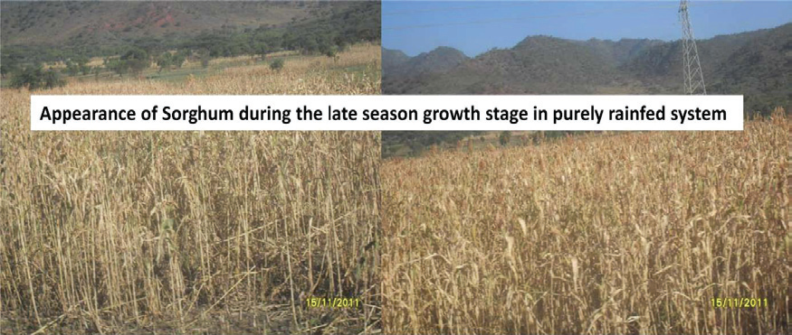
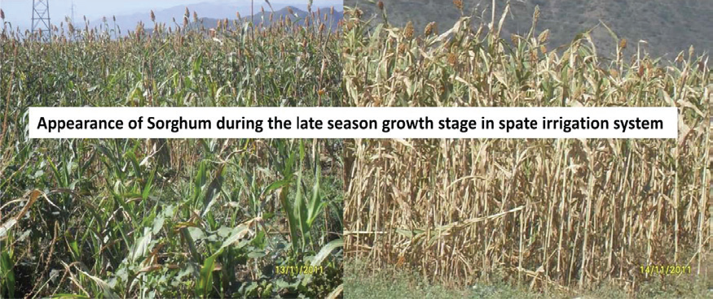

Slide 27
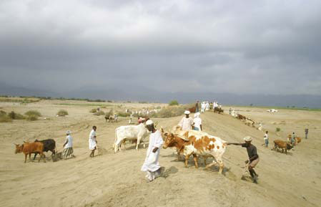
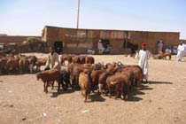
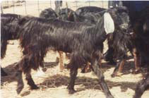
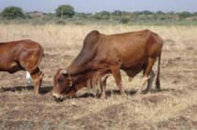
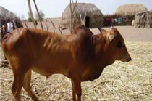
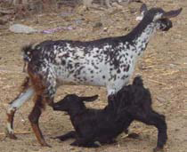
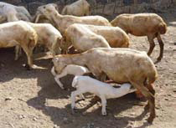

Slide 28
Livestock
Fodder and rangeland improvement
Livestock watering
Sustainable para-veterinary services
Processing and marketing of livestock products
Breeding and exchange programs
Animal genetic resources conservation

Slide 29
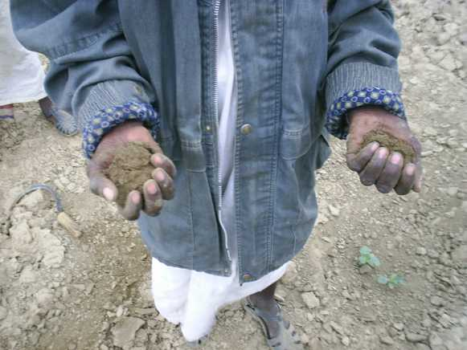

Slide 30
