Slide 1




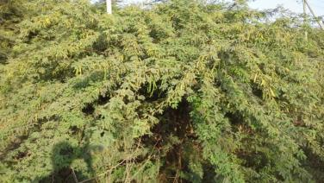
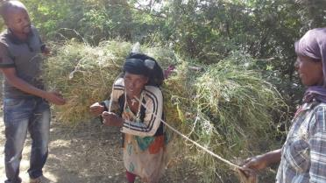
Total Economic Value of Prosopis Invasion: An economic assessment of the impact of Prosopis invasion and participative management approaches in Afar region, Ethiopia
John Ilukor, Regina Birner, Mesfin Tilahun & Shimelis Getu
Regional Conference on Managing Prosopis Juliflora for better
(agro-)pastoral Livelihoods in the Horn of Africa
May 1, 2014
Dessalge Hotel, Addis Ababa
Notes:
1

Slide 2
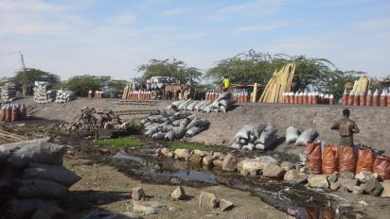
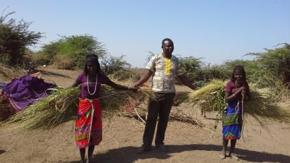
Introduction
The Prosopis dilemma
  Utilize/control or Eradicate
  Cost effective management
What are the benefits and costs?
    Utilization or control
    Eradication
    Inaction
Total Economic value
    Primary and secondary
Notes:
2

Slide 3
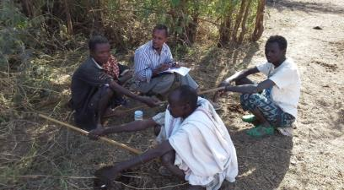
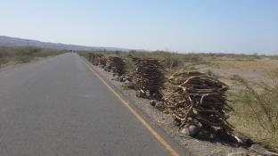
Materials and Methods: Techniques used
The total economic value (TEV)
    use values
    non-use or existence values
Valuation techniques
    Stated preference- non use values
    Revealed & stated preference-use values
    “Dose response function” or “production function”
Notes:
3

Slide 4
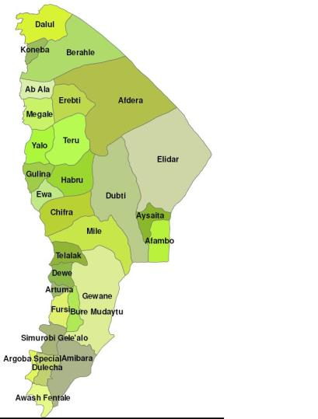
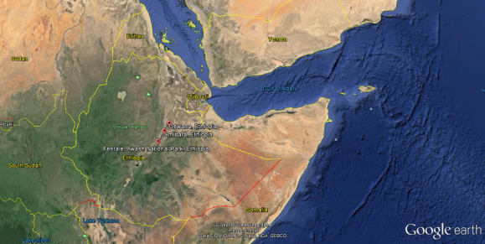
Materials and Methods: Study area
 | Sample size | Kebeles
Afar | 490 | 490
Gewane | 177 | 177
Amibara | 213 | 213
Awash Fentale | 100 | 100

Slide 5
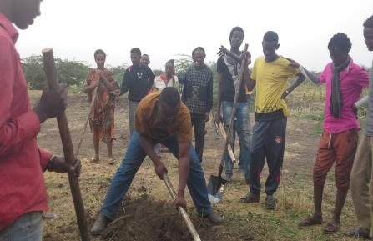
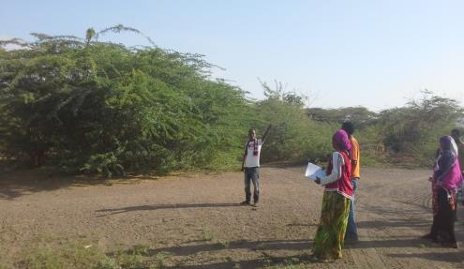
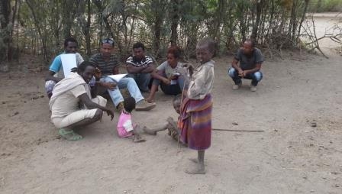
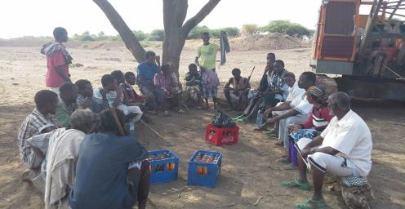
Materials and Methods: Study tools

Slide 6
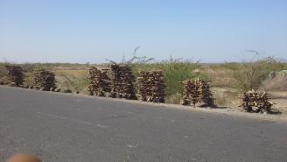
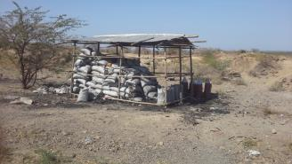
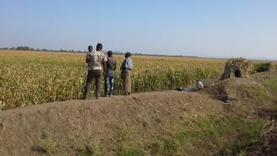
Economic Benefits
  Environmental income:
    Afar region -4 billion birr
  Desalinization
    More than 60million birr
  Carbon sequestration:
    200 million birr
  Crop production:
    Crop income 182 million birr

Slide 7
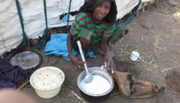
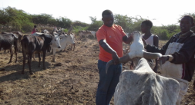
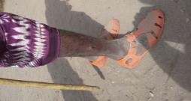
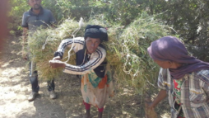
Negative impacts
  Negative impact on animal production :
    Milk loss-14million birr
    Weight loss 546 million birr
  Negative impact on animal health:
    A bout 182 million birr
  Negative impact on Human health:
    Total loss per household per year is $189
    470 million birr-Afar
  Biodiversity
    Pasture-1.04 billion birr

Slide 8
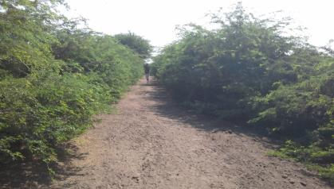
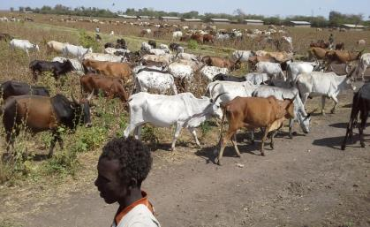
Total Benefits and costs
  Benefits 4.4 billion and costs 2.2 billion
  OECD guidelines on weighting
    UNDP definition of pastoralists
  If we do not control
    TEV =-37 trillion in 30 years
  If we control
    TEV = 92billion in 30 years
  Action is needed

Slide 9
Prosopis impact on climate variables
Complete eradication may result to loss of ecological benefits and environmental income
    Solar radiation, evaporation, and wind (-)
    Relative humidity and temperature
  absorption/trapping of solar radiation (Cao et al., 2010)
    Control use but eradication

Slide 10
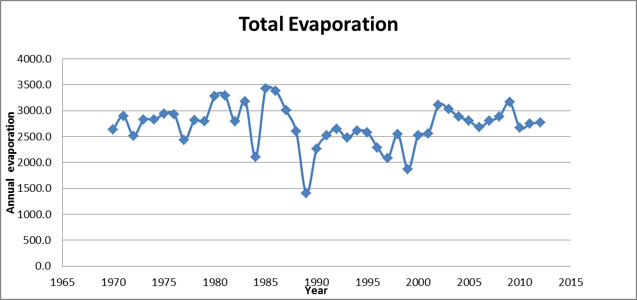
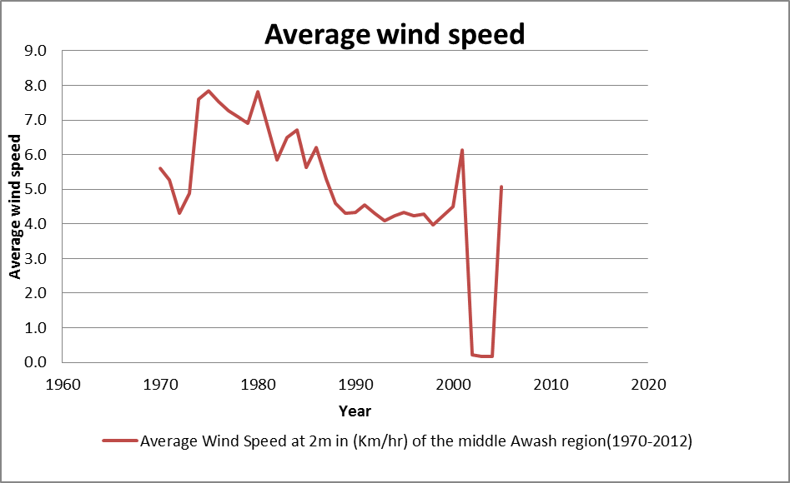
Total Evaporation and Average Wind Speed
Notes:
10

Slide 11
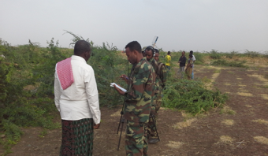
Management of prosopis
  Utilization Pod crashing
    Pod crashing (NB =-785 birr/yr)
    Charcoal burning (NB =7985 birr/yr)
ear each house hold cuts about 362 trees on average.
  Mechanical clearing – costs effectiveness
    Clearing without using wood (NB =-2826 birr/ha)
    Clearing & using wood (NB =30 birr)
    Clearing, using wood & digging roots (NB =-2116 birr)

Slide 12
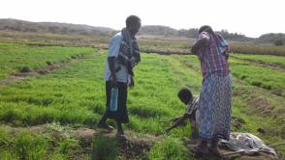
Management of prosopis
In a year each house hold cuts about 362 trees on average.
  Mechanical clearing charcoal burning
    Clearing without digging roots (NB =1630 birr)
    Clearing & digging roots (NB =-516 birr)
    Clearing, digging roots & crop production (NB =9484 birr)
    Clearing, digging roots & hay (NB =775 birr)
  Implications for sustainable management
    Mechanical is economical feasible with use
    Continued utilization either for fodder or crop production

Slide 13
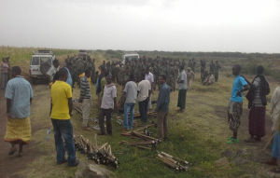
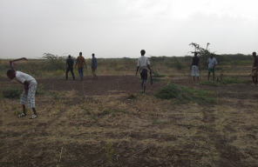
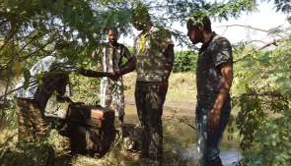
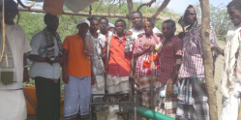
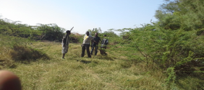
Requirements for sustainable management
e hold cuts about 362 trees on average.
  Involve pastoralists
    Communal land rights
    Empower clan institutions
    Rethink the mass clearing
  Provide high powered generators
    Those are willing
    And are along the river and water canals
  Seek pastoralists opinion
    Cutting equipment Vs generators

Slide 14
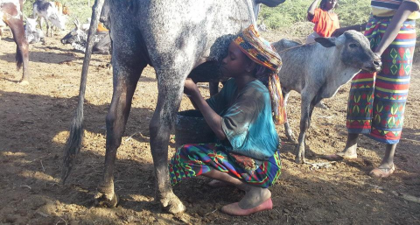
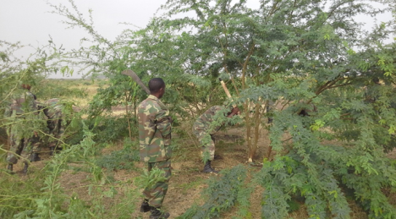
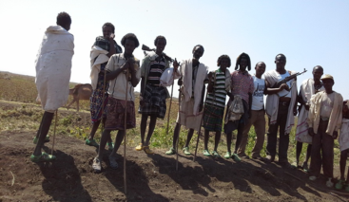
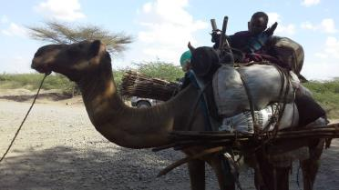
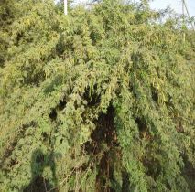


END OF THE PRESENTATION COMMENTS AND QUESTSTION ARE WELCOME
GEDEGA

