Slide 1
Establishment of Water Users Associations(WUAs) in the main Spate Irrigation Area in Tihama Region of Yemen
REPUBLIC OF YEMEN
MINISTRY OF AGRICULTURE
AND IRRIGATION
TIHAMA DEVELOPMENTAUTHORITY
HODEIDAH
الجمهورية اليمنية
وزارة الزراعة والري
الهيئة العامة لتطوير تهامة
الحديدة

Slide 2
Tihama Region of Yemen
The Tihama Region is one of the most important agricultural areas in Yemen where spate irrigation is predominantly practiced as a major source of livelihood for the rural poor. Spate irrigation mainly relies on floods that are unpredictable in occurrence and often destructive in nature

Slide 3
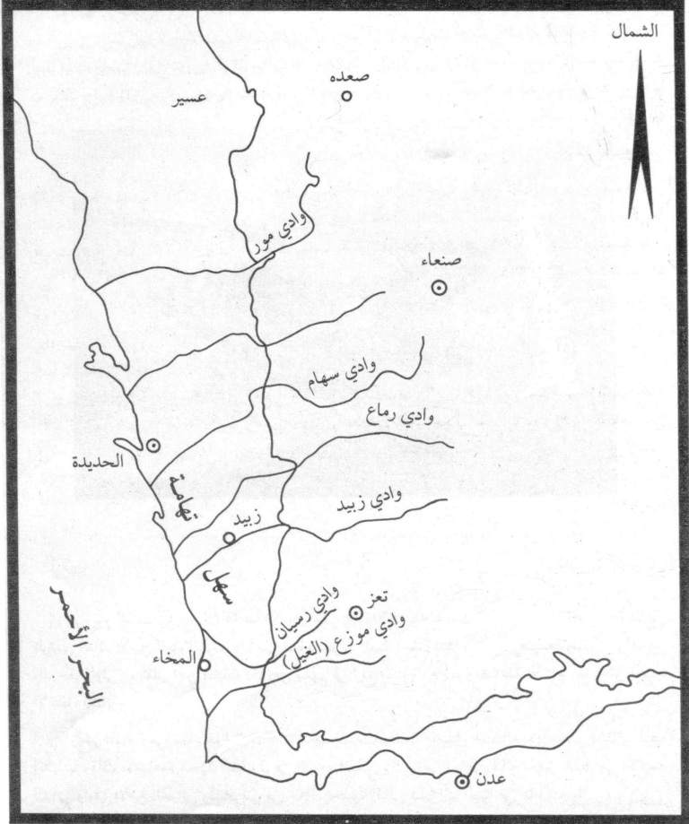
Republic of Yemen Map shows The Main Wadis of Tihama

Slide 4
Wadi Mawr Map

Slide 5
TA-TDA European Union Food Security Programs
The Tihama Development Authority(TDA) with support of The European Union Food Security Programs through Technical Assistance Project (TA) to the TDA in increasing water management and productivity in the Tihama Region, have embarked on the establishment of Water User Associations (WUAs) in Wadi Mawr, Wadi Siham and Wadi Rima’a

Slide 6
TA-TDA Project
To implement this Task, the TDA and TA assigned a Spate Irrigation and Participatory Irrigation Management (PIM) Specialist (Abraham Mehari Haile) to lead the WUA establishment approach with cooperation of Director of TDA Agriculture and Extension Director, This is because, the TDA and TA believe that WUAs could play a considerable role in the sustainable improvement of crop and livestock production through better operation and maintenance of the irrigation systems, improved agronomic practices, pest and disease control measures and other agricultural activities in the Tihama Region by significantly contributing to:

Slide 7
TA-TDA Project
Timely and appropriate operation and maintenance of the spate irrigation system in the Tihama;
Fair water sharing within and among the upstream, midstream and downstream farmers;
Adoption of improved agronomic practices, pest and disease control measures and other relevant agricultural practices

Slide 8
To be credible partners in the above noted activities, the WUAs, should, among other things, have:
A wide support base among the farming community;
A streamlined organizational structures process;
A well defined by-law
A Management Board

Slide 9
THE STEPS OF ESTABLISHMENT WUAs IN TIHAMA RIGION OF YEMEN
For WUAs to be viable and sustainable, the farmers, with the help of their elected representatives:
Should play a lead role throughout the WUA establishment process;
Should carefully evaluate the potential benefits of a WUA in relation to the tasks that they need to undertake. They should only decide to establish a WUA and take over responsibility for operation and maintenance of the systems and other agricultural activities, when they are confident that the economic gains will outweigh the extra tasks and obligations.

Slide 10
Informative and Follow up Farmers’ Meetings
The objectives
Assessment of the farmers interest in establishing WUAs
To Inform far obligations simple on some general purposes, benefits and Rights of WUAs
Get feedback on the last meeting
Further discuss the benefits and obligations of WUAs with farmers representatives from each secondary canal; preliminary explanation of the WUA process

Slide 11
pictures about Informative Meeting activities

Slide 12
pictures about Informative Meeting activities

Slide 13
pictures about Informative Meeting activities

Slide 14
pictures about Informative Meeting activities

Slide 15
Data base Survey
The objectives
Preparation of related data-base of the
Secondary and tertiary canal systems, their
command area and water users (farmers)
Retrieve all available secondary data: maps, names and land holding of water users
Walk through survey (see form 1)
Register all secondary and tertiary canals Refine and finalize farmer data base (names and landholdings) for each secondary and tertiary canal.

Slide 16
Annex 1: Walk-through survey form1 Name of Wadi: __________________ Name of secondary Canal: _________ Name of tertiary canal: ___________
No. | Full name of farmer | Area by Type of farmer (hectares) |  |  | Total Landholding area
 |  | Owner | Share cropper | Tenant | ha
1
2
The form is filled by:
Name: ________________________Signature: _____Date: _______
The form is checked by:
Name: _______________________ Signature: _____Date:________
Approved by: Director of Agriculture & Extension
Name: _______________________Signature: ______Date:________

Slide 17
Sample of Data Base Survey in Wadi Mawr
(Tihama Region of Yemen)
Number of Farmers and Land holding area of water users in Wade Mawr
S.N. | Name of secondary Canals | OWNER |  | SHARECROPPERS |  | TENANTS |  | TOTAL
 |  | No | area/ha | No | area/ha | No | area/ha | No | area/ha
1 | Al-Daraaniah | 547 | 1935 | 1 | 8.7 | 1 | 2 | 549 | 1945.9
2 | Al-Madbaeyah | 51 | 224 | 0 | 0 | 1 | 1.3 | 52 | 225.3
3 | Al-Maawasiah | 220 | 510.9 | 37 | 47 | 7 | 12 | 264 | 569.9
4 | Annasery | 10 | 56.1 | 57 | 122.6 | 0 | 0 | 67 | 178.7
5 | Al-Hezmeiah | 76 | 291.3 | 46 | 162.2 | 0 | 0 | 122 | 453.5
6 | Fath AlBary | 4 | 23.5 | 36 | 141.7 | 0 | 0 | 40 | 165.2
7 | Barrwdah | 27 | 154.8 | 27 | 145.2 | 8 | 18.3 | 62 | 318.3
8 | Ghulifekah | 25 | 105.2 | 36 | 110.5 | 3 | 25.3 | 64 | 241
9 | Attaheryah | 55 | 396.5 | 40 | 116.2 | 5 | 43 | 100 | 555.7
10 | Al-Bukeiriah | 60 | 179.3 | 61 | 153.5 | 3 | 7.8 | 124 | 340.6
Total |  | 3143 | 13873.5 | 1732 | 5921.9 | 256 | 873.8 | 5131 | 20656.5

Slide 18
pictures about Training of Extension Staff in Walk Trough Survey Subject

Slide 22
Selection of Lead Farmers
The objectives
responsible for the different activities till the formation of the WUAs.
Especially those Leaders considered as the preparatory committee for formation of the WUAs.
Organize separate meetings
Explain the role of the 'lead' farmers they are mainly going to be responsible for the different activities till the formation of the WUAs
Explain the main criteria for selection of 'lead' farmers

Slide 23
Criteria & Ranking the selected lead farmers
Name of Wadi: ____Name of S. Canal: _________ Name of tertiary canal: ____Name of Selected Farmer_____
Selection criteria | Ranking by the farmers
 | 1 (least suitable) | 2 | 3 | 4 | 5 (most suitable)
1. Able to read and write properly
2. Respected as a good and hard working farmer in the area
3. Successful involvement in fair water distribution and conflict mitigation
4. Knowledge of basic characteristics of WUAs - boundaries, hierarchy of leadership
5. Farmed and continuously lived in the area for at least 10 years
6. Farming is a major source of livelihood (contributes > 75% of household income)
7. Willingness to devote time for establishment of the WUA
8. Positive motivation to establish a WUA

Slide 24
pictures about Selection of Lead farmers activities

Slide 28
WUAs Training for Leader Farmers and Extension staff
TRAINING MODULE 1
PROCESSES AND REASONS FOR ESTABLISHMENT
OF A WUA
Objectives of the training
This training aims at enhancing the understanding of and getting feed back from the lead farmers and extension staff of the TDA on:
The WUA establishment strategy;
The expected roles of the lead farmers and extension staff during the whole process of WUA establishment;
The purpose, tasks and responsibilities, rights and potential benefits of organizing farmers into WUAs;

Slide 29
WUAs Training for Leader Farmers and Extension staff
TRAINING MODULE 2
ORGANIZATIONAL CHARACTERISTICS OF A WUA
Objectives of the training
This training module intends to help the lead farmers and TDA Extension staff comprehend the following characteristics of WUAs:
Key features of a WUA (ingredients of viable and sustainable
(WUAs)
Constitution and by-laws
Membership criteria
Size and boundaries of the WUA
Organization structure
Decision-making
Federation of WUAs into a larger organization
Link with the TDA and other Government organizations
Registration of the WUA as a legal entity

Slide 30
WUAs Training for Leader Farmers
Training structure and approach
The training modules have both informative and
interactive components
Informative part
In the informative part, the flow of information will
mainly come from the trainers
Interactive part
In the interactive part, the farmer leaders and
extension staff will form groups of 5 to 7 persons
each and will discuss some of the topics:

Slide 31
WUAs Training for Leader Farmers
Examples of Some Discussing Topics:
Why do they think they need to form WUAs?
What kind of tasks are they willing and able to undertake and what responsibilities to shoulder?
What are the potential benefits they want to attain by forming WUAs?
What makes the WUA a viable and long-lasting organization?
what are the constitution and by-laws relevant to your area? What is its function?
What are the membership criteria that you consider
Do you think there should be any membership charges? If yes, how much?
How often do you coordinate now with the TDA?
What do you need to be improved in this coordination?

Slide 32
Training of farmers by the lead farmers
WUAs are to be established only when the majority of the concerned farmers, after having understood and carefully weighed the potential benefits and rights on one hand and the obligations and responsibilities on the other, show a genuine desire to organize themselves into WUAs. They have to demonstrate this desire by enthusiastically participating at all stages of the WUA establishment process.

Slide 33
Training of farmers by the lead farmers
The Training of Farmers in Tertiary canal by Lead Farmers in above Modules of training
gives a good knowledg to mijoraty of
farmers About:Rights, obligations,
benefits and responsibilities of being a
member of a WUA
Size and boundaries
Membership criteria
Appropriate organizational structure

Slide 34
some pictures about Training

Slide 40
Formation of Water Users Associations (WUAs)
After the implementation of the previous training of leaders, have become well versed in writing bylaws for their association, however the farmers need some support of extension staff.
Steps of Formation:
Preparation of a WUA working document (ByLaws)
Approval of the By-Laws by more than two third
of the concerned farmers by 1-2 meetings in the
secondary canals,
election of WUA leaders in the presence of about
two third of the respective farmers (foundation
members),

Slide 41
some pictures showing Steps of Formation of WUAs in Tihama. Yemen.

Slide 48
Strategy for strengthening WUAs in Tihama Region
At the core of the strategy for strengthening and ensuring the long term viability of WUAs is:
Having a Management Board that is aware of its core tasks and activities and that possess the necessary technical, managerial and financial capability to effectively carryout these tasks and activities

Slide 49
Strategy for strengthening WUAs in Tihama Region
The strategy entails the following elements:
Training WUA Management Board members on “Managing WUAs”;
Training WUA Management Board members on “sustainability of WUAs”;
On-site practical training of WUA Management Board on technical features of the Wadi spate irrigation system;
Placing the WUAs at the centre of the agricultural extension activities
Providing small works contract to WUAs
Provide extra incentive to outstanding WUA Management Board members that take concrete initiatives that bring about benefits to the WUA
Making contacts with development agencies
Organizing and implementing small repair and maintenance works.

Slide 50
Thank you
Please Watch this 8 minutes Video which talk about
Converted Dams
in Tihama Region of Yemen

