Slide 1
Unlocking the potential in spate irrigation: Improved Support and Improved Governance

Slide 2
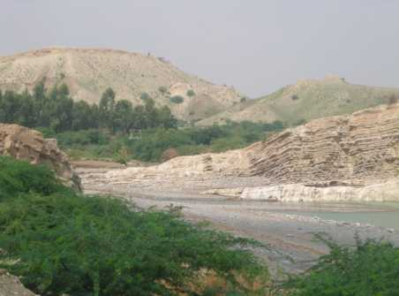
Some basics
Area known around 2,600,000 Million
North Africa – in decline
Horn of Africa – increase for crop, livestock. agroforestry
Elsewhere in Africa – livestock related
Middle East – highly productive conjunctive systems
Iran and Pakistan – largest area, but neglected
Central Asia and Latin America – the great unknown

Slide 3
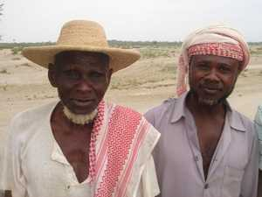
Some more basics
People directly dependent on spate irrigation systems: 9-13 Million
Poverty pockets
Difficult and risky but can contribute substantially to food security, poverty reduction, adaptation to climate variability
Improvement options in
Agricultural production
Non agricultural production
Improving livelihoods

Slide 4
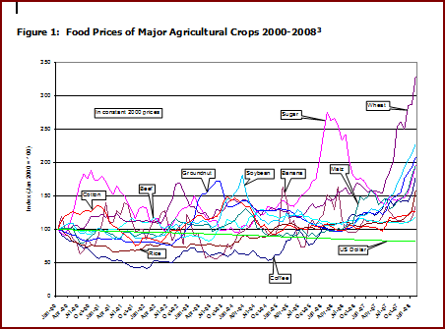

Slide 5
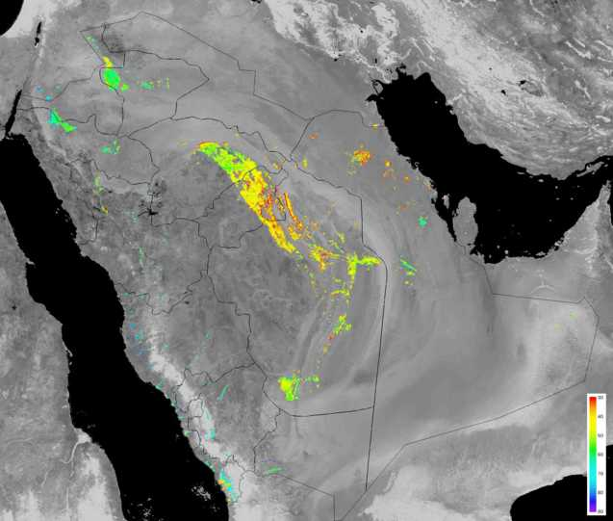
Irrigation efficiency (consumption/supply) for all irrigated areas in Saudi Arabia averaged for the period 1975 to 2005. The wheat belt with (badly managed) centre pivot irrigation systems have an efficiency of 40%. The highest efficiencies (70%) are obtained at the spate irrigation systems along the Red Sea coast!
Source: WaterWatch

Slide 6
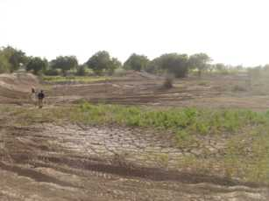
Case: Mochiwal Flow Division
Darabam Zam
North channel:
500 ha
low lying area
Mochiwal Division Point
West Canal:
- 3000 ha

Slide 7
Comparing..
Perennial irrigation (dam based) | Spate irrigation
Secure supplies – provided dam has reasonable catchment and manageable sedimentation | Insecure supplies unless combined with groundwater irrigation
In shallow dams high evaporative losses, in deep reservoirs not too much | Water storage in soil profile/ shallow aquifer – low evaporation losses
Investment costs per m3 stored is high | Investment cost per m3 stored is low (if there is a fresh water aquifer)
Sedimentation may cause siltation (and prevents recharge) | Sedimentation contributes to fertility
Can store peak flows | Cannot utilize all peak flows, but shallow reservoirs may be added within command area

Slide 8
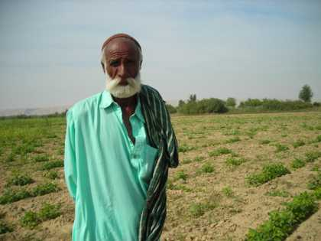
Agricultural production - 1
New crops – biofuels, oil seeds, legumes, cucurbits, medicinal plants/ herbs
New varieties and exchange of varieties
Improved crop husbandry – seed treatment, weed control, target use of agri-inputs, etc
Market chains for main crops – capture changing market
Market chains for minor crops – mushroom, guar
Improved grain storage
Research and documentation

Slide 9
Crop yields often vary with factor 3-5 Indicating scope for improvement of crop production with agronomic and field water management improvements

Slide 10
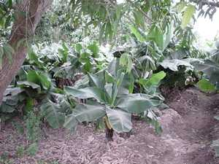

Slide 11
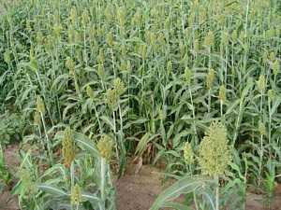

Slide 12
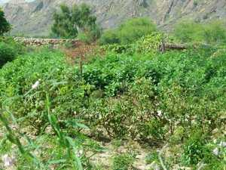

Slide 13
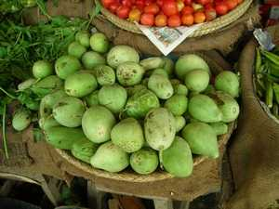

Slide 14
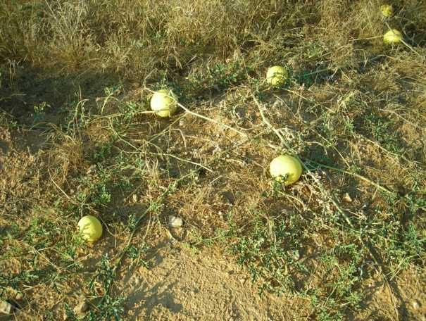

Slide 15
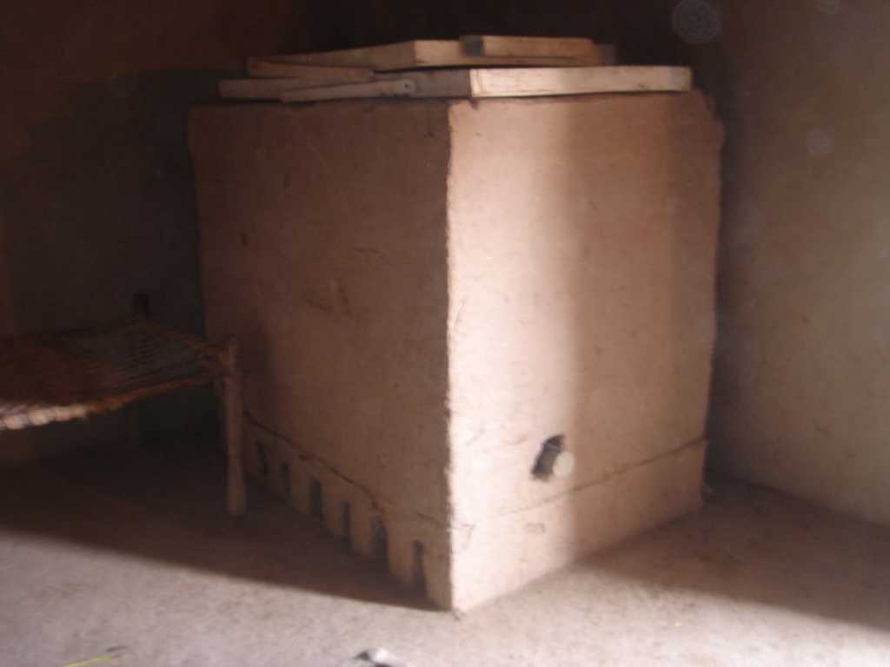
Improved grain storage
Detached
from the
wall
Opening to
take grains
Detached
from the floor

Slide 16
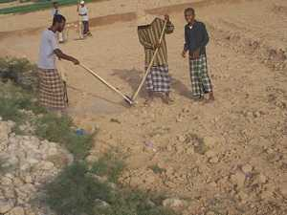
Agricultural production - 2
Improved soil moisture management
Pre irrigation planting
Promote burrowing rodents, crusteans and insects
Improved field overflow structures
Ploughing, mulching, field bunding
Rules on maintaining field bunds
Water distribution to allow second turns – keeping command area compact

Slide 17
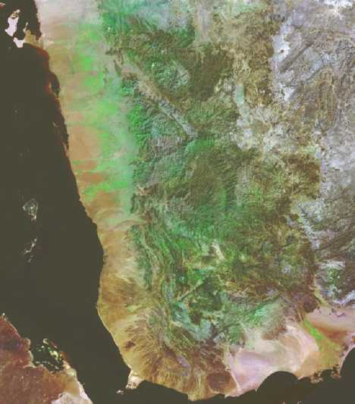

Slide 18
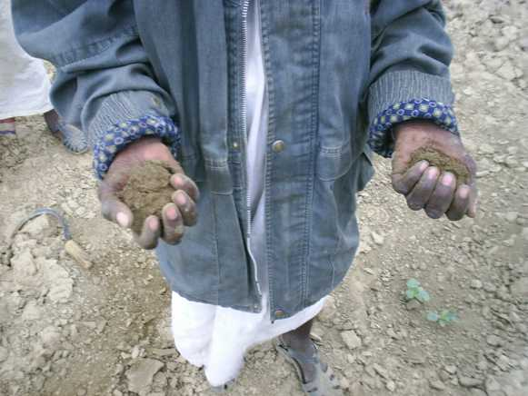

Slide 19
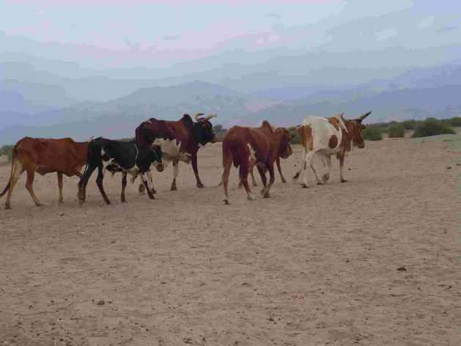

Slide 20
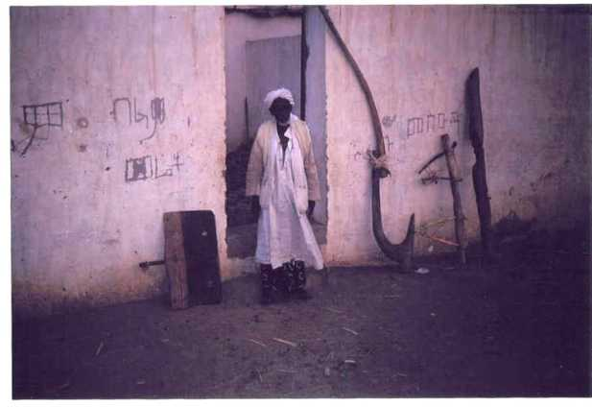

Slide 21
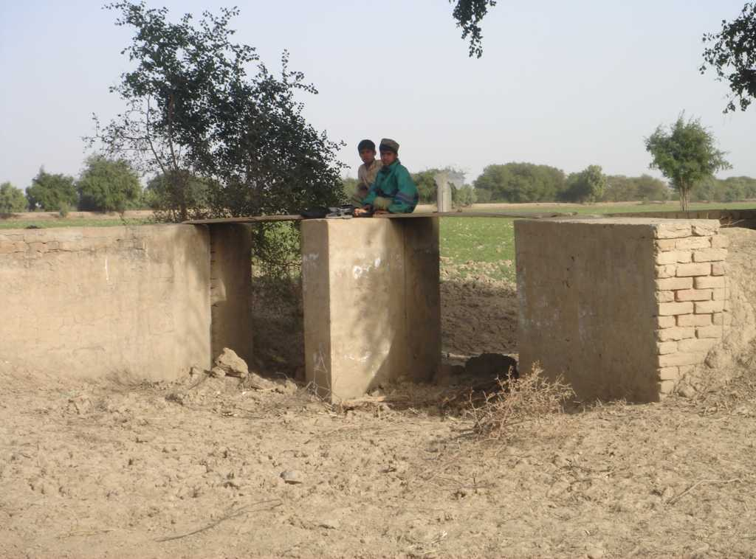
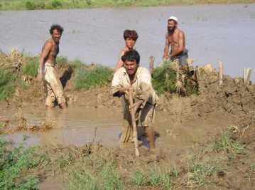

Slide 22
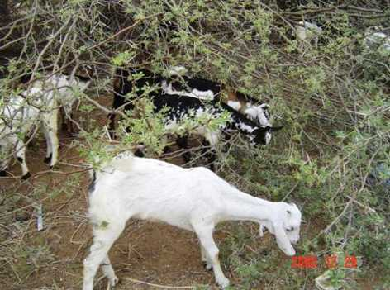
Non - agricultural production
Improved livestock production
Restocking
Paravet services
Improved breeds (exchange)
Range land improvement
Improved agroforestry
Spate agroforestry
Uprooting invasive species
Improved marketing of non timber products
Selective tree cutting bans

Slide 23
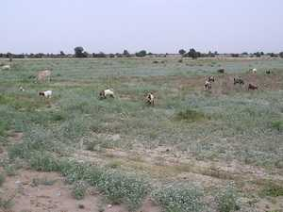

Slide 24
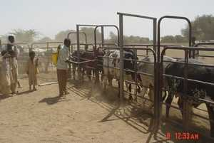

Slide 25
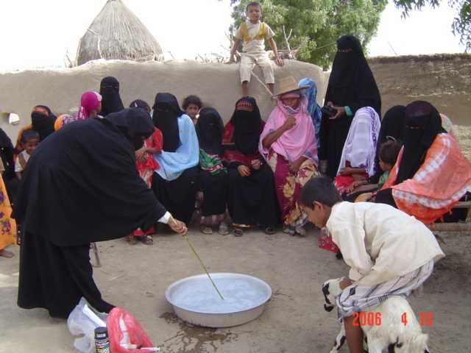

Slide 26
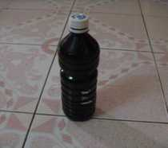
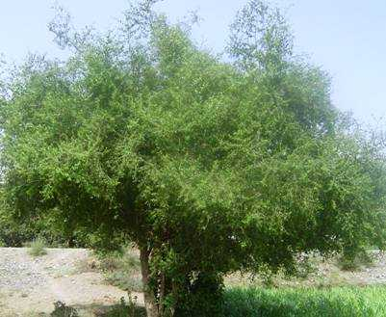

Slide 27
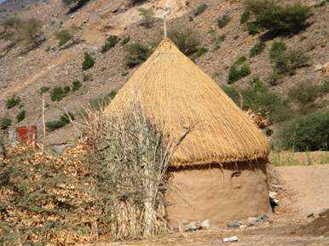

Slide 28
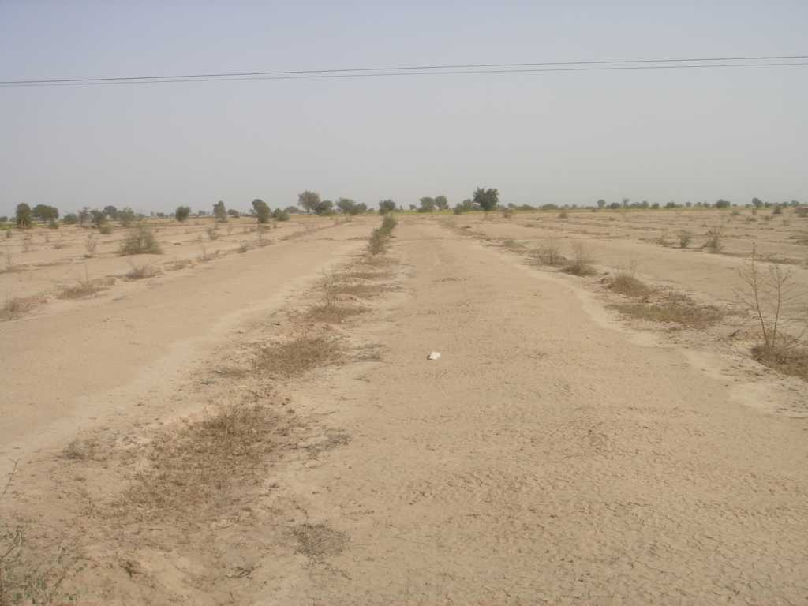
Forest plantation in DI Khan (year 1)
Slope towards plants

Slide 29
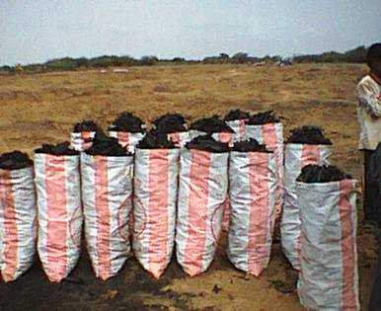

Slide 30
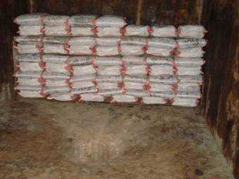
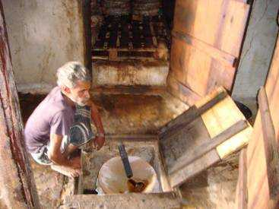
Kitara traditional production system: Documentation in Riman Village
Dripping black fluid flows on Concrete floar and is collected in a hole (traditional)
Dripping black fluid is collected through a pipe into a container with a cloth filter on top (improved traditional)

Slide 31
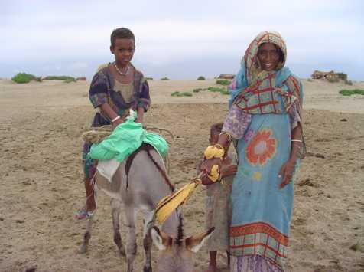
Improved livelihoods
Drinking water improvements
Improved drinking water ponds
Sand dams
Wells in dry rivers
Managed artificial recharge through low weirs, subsurface dams and water spreading
Water distribution tailored to groundwater recharge
Protection measures
Village flood protection
River bank protection
Dune stabilization
Eradication of malaria and tryposonamis

Slide 32
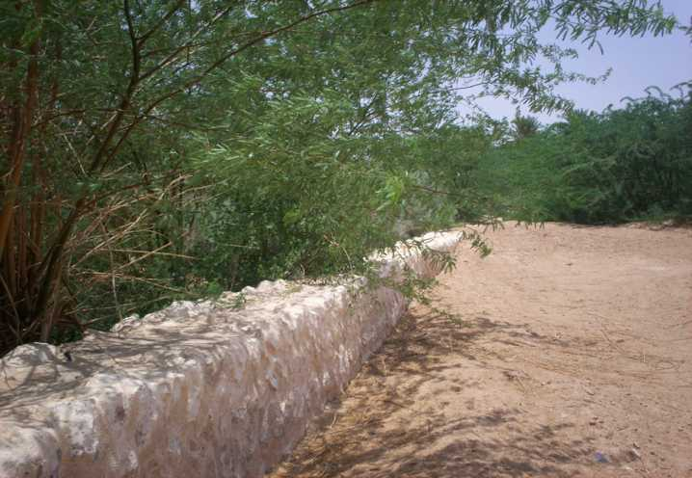
LOW RECHARGE WEIR
TO SLOW DOWN AND SPREAD FLOODS

Slide 33
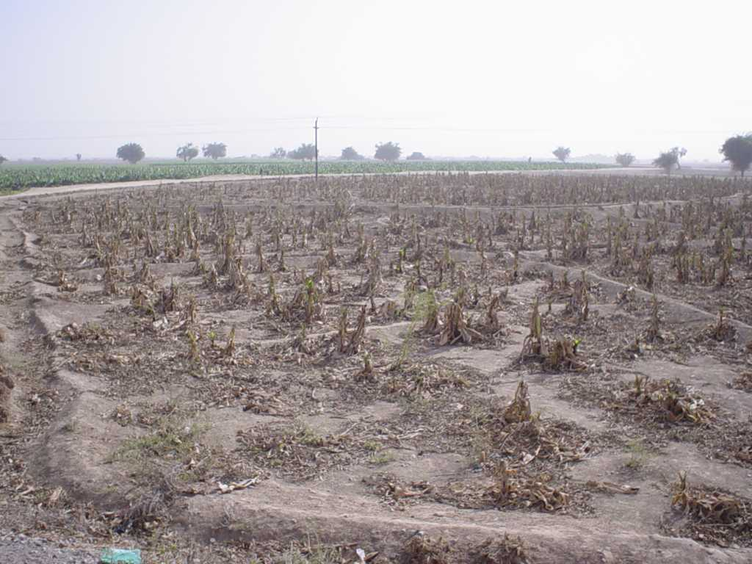
Yet overuse occurs
Banana plantation (Yemen) failed
because of ingression of saline water

Slide 34
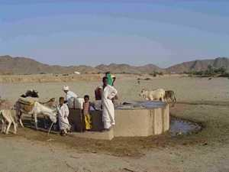

Slide 35
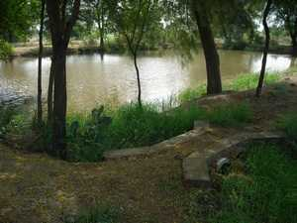

Slide 36
Hand Pump Sand Filter
Filter of graded
layers of sand

Slide 37
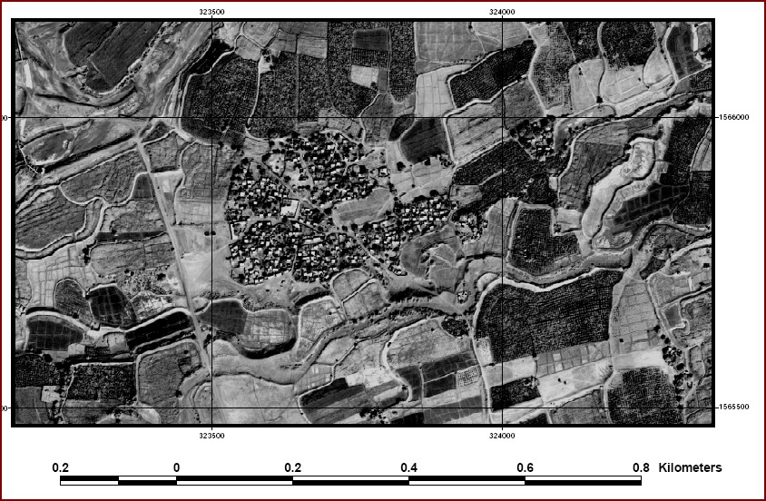

Slide 38
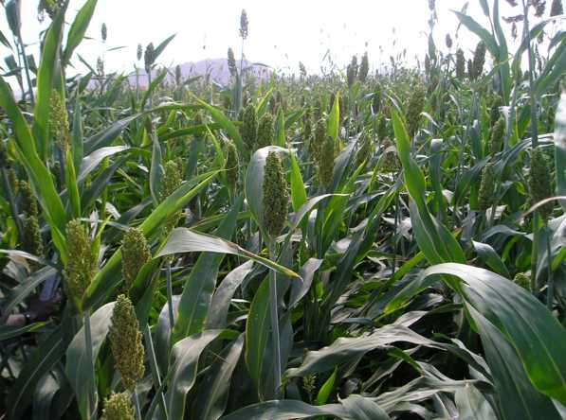

Slide 39
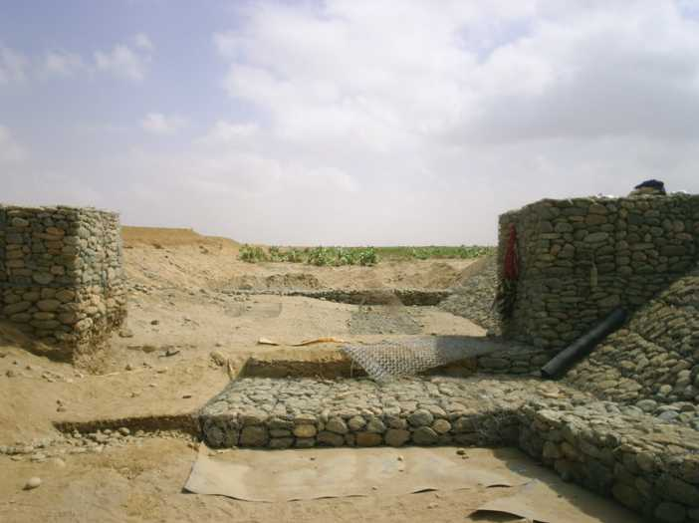
Important to survey channel bed
downstream and check for gullies
SOME HINTS
The downsteam apron should
be long and deep enough to withstand
the upstream formation of gullies

Slide 40
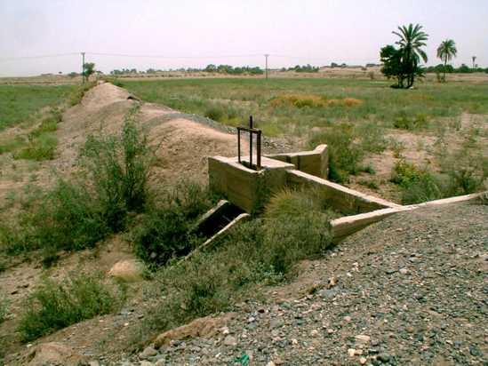

Slide 41
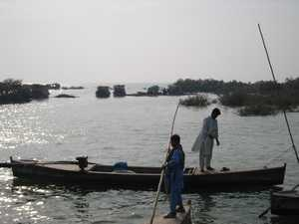
Improved governance - 1
Wadi management at basin or subbasin level
Upstream/ downstream use
Maintain river morphology
Groundwater recharge
Flood management
Catchment management and dune stabilization
Biodiversity and natural vegetation (and control invasive species)

Slide 42
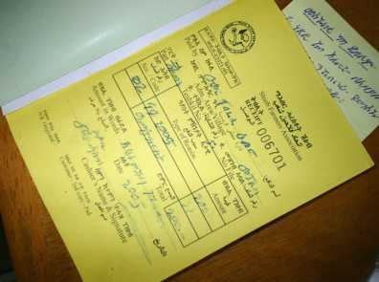
Fee collection system is well-organized
Different source of income: annual fees, fines, penalties

Slide 43
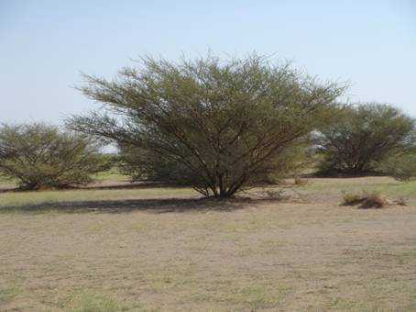
Improved governance - 2
Secure land tenure and safeguarding of water rules
Land registration
Codification
Strengthen local organization for rules enforcement

Slide 44
