Slide 1
Education in Watershed Management and Artificial Recharge of Groundwater in Fars province , Iran
Workshop on Mainstreaming spate irrigation in higher education, Delft, The Netherlands, 20-22 Sept 2010
Prepared by:
Mazda Kompanizare (assisstant Prof., Shiraz University, Iran)
Ahang Kowsar (Emeritus Prof., Fars Agriculture and Natural Resources Research Center, Iran)
Shakiba Aghaamiri (MSc student, Shiraz University, Iran)
Saieed Boostani (Fars Watershed Management Organization, Iran)
Mohammadreza Khoshnami (Fars Watershed Management Organization, Iran)
Fakhreddin Afzali (Assistant Prof., Shiraz University, Iran)

Slide 2
In southwest of Iran The range and basin morphology, coarse alluvium and the end of monsoon rains made this areas suitable for spate irrigation and Artificial recharge of groundwater About 40,000,000 hec are good for Artificial Recharge of groundwater and 30,000,000 hec for spate irrigation Alluvial aquifers have the capacity for storing 5000Km³ water, 11 times of annual rainfall of Iran, enough for water supply during 40 years based on recent consumption In most parts of southwest and south of Fars more than 50% of water supplied by Spate irrigation The main part of funds in Jihad Organization is spending for watershed Management, Floodwater control and reduction of sediment load of flood water Relying on its 20 years academic experiences on Artificial Recharge of Groundwater by Spate Irrigation, Iran has the ability for training the people from developing countries. These services can be presented upon the request of the official international organizations.
Workshop on Mainstreaming spate irrigation in higher education, Delft, The Netherlands, 20-22 Sept 2010

Slide 3
1.Studies and Technical Services
4.Promotion and Participation
Watershed Management
2.Executive Activities
3.Land Suitability assessment
And GIS
Workshop on Mainstreaming spate irrigation in higher education, Delft, The Netherlands, 20-22 Sept 2010

Slide 4
1.Hydrology
Field of studies
relevant to watershed
Management
and reduction of
floodwater
sediment load
2.Soil and Sediment
3.Vegetation cover
4.Geology
5.Economy
6.Society
7.Civil Engineering
Workshop on Mainstreaming spate irrigation in higher education, Delft, The Netherlands, 20-22 Sept 2010

Slide 5
1. Mechanical
2. Biological
Executive
activities
3. Biomechanical
Workshop on Mainstreaming spate irrigation in higher education, Delft, The Netherlands, 20-22 Sept 2010

Slide 6
Executive activities
Mechanical
1. Flood water and sediment Control
2.Groundwater recharge
1.1-Earth Embankment
2.1-Flood Water Spreading
2.2-Artificial Recharge
1.2-Stone Mortal Dams
Workshop on Mainstreaming spate irrigation in higher education, Delft, The Netherlands, 20-22 Sept 2010

Slide 7
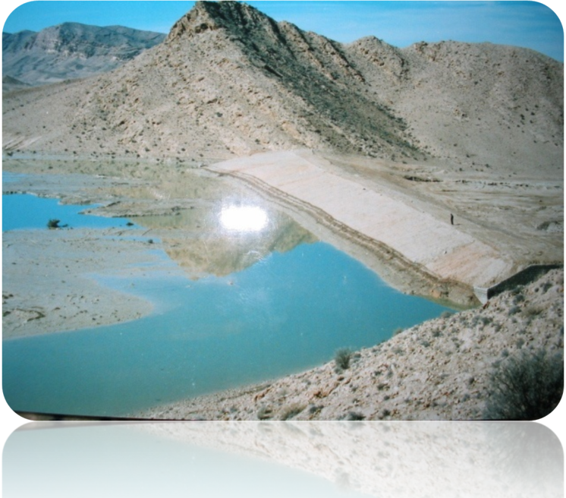
Earth Embankment
Larestan
Workshop on Mainstreaming spate irrigation in higher education, Delft, The Netherlands, 20-22 Sept 2010

Slide 8
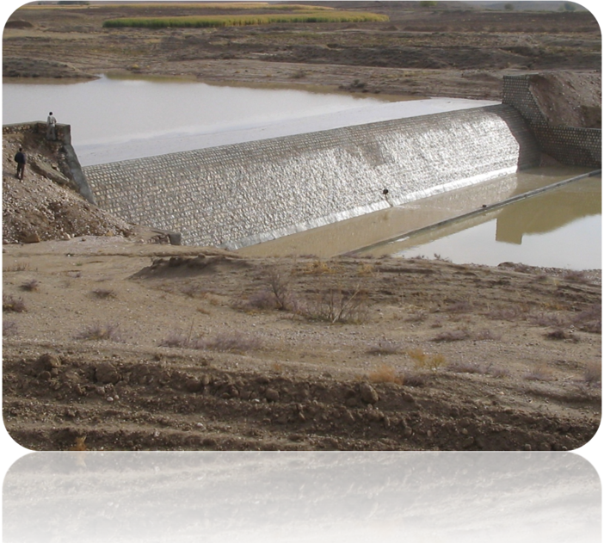
Stone Mortal Dams
Vasel abad - Fasa
Workshop on Mainstreaming spate irrigation in higher education, Delft, The Netherlands, 20-22 Sept 2010

Slide 9
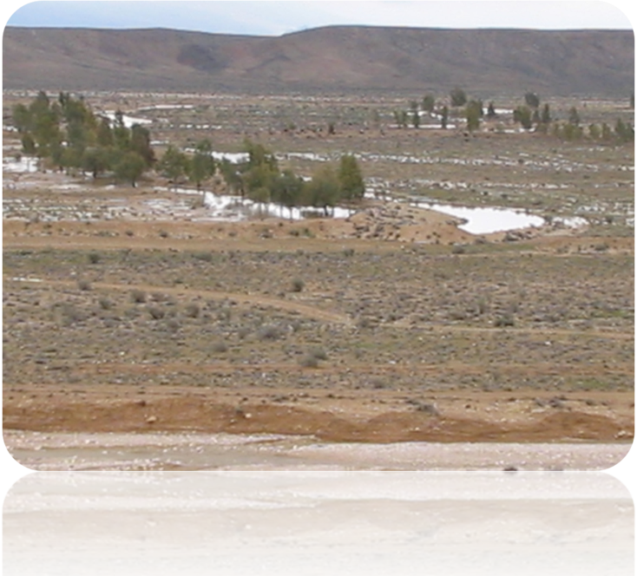
Flood Water Spreading
Doodej Abad-Fasa
Workshop on Mainstreaming spate irrigation in higher education, Delft, The Netherlands, 20-22 Sept 2010

Slide 10
Artificial Recharge
Darehbad-Fasa
Workshop on Mainstreaming spate irrigation in higher education, Delft, The Netherlands, 20-22 Sept 2010

Slide 11
Biological Activities
1.Transplanting
4.Enclosure
2.Seeding
3.Hole seeding
Workshop on Mainstreaming spate irrigation in higher education, Delft, The Netherlands, 20-22 Sept 2010

Slide 12
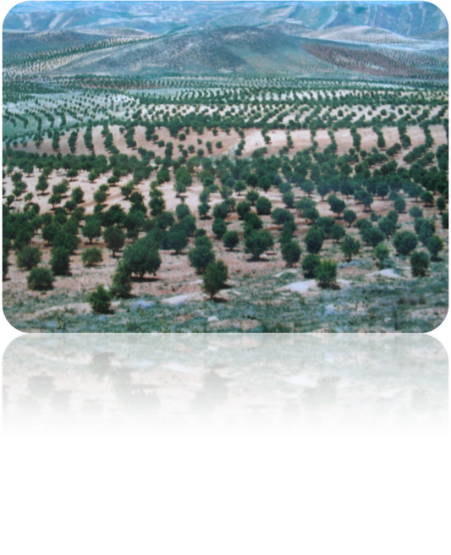
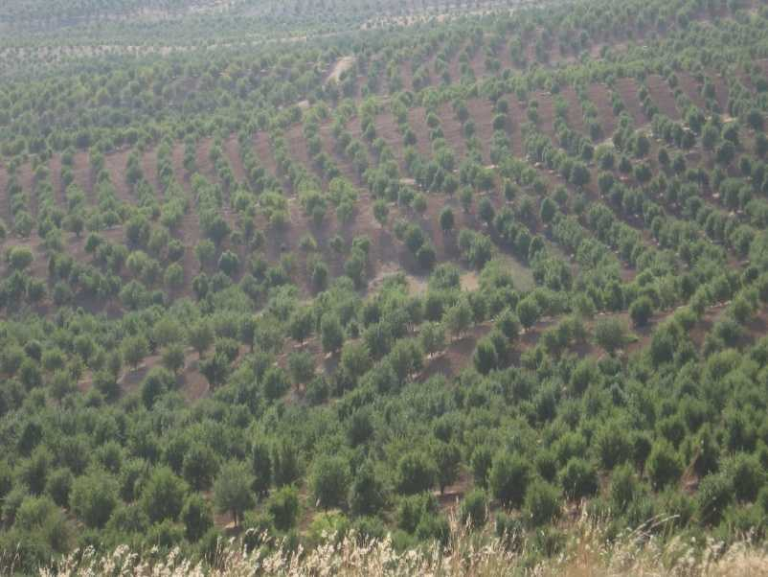
Transplanting
Eghlid
Workshop on Mainstreaming spate irrigation in higher education, Delft, The Netherlands, 20-22 Sept 2010

Slide 13
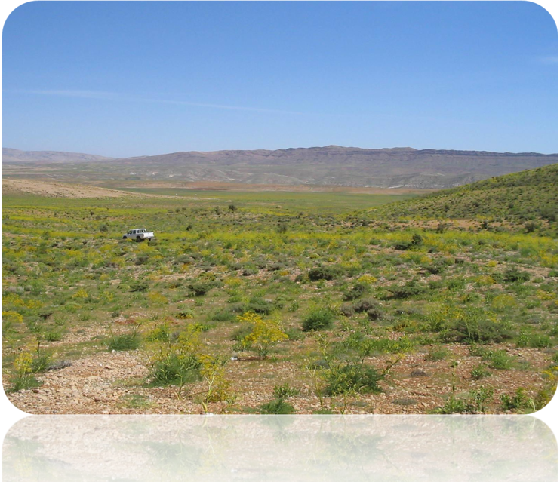
Seeding
Workshop on Mainstreaming spate irrigation in higher education, Delft, The Netherlands, 20-22 Sept 2010

Slide 14
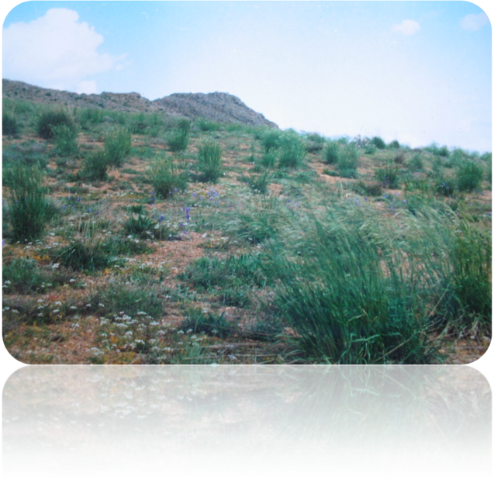
3.Hole seeding
Khosro shirin Eghlid
Workshop on Mainstreaming spate irrigation in higher education, Delft, The Netherlands, 20-22 Sept 2010

Slide 15
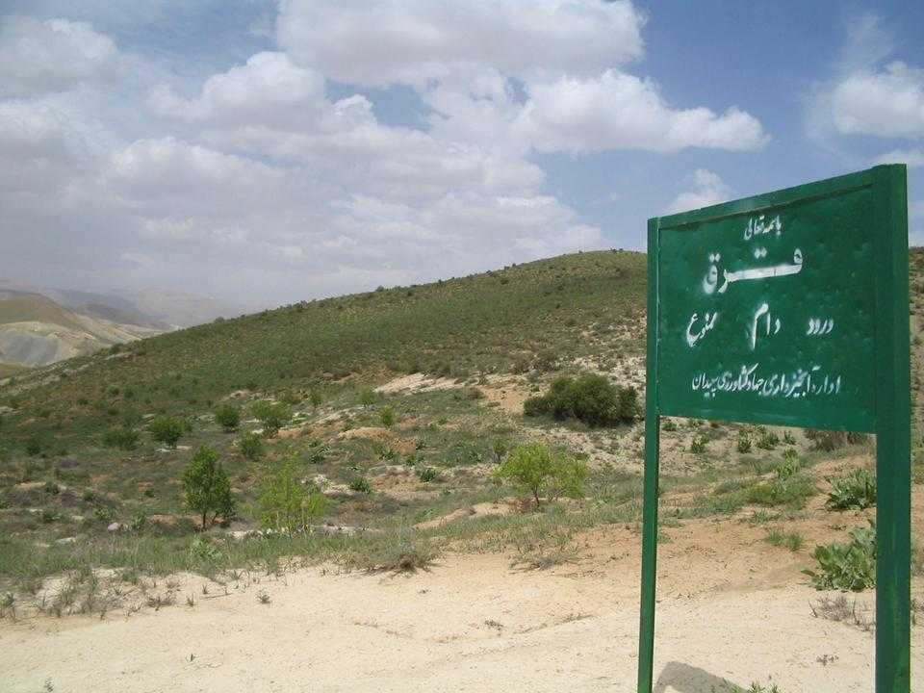
4.Enclosure
Khosro shirin Eghlid
Workshop on Mainstreaming spate irrigation in higher education, Delft, The Netherlands, 20-22 Sept 2010

Slide 16
1.Banquette
Biomechanical
activities
3.Terracing(2)
(1)2.Terracing
4.checkdam
4.1:Rock dam
4.2:Brush gully check
4.3:Cribbing/timber dam
Workshop on Mainstreaming spate irrigation in higher education, Delft, The Netherlands, 20-22 Sept 2010

Slide 17
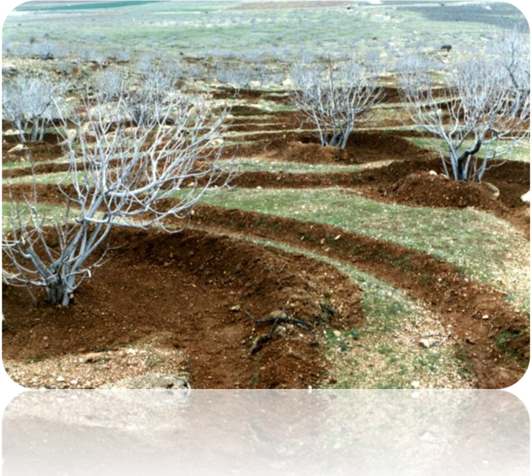
1.Banquette , contour furrows
Anjirestan-Estahban
Workshop on Mainstreaming spate irrigation in higher education, Delft, The Netherlands, 20-22 Sept 2010

Slide 18
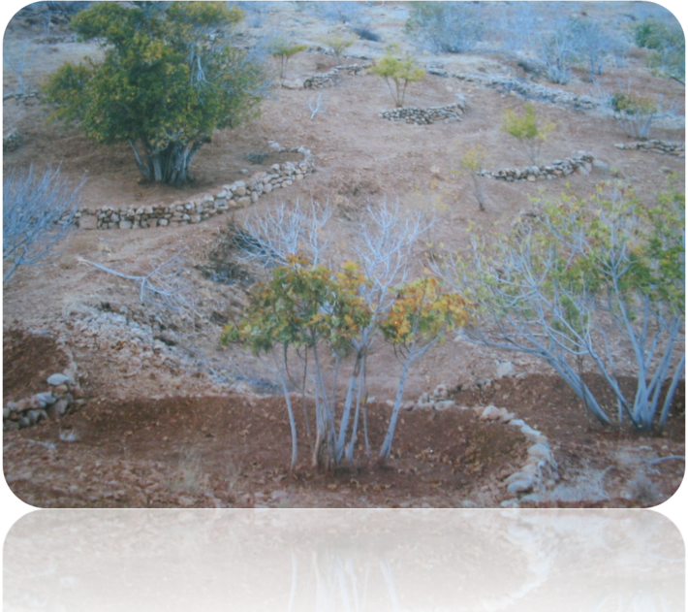
2.Terracing(1)
Kavar
Workshop on Mainstreaming spate irrigation in higher education, Delft, The Netherlands, 20-22 Sept 2010

Slide 19
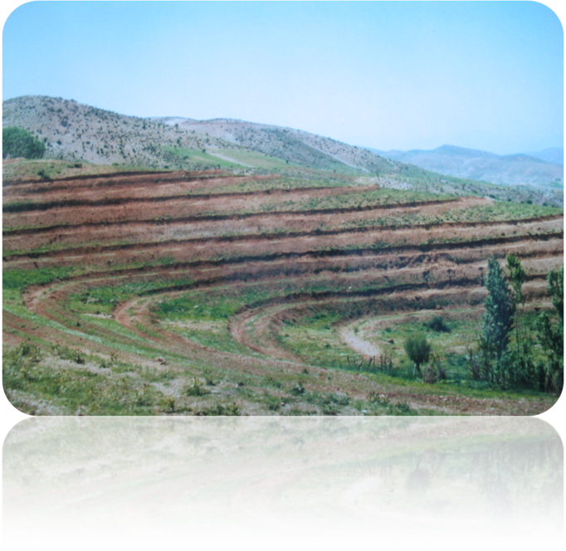
3.Terracing(2)
Sepidan
Workshop on Mainstreaming spate irrigation in higher education, Delft, The Netherlands, 20-22 Sept 2010

Slide 20
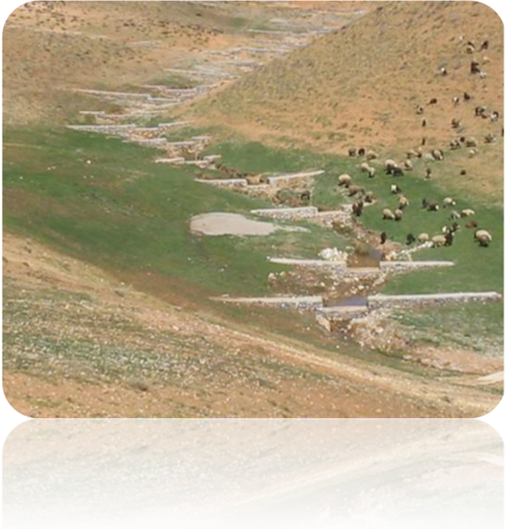
4.1:Rock dam
Workshop on Mainstreaming spate irrigation in higher education, Delft, The Netherlands, 20-22 Sept 2010

Slide 21
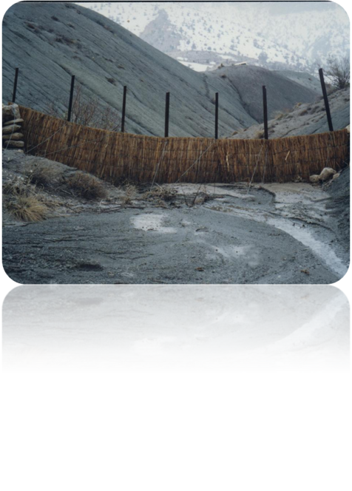
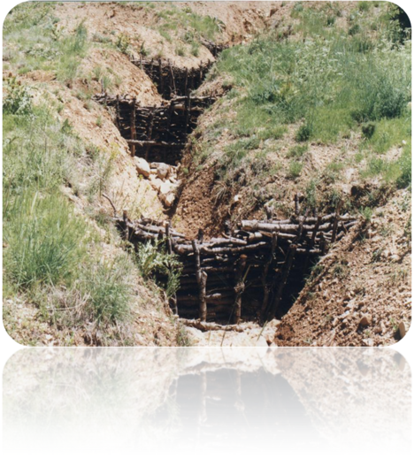
4.2:Brush gully check
4.3:Cribbing/timber dam
Workshop on Mainstreaming spate irrigation in higher education, Delft, The Netherlands, 20-22 Sept 2010

Slide 22
MSc Courses:
Artificial Recharge of Groundwater
Workshop on Mainstreaming spate irrigation in higher education, Delft, The Netherlands, 20-22 Sept 2010

Slide 23
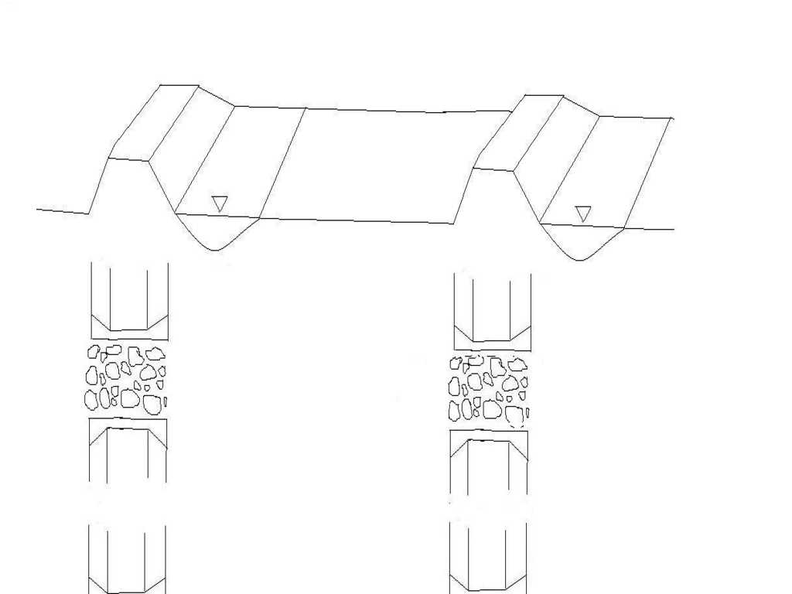
How to design an artificial recharge network system
Channel width
Width of spreading strips
Banquette elevation
Channel slopes
Channels’ edge slopes
Opening width
Distance between openings
Workshop on Mainstreaming spate irrigation in higher education, Delft, The Netherlands, 20-22 Sept 2010

Slide 24
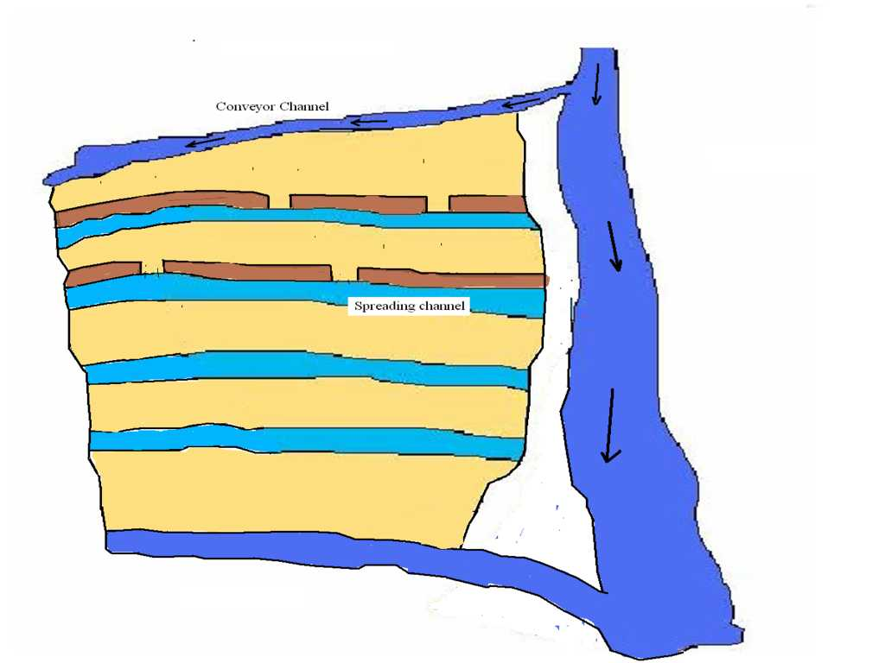
Workshop on Mainstreaming spate irrigation in higher education, Delft, The Netherlands, 20-22 Sept 2010

Slide 25
Two most recently MSc thesis works on Artificial Recharge of Groundwater
In
Department of Desert Region Management
School of Agriculture, Shiraz University
1- Assessment of artificial Recharge Rate By Numerical methods
2- Determining the Favorable area for Artificial Recharge network site
Workshop on Mainstreaming spate irrigation in higher education, Delft, The Netherlands, 20-22 Sept 2010

Slide 26
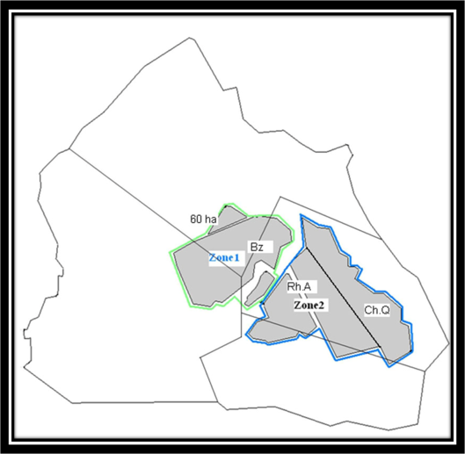
Determination of recharge zones,Gareh-Baygon plain. Research station
By GMS and MODFLOW 2005
Workshop on Mainstreaming spate irrigation in higher education, Delft, The Netherlands, 20-22 Sept 2010

Slide 27
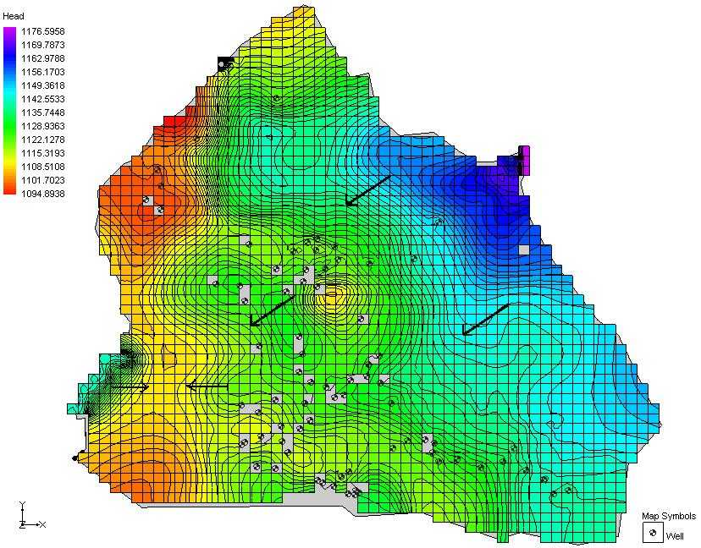
Simulated ground water surface in Gareh-Baygon plain (Sept 2001)
Workshop on Mainstreaming spate irrigation in higher education, Delft, The Netherlands, 20-22 Sept 2010

Slide 28
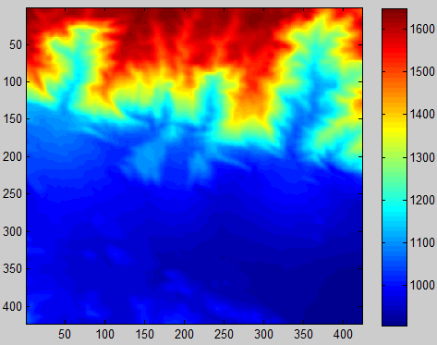
Favorable areas for artificial recharge network site based on quantitative geomorphology (Slope, curvatiure, rotor and …) and fuzzy logic
Topography of Jooyom area
Workshop on Mainstreaming spate irrigation in higher education, Delft, The Netherlands, 20-22 Sept 2010

Slide 29
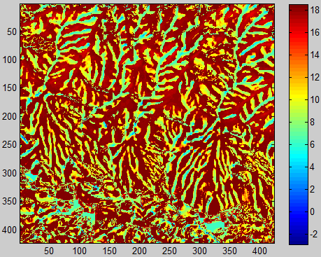
Areas of maximum horizontal curvature in Jooyom plain
Workshop on Mainstreaming spate irrigation in higher education, Delft, The Netherlands, 20-22 Sept 2010

Slide 30
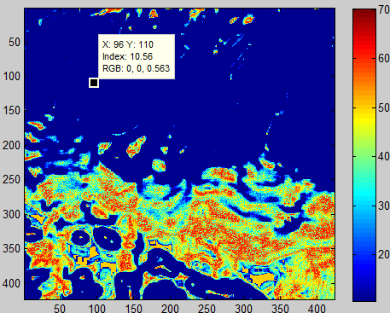
Topography of Jooyom area
The degree on which the area is
geomorphologically favorable
Workshop on Mainstreaming spate irrigation in higher education, Delft, The Netherlands, 20-22 Sept 2010

Slide 31
Thanks for your attention
Workshop on Mainstreaming spate irrigation in higher education, Delft, The Netherlands, 20-22 Sept 2010

